Slide 1
Area of Knowledge:
HISTORY

Slide 2
What is History?
How certain is our knowledge of the past?
Do historians have more in common with scientists or with artists? Is their work evidence based or intuition based?
What constitutes acceptable evidence to a historian?

Slide 3
What is History?
History is the present traces of the past
In trying to reconstruct the past on the basis of the evidence two problems may arise:
Too little evidence – distant past (ex. The knowledge of the wars between Greece and Persia in the 5th century B.C.E. is based on a single, rather unreliable source – Herodotus)
Too much evidence – more recent events
SCOPE: History studies what happened in the past, and why it happened.

Slide 4
Scope:
If you keep a diary, what determines what you choose to include and what you choose to omit?

Slide 5
What becomes a part of official history?

Slide 6
Only significant events, not everything that happened in the past – the problem is with how can we and who ultimately does, decide what is significant?
History is also concerned with explaining and understanding the history, not merely with describing the past

Slide 7
Significance
Using any criteria of your choice, rate the historical significance of the following events:
The publication of Charles Darwin’s The Origin of Species in 1859
Your last TOK class.
The assassination of Mahatma Gandhi in 1948
The 1930 soccer World Cup Final – won by Uruguay
The birth of Bill Gates in 1955
Former US President Bill Clinton’s affair with Monica Lewinsky
The terrorist attacks on the World Trade Center and the Pentagon in 2001.

Slide 8
Why study history?
Why should you study history?

Slide 9
Why study history?
Gives us sense of identity
Is a defense against propaganda
Enriches our understanding of human nature

Slide 10
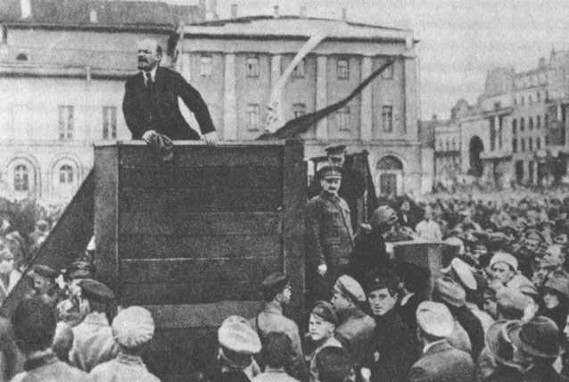
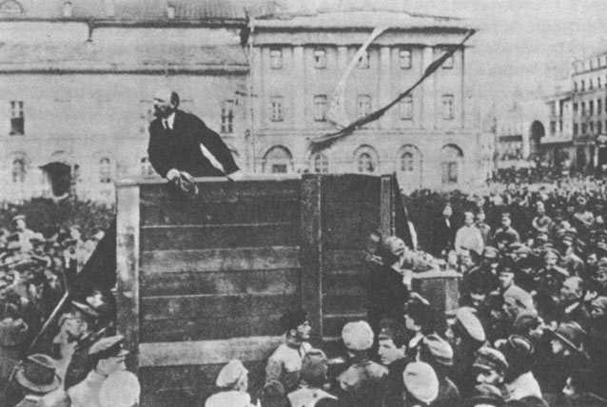
Trotsky or No Trotsky? That is the question!

Slide 11
How important do you think it is for our political leaders to have a good knowledge of history?

Slide 12
How can the past be known?
The problem is whether historical knowledge can be considered objective
We can know the past only by reconstructing it on the basis of evidence that exists in the present. However, memory is fallible, evidence is ambiguous, and prejudice common
To what extent can a trained historian approach the ideal of objectivity?

Slide 13
WoK and Methods in History
The events of the past – sense perception and memory
Only very recent history deals with living people’s sense perceptions and memories
Despite the uncertainties that surround observation and memory, we do gain first hand information from eyewitnesses and a chance to ask questions
The historians cannot rerun the past (No experiments) in order to take better notes – they are trying to find out what happened from the echoes that remain
2. Evaluating sources – Language
- Language is a major means for eyewitnesses to give us their personal knowledge – through records
- The information is skimpy for distant past but vast for recent past; records that are left require interpretation

Slide 14
3. Historical Event – language and reasoning
- What counts as historical event – decision has implications for the direction of research and conclusion that are drawn from the documents
- historians cannot describe everything – they must select information relevant to the stories they want to tell in response to the question they want to ask
4. Conjectures about the past – imagination
- “creative friction” of the historians between fact and interpretation – historians have to use their imagination to understand what happened in the past – to connect the dots of evidence
5. Neutrality of history – emotion and imagination
- Is the historical writing necessarily neutral – denotative rather than connotative and free of emotion?
- facts place constrains on the exercise of imagination ; emotion is almost inevitably part of the subject matter of human experience (Historical sources contain emotion, the historian has emotions, and readers interpret with emotions);
- real question is whether the historian should attempt not to let his emotions affect his writing – it could be argued that an effective presentation of the facts should be enough to convey the significance of the past events, but it could also be argued that to write unemotially about genocides would be to miss the point of communicating about the topic

Slide 15
6. Causal connections – reason and intuition
We do not observe cause, we infer cause through reasoning as we make connections between variables. Historian has to make choices – how far back and out should he go to capture enough detail to explain the cause
Possible fallacy – post hoc ergo propter hoc
Historians sometimes contradict each other
Historians might have an intuitive grasp of patterns – it can happen that historians may grasp relationship not though conscious reasoning but by intuition.

Slide 16
Role of intuition
Sir Isaiah Berlin:
“ If someone tells us “x forgave Y because he loved him”, or “x killed Y because he hated him”, we accept these propositions easily, because they, and the propositions into which they can be generalized, fit in with our experience, because we claim to know what men are like, because we claim to know (not always justifiably) what – in essentials – a human being is, in particular a human being who belongs to a cyclization not too unlike our own, and consequently one who thinks, wills, feels, accts in a manner which (rightly or wrongly) we assume to be intelligible to us because it sufficiently resembles our own or those of other human beings whose lives are intertwined with our own. This sort of “because” is the “because” neither of induction nor of deduction, but he “because” of understanding – Verstehen - of recognition”

Slide 17
7. The balance of particular and general: reason and language
- we are forced to generalize between specific events, even though they will never repeat again – we group all armed conflicts as “war”, etc.
- The very process of identifying similarities is interpretative as historians choose between “civil unrest” and “revolution”.

Slide 18
Nature of Historical Evidence
Primary Sources: sources written by someone who was there at the time; very important for history
Secondary Sources: later, second-hand account of what happened.

Slide 19
What are some limitations of primary sources?

Slide 20
Problems of Primary Sources
Due to knowledge we have about different WOK, we can say that even primary sources are already contaminated
Fallible eye-witness: perception and emotion of the witness will alter the account
Social Bias: primary sources often reflect the interests of one social group rather than society as a whole – gives us distorted picture; example: medieval Europe was very religious place; however all evidence comes from religious personnel, because they were the ones who were literate
Deliberate manipulation: governments often manipulate facts to give a different view of history

Slide 21
Despite the issues, can primary documents still be reliable and valuable sources of historical knowledge?
How can we reduce/overcome these limitations? Basically, how can be distinguish between a reliable and a less reliable primary source?

Slide 22
Despite their limitations, if properly used primary sources are very valuable
We need to always ask questions such as : who wrote this? What was their motive in writing? How long after the event was it written? And we should compare different primary sources with one another
We can also look at documents of a legal and administrative nature, which are likely to be less biased

Slide 23
Imagine, you are a historian in the year 2112. Has the Internet revolution of the early 21st century made the job of future historians easier or more difficult?

Slide 24
Writing History
History is a selection of selection – historian will select from available evidence, and the available evidence is already a selective interpretation of events
Advantage of hindsight - historian knows how things turned out
The division of history into various periods is also influenced by hindsight
However, hindsight can also distort our understanding of the past – hindsight bias - after something bad happened we may believe that it was obvious what was coming and that it should have been prevented

Slide 25
3 Epistemological Problems of History
1. the weaknesses of the raw material (sources) – most people who have ever lived and most events that ever happened left no record. Historian has to use sources never intended for future interpretations.
2. the process of historical research (method)- all history does is interpret – it constructs plausible meanings from the evidence left behind
3. textual presentation (product) – the historical text can never correspond to the past as it was, because the past was not a text, it was a series of events, experiences and situations.

Slide 26
Activity 1: Creating a Primary Source
You have 5 minutes to write about our last TOK class. Your writing should be about 5 -10 sentences long. Use page. 62 of your notebook for this activity.
I might call out a few random students to read their “histories”.

Slide 27
Share with your neighbor
Find a person near you. Read your story to them; have them read their story to you.
Discuss the following questions with each other, and write brief notes under your paragraphs:
In which ways were your histories similar? Different?
Did one of you write in a more or less emotional way? Does one seem more factual than another? How about opinions?

Slide 28
Activity 1: Creating a Primary Source
How many were just descriptive? How many included what they felt? How many included opinions and judgments? How many included supporting factual information?
Were the accounts similar or different? In which ways? Were any of the “histories” more truthful than others? Better than others?

Slide 29
Do you think you should study current events in history – say, things that have happened in the last five years – on the grounds that they are relevant to your experience, or do you think they should be excluded on the grounds that they are too close for your to see them objectively?

Slide 30
The problem of textual presentation
3. textual presentation (product) – the historical text can never correspond to the past as it was, because the past was not a text, it was a series of events, experiences and situations.

Slide 31
Activity 2: Facts and Fillers PG. 63
Read the excerpt below, written by a historian Orlando Figes, describing the events of Bloody Sunday in Russia, 1905 Highlight only factual essentials of this excerpt, a list of events in chronological order.
“Snow had fallen in the night and St Petersburg awoke to an eerie silence on that Sunday morning, 9 January 1905. Soon after dawn the workers and their families congregated in churches to pray for a peaceful end to the day…Singing hymns and carrying icons and crosses, they formed something more like a religious procession than a workers' demonstration. Bystanders took off their hats and crossed themselves as they passed. And yet there was no doubt that the marchers' lives were in danger…Church bells rang and their golden domes sparkled in the sun on that Sunday morning as the long columns marched across the ice towards the centre of the city. In the front ranks were the women and children, dressed in their Sunday best, who had been placed there to deter the soldiers from shooting. At the head of the largest column was the bearded figure of Father Gapon in a long white cassock carrying a crucifix. Behind him was a portrait of the Tsar and a large white banner with the words: 'Soldiers do not shoot at the people!' Red flags had been banned… Suddenly, a bugle sounded and the soldiers fired into the crowd. A young girl, who had climbed up on to an iron fence to get a better view, was crucified to it by the hail of bullets. A small boy, who had mounted the equestrian statue of Prince Przewalski, was hurled into the air by a volley of artillery. Other children were hit and fell from the trees where they had been perching… When the firing finally stopped and the survivors looked around at the dead and wounded bodies on the ground there was one vital moment, the turning-point of the whole revolution, when their mood suddenly changed from disbelief to anger…

Slide 32
Activity 2: Facts and Fillers
What are we left with?
Other than chronologically determined facts, everything else – selective emphasis, anecdote, poetic scene setting, dramatic structure of the story, figurative language, moral judgment and significance (the turning point of the whole revolution) , all come from the imagination of the historian.

Slide 33
Do you think your cultural background influences how you read and understand history?

Slide 34
Writing of History : The Problem of Bias
Topic choice bias:
Historian’s choice of topic may be influenced by current preoccupations
Confirmation bias:
Historian may be tempted to appeal only to evidence that supports his own case and to ignore any counter-evidence
National bias:
National pride interferes with historian’s objectivity
How CAN WE address THESE PROBLEMS?

Slide 35
Pluralistic Approach
Cubist history – a multicultural, multi-perspective view of history – may solve the problem of bias to some extent
Pluralistic view of history will open our eyes to other stories, but it would not make it relativist

Slide 36
Theories of History
It is difficult to establish a single cause of any historical event; rather causes may be varied and influenced by things such as geographical conditions, individual motives, social and economic conditions, chance occurrences
The “great person” theory of history states that history is mainly determined by great individuals – it implies that if one or other great individual had not existed, then the course of history would have been different.

Slide 37
To what extent do you think that your country’s history has been influenced by its geography?

Slide 38
Collingwood on empathy – Collingwood suggested we need to empathize with thoughts and feelings of people in history, so we can try to understand a situation in the same way that a historical agent would have understood it. (kind of like Verstehen position)

Slide 39
To what extent do you think one can and should try to empathize with Hitler in order to understand his actions?

Slide 40
Is human experience chaotic and random, or are there patterns which can be discovered and seen over and over?

Slide 41
Criticism to “great person” approach
It exaggerates the role played by individuals in the process of historical change
Economic Determinism: another theory
Claims that history is determined by economic factors (Karl Marx)
Marx said that it was not great individuals but rather economic and technological factors that are engines of historical change (Arab Spring?)
For PT #5 it would be nice to look into Popper’s perspective, and Marx’s perspective
The role of chance:
Some people have concluded that there is no meaning in history and that it is governed by chance (Blaise Pascal)
Extreme to say that history is completely random process

Slide 42
Which invention do you think has had the most decisive impact on history in the last two thousand years and why?

Slide 43
Do you agree or disagree with Marx’s claim that technology plays a bigger role in shaping the future than the actions of individuals?

Slide 44
History and Personal Knowledge
History is shared knowledge that can contribute significantly to our personal knowledge – our sense of who we are and how we are placed between the past and the future
Cultural interpretations of history
Sense of self as a member of a group (“many of us died”, “we as victims”)

