Slide 1
Causes of the Spanish Civil War
1936-1939

Slide 2
The Causes of the War
Profound cause: long period of decline since the great days of he Spanish Empire
Spain had made little progress, lost her empire, and fallen behind in the industrialization process
Deep division in Spanish society
Landowners vs. Peasants

Slide 3
The Spanish Civil War
Objectives:
The Nationalists
sought to preserve Spain’s integrity, while
Republicans
wished to preserve the Second Republic

Slide 4
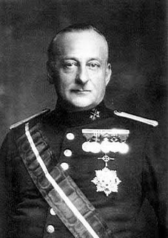
Overview:
History of political instability and regional differences
Rise of a militant left intensified divisions / army and church resisted the change – growing unrest and extremism
Dictatorship of Primo de Rivera failed to solve the issues/ he was replaced by a republic in 1931 (Second Spanish Republic)
By 1930s – deep divisions between left and right
Civil War- fought by different groups within the same country – often very bitter, and long-lasting effects/ resulting in divided communities
Spanish Civil War (1936-39) a result of an attempted military coup on the Second Spanish Republic
The creation of the leftist coalition of the Popular Front and a murder of a right-wing politician (Sotelo) provoked ad military coup in 1936;
Military leaders started revolt in Spanish Morocco – then entered mainland

Slide 5
Main Long Term Causes
Divisions in Spanish History
1803-1936 – 19 military coups, and 3 civil wars between 1833 and 76
Conflicting beliefs:
Profound traditional Catholicism against more liberal groups
Regional independence against traditional central control
Political liberalism against deep, conservative monarchism
Economic and social divisions
Centers of industrial development in the economically dynamic north (Barcelona, Madrid, Bilbao) created a new urban proletariat and new industrial elites
However, the rest of the country was dependent on a feudalistic agricultural system where the peasants in the south lived under miserable conditions as they worked on the vast private estates of the rich, on the verge of starvation.
Political
Regional/social/economical divisions led to deep social tensions and divided the country into to opposing sides. 1) Rich landlords/ industrial elite, Army, Church and Monarchists supported the conservatives and fascists. 2) Poor, republicans, reformers, proletariat, peasantry and minorities supported socialists and anarchists.

Slide 6
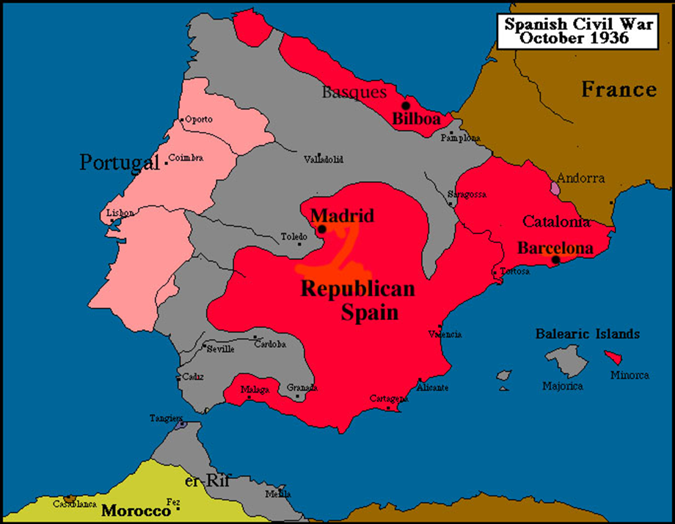
Divisions (continued)
The Rise of the Left
For a long time no labor movement – most of Spain agricultural, traditional, religious
Anarchism – gains major revolutionary influence/ focus on working class revolution which would result in end of the state rule
Anarchists being repressed, turn to underground, and terrorist attacks
By the 20th c. – anarcho-syndicalism – state could be challenged by cooperative action by workers in strikes
The Federation of Workers’ Societies of the Spanish Region is formed (CNT) – organizes strikes against political power / suppressed
General strike in 1909 Barcelona – major effects / 1700 arrests, attacks on railway lines, anti –clericalism (80 churches/monasteries attacked)
In 1910 – CNT (National Confederation of Labor) – called for another general strike/ organization was banned
By 1917, general strike in Barcelona/ clashes between workers and policy and army

Slide 7
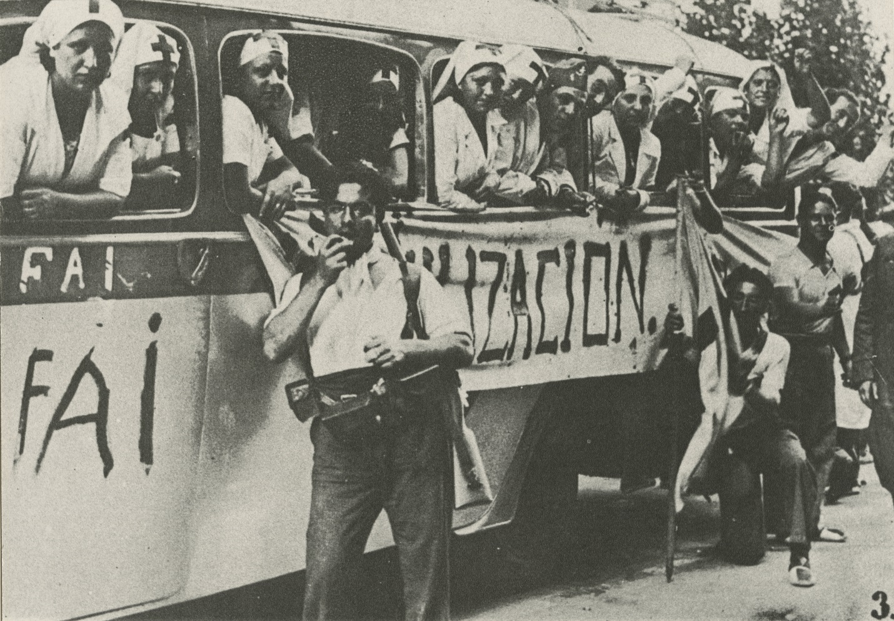
Post War Unrest
After WWI – increased unrest in urban areas/ another general strike in Barcelona (100,000 workers) and for the first time concessions were given – union recognition and 8 hr workday
Political violence continued; 1923 right-wing military dictatorship was established by General Primo de Rivera – due to increasing fear of the left
Between 1923 and 1930 – anarchism was banned, and the movement split into a more radical Spanish Anarchist Federation (FAI) and more lenient CNT
FAI militant, organized bank robberies and assassinations

Slide 8
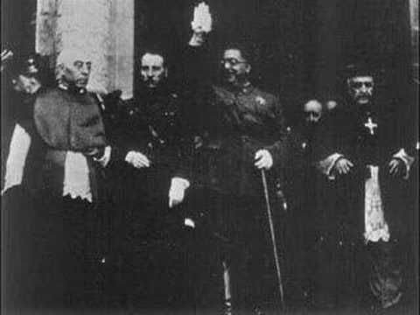
The Catholic Church
Church – significant for Spaniards; associated with survival of Christianity and racial purity/ linked with the power of the state
Concepts of love of nation and love of Church deeply connected
Church alarmed by growth of anti-clericalism, anarchism, socialism – allied itself with landowners, the army
Supported dictatorship of Primo de Rivera

Slide 9
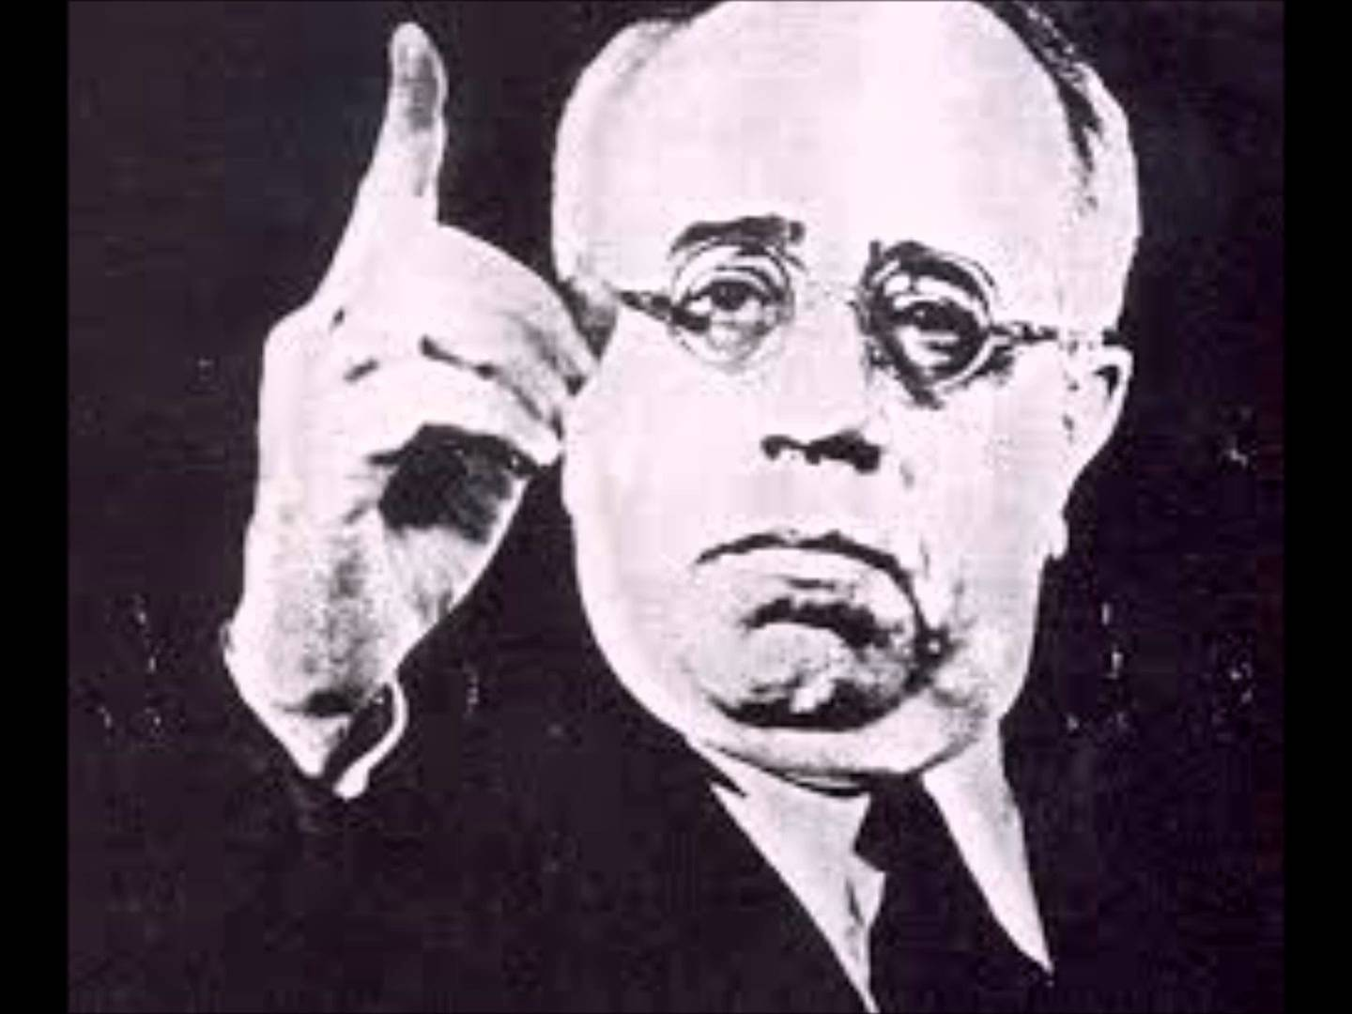
The Army
Military coups common
Miguel Primo de Rivera (1923) – suspended the constitution, and his own party (Spanish Patriotic Union) was the only one permitted until 1930, when Second Spanish Republic was established
Army enjoyed a privileged position in Spain before 1931 and felt threatened by the Republic
Republican Government under Manuel Azana announced anti-military reforms
Military tribunals no longer had authority over the civilians
Army to swear an oath of loyalty to the Republic, elitist academies closed
Length of military service reduced to a year, and the size of the army reduced

Slide 10
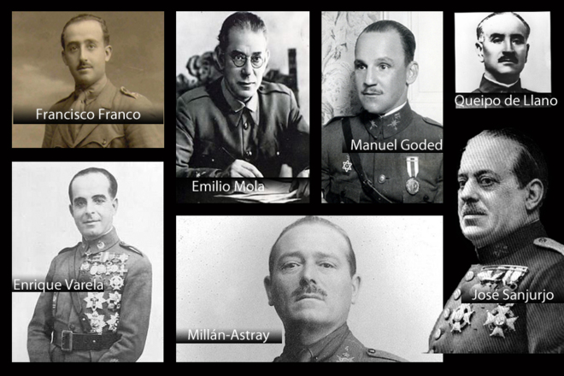
Military’s role in Morocco
Controlled Morocco since 1906, face opposition from locals
1921 Spanish army suffered defeat in Morocco, after which they reorganize and radicalize;
Spanish African Army emerged (Africanistas), part of the Foreign Legion – conquer Morocco, used chemical weapons, brutal force, anti-Republican, spearheaded the revolt against the Spanish Republic
Bridegrooms of Death – most brutal element of the Foreign Legion, led by Francisco Franco, intensely nationalistic, saw themselves as Spanish saviors, angry about Azada’s reforms
1936 Rebellion – they have support from the landowners, industrialists, Catholic Church and traditionalists, and opponents of Separatism

Slide 11
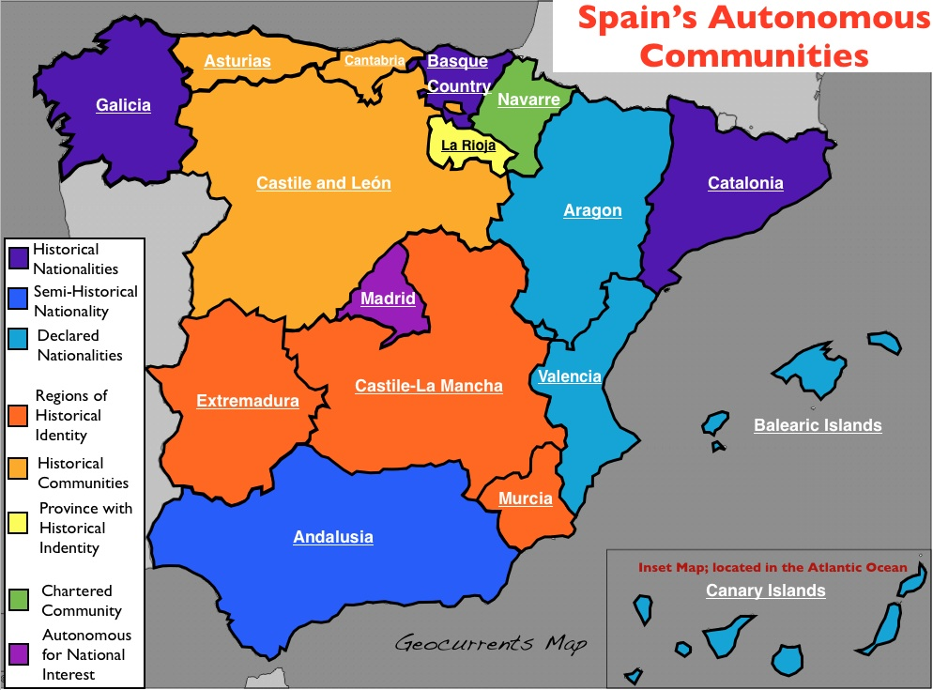
Separatism
Revolt of 1936 – reaction to threat of the break up of Spain
Catalan separatism – historic issue, but awakened by Primo de Rivera’s repeal of self-government
Anarchists – best hope for self rule
Formation of ERC – Esquerra Republicana de Catalunya (Republican Left – coalition party)
Won sweeping victory in election of 1931, and proclaimed a Catalan Republic
Sept 1932, statute of autonomy for Catalonia became law
Forces of conservatism opposed local rights and national unity became a rally force of the nationalist rebels

Slide 12
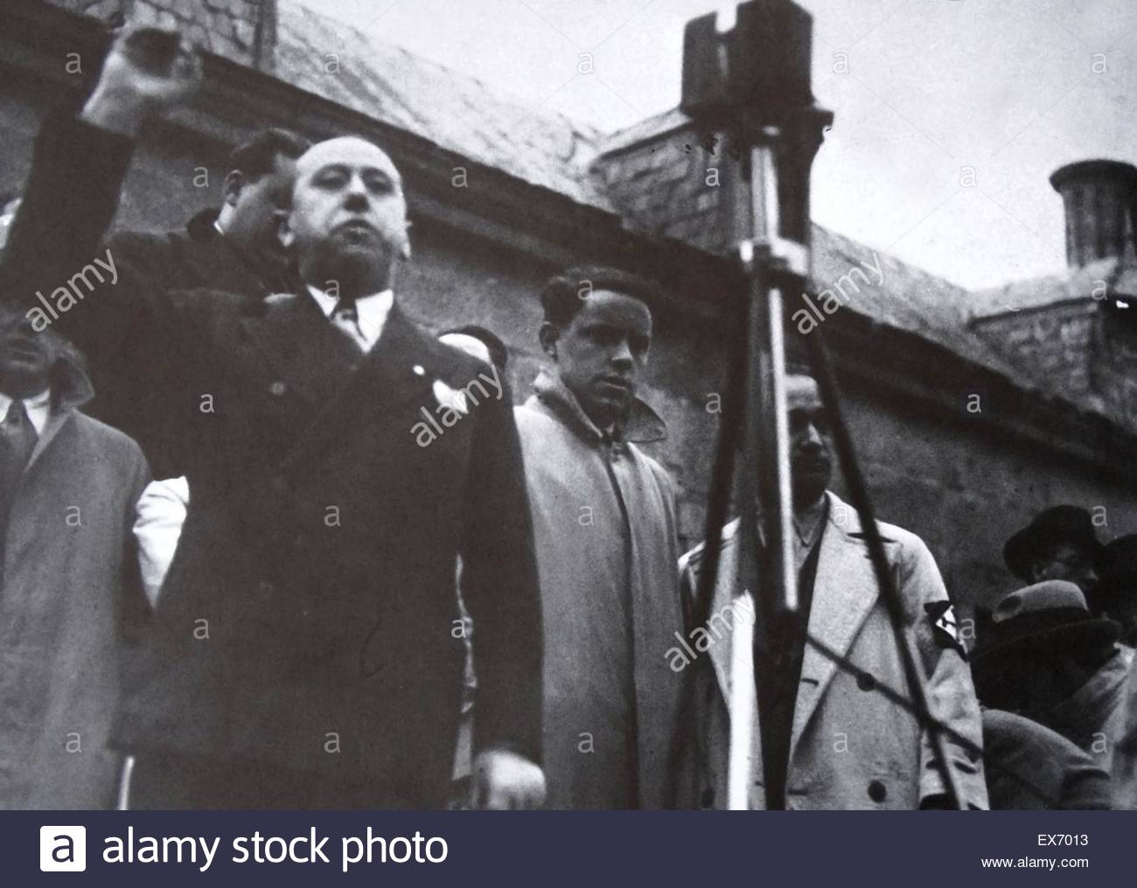
SHORT TERM CAUSES
Religious discontent:
Church angered by the initial reforms introduced by the Republic – lost control over the marriage, religious symbols removed from public buildings, Church lost state subsidy, outburst of anti-clericalism in Madrid
In the 1930s, Church started supporting political groups that protected Church interests (CEDA – Spanish Confederation of Independent Rightists)
1933 election - resulted in a coalition between the moderate radicals and the CEDA led by Jose Maria Gil Robles
Provoked fury from the left – afraid of radical changes similar to Italy and Germany
new right wing government undid most of the reforms done from 1931 to 33, used police and army to suppress protests

Slide 13
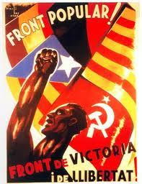
The Popular Front
Robles failed to be appointed PM in 1936/tried to negotiate a coup but failed
Formation of the Popular Front – linked to international communism and influenced by the USSR/ alliance between communists and other left-wing groups
Won in 1936, renewed campaigns against the church
Divisions between left and right became part of an international battle
There was a lack of a political middle, and extremists elements were increasingly popular
Massive divisions between countryside and towns

Slide 14
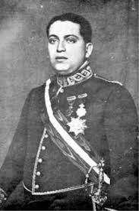
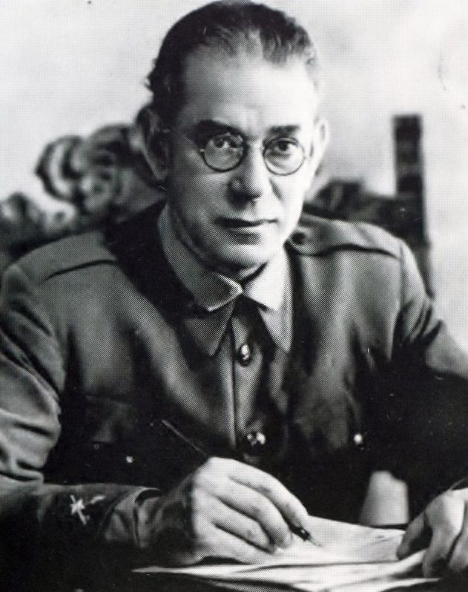
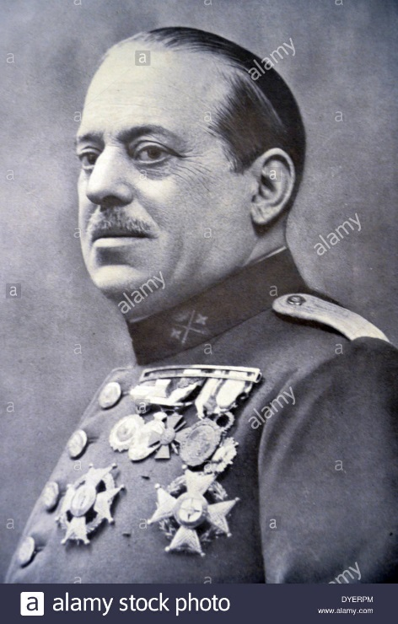
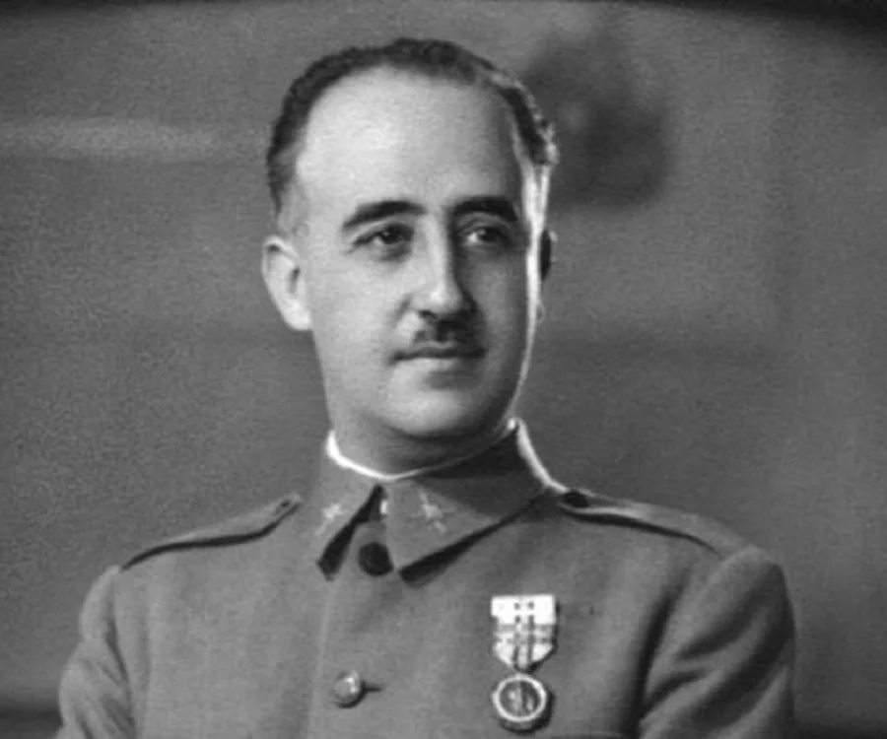
Trigger for War
Murder of former finance minister Jose Calvo Solelo on July 13th 1936/ he was associated with the Spanish Fascists (Falange)
Clashed with socialists/ was murdered by left-wing members of the Civil Guard
His death hastened the preparation for the military coup by generals Sonjuro and Mola and by the Foreign Legion
Franciso Franco decided to join the coup from Canary Islands

Slide 15
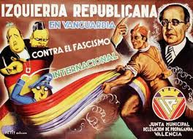
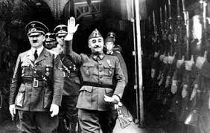
What were the political, ideological and economic causes?
The two sides were:
The Nationalists - a loose coalition of right wing groups, including Army high command, the Church, the landowners, monarchists, and the Falange (fascist party), much of Castile and NW Spain – they were authoritarian, militaristic, conservative, supported by Nazis and Fascists of Germany and Italy
The Republicans - looser coalition or left wing groups, including socialists, trade unionists, communists, anarchists and moderate liberals, republicans, Catalan separatists, landless laborers – they were secular, reformists, supported by Soviet Russia and Democracies
International element was an important factor
Deep ideological division between left and right
Spanish fascist movement (Falange) was founded by Jose Antonio Primo de Rivera

Slide 16
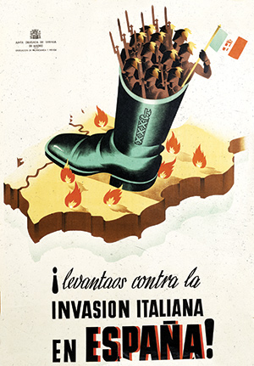
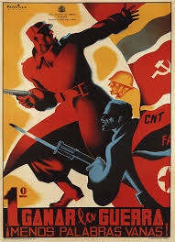
Political and Ideological Causes
Battleground for opposing ideologies/ bewildering mix of ideas
War was complicated by the desire of some areas to break away from central domination
European powers could not ignore, ideology prompted intervention
USSR sent supplies, weapons and political advisers to the left (Republicans)
Germans contributed air power, Italians land forces to the right (Nationalists)
GB, France, attempted non-intervention

Slide 17
Economic Causes
Rural unrest
Land ownership concentrated among small numbers of people; large estates exploited cheap labor/landless laborers
Agricultural wages kept down/ protest difficult due to close relationship between landowners and local authorities
By 1919 frequent episodes of rural unrest and violence/ socialists, anarchists ideas spread demanding land reform
1931 - wage cuts, agricultural prices dropped/ reform blocked and countryside became radicalized – rise in membership to FNTT – National Federation of Land Workers – went from 27000 in 1930 to more than a million by 1932.

Slide 18
Economic Causes
Unrest after 1932:
Agrarian reform – major feature of the new Republic, work hours reduced, paid overtime
Land owners had to cultivate all usable land or have it requisitioned/ redistributed to landless workers- had major effect on wealthy landowners
Countryside became a battle ground
Land distribution slow – angered peasants
1933 – center-right coalition formed – reversed all changes from 1931, landowners dominated local tribunals, working hours legislation was not enforced and confiscated land returned – unrest grew in the south
Self-Government of Catalonia ended
January 1936 – left united under Popular Front – generated fears among the right and military coup attracted much support

