Slide 1
ECONOMIC AND DIPLOMATIC EFFECTS OF WWII
CANADA, MEXICO and the USA

Slide 2
CANADA – A BACKGROUND
Canadian Prime Minister, Mackenzie King had established close relations with US President F. D. Roosevelt even before the outbreak of WWII.
Intercontinental cooperation was initially promoted in light of the Great Depression that led to the promotion.
Mutual defence agreements strove to deter Axis aggression against Canada.
Canada’s membership of the British Commonwealth made American politicians weary of integrating her into the Pan-American Union, but it also made her an ideal intermediary between the USA and Britain.
Canada was involved in the Quadrant Conference in 1943 – in which Roosevelt and Churchill discussed plans for D-Day, and developing the atomb bomb with Canadian assistance. This conference was organised by Prime Minister King.
Canada had little influence over the war itself, but King’s assistance of Roosevelt and Churchill gave Canada an important position of strength after the war.

Slide 3
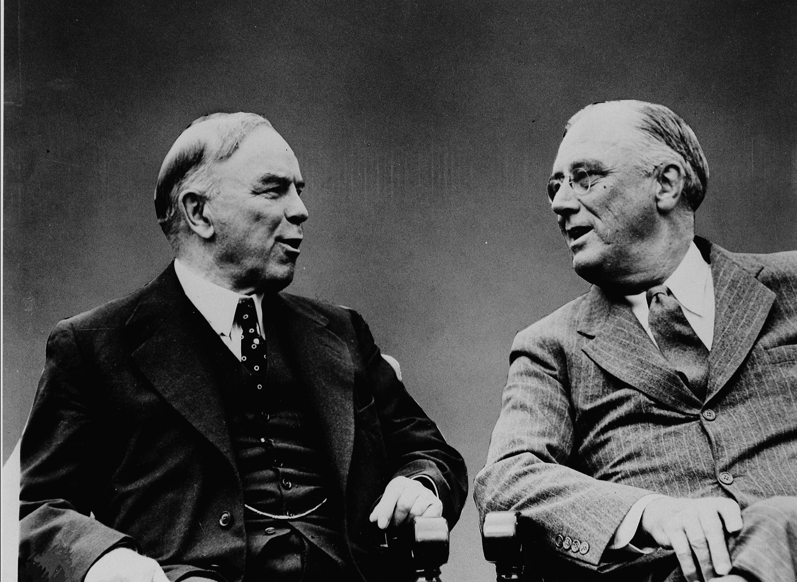

Slide 4
CANADA’S HOME FRONT AND WAR ECONOMY
When the war began, Canada’s government passed the War Measures Act – which gave the government authority to carry out any measures necessary for Canada’s success in the war.
By the War Measures Act, wages and prices were frozen, and from 1942 sugar, meat, gasoline, rubber, coffee, and textiles were rationed.
Salvage campaigns were launched and people contributed newsprint and scrap metal to the war effort.

Slide 5
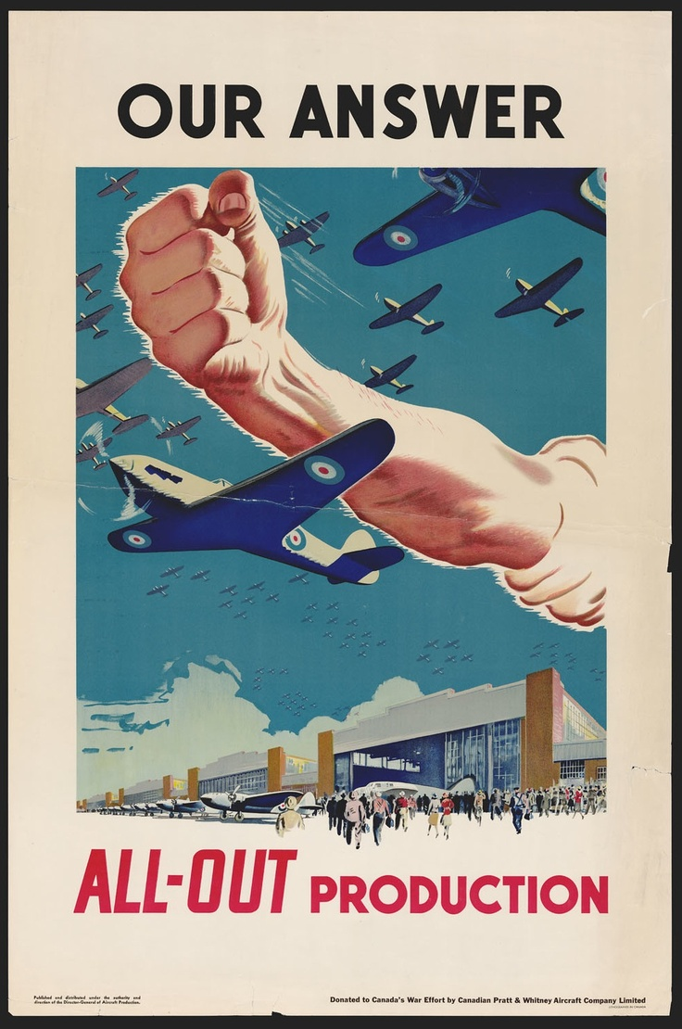
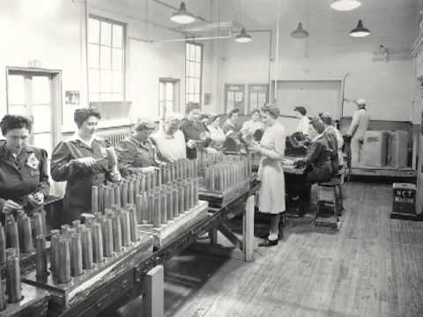

Slide 6
The Department of Munitions and Supply had wide powers to expand industry, fund new factories and adapt old ones to produce war materials. It coordinated purchases of raw materials from Britain and the USA.
Military transport made up most of the production , but production also included parachutes, uniforms, mine-sweeping equipment, and hospital supplies.
This level of production required workers, and it needed workers to re-locate, to which end rental homes were built for industrial workers, servicemen, and returning veterans.
Work positions which had been vacated by men serving overseas had to be filled – women took on many positions;
Over the course of the war Canada provided $3bn in assistance to Britain, which benefitted the war effort, and helped Canada totally overcome the Great Depression.

Slide 7
DIPLOMACY
Roosevelt and King created the Ogdensburg Agreement in August 1940.
They advanced a plan, originally developed by Roosevelt for mutual defence in an attack on either country.
This led to the creation of Permanent Joint Board on Defence which as an advisory of American and Canadian citizens and military officials who would come to mutually-agreed strategies.
Its contribution was valued amongst the British Commonwealth until 1941, but Canada felt isolated within the Americas.
All other countries from the Americas were neutral.
The Pan-American Union established a 300-mile neutrality zone round the Americas – albeit one which was designed to discourage an Axis attack.

Slide 8
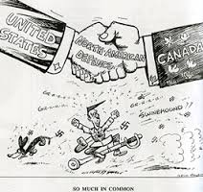
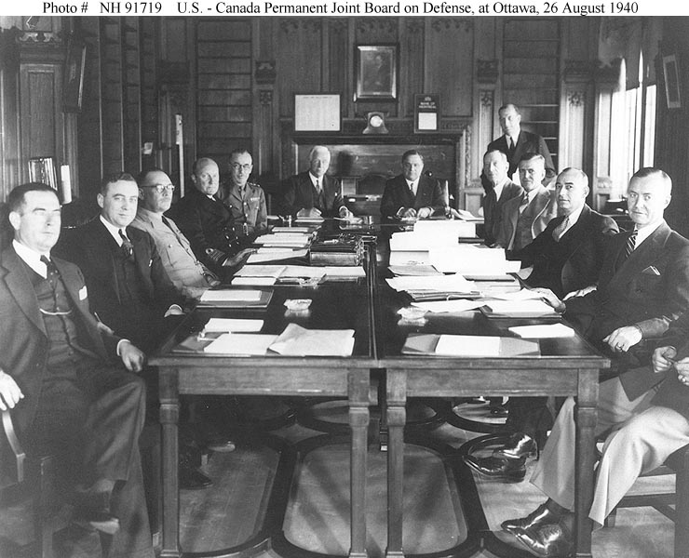

Slide 9
Canada’s was lacking in representation for pragmatic reasons:
Canada’s government was under-funded and with a shortage of qualified diplomats.
She had representatives in the USA, Britain, France and Japan before the war.
She had formal independent relations with Brazil, Argentina and then Chile during the war.
This exhausted Canada’s list of qualified diplomats.
Canada therefore had to pursue interested parties from the business rather than public sector.
The other countries of the Americas however wanted good relations with Canada.
Canada however enjoyed the advantage of being a go-between between Britain, the USA, and Latin America.

Slide 10
MEXICO AND WARTIME ECONOMICS
Mexico’s main role in the war was the production of strategic goods.
This accelerated industry and mining on the country with an emphasis materials such as zinc, copper, and mercury.
In the spirit of hemispheric solidarity, Mexico’s government instituted price controls to prevent the inflation of the value of the desired resources.
This brought an influx of American capital for the first time since the revolutionary period.
During the war, Camacho’s administration equated good citizenship with worker productivity. Propaganda targeted agricultural and industrial workers, but industrialisation was key to victory – even though Camacho presented the two as inextricably linked sectors.
Defence of democracy and personal freedom were equated to financial security for private investors.

Slide 11
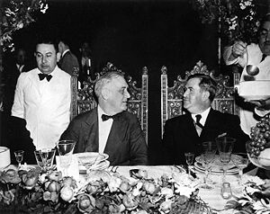
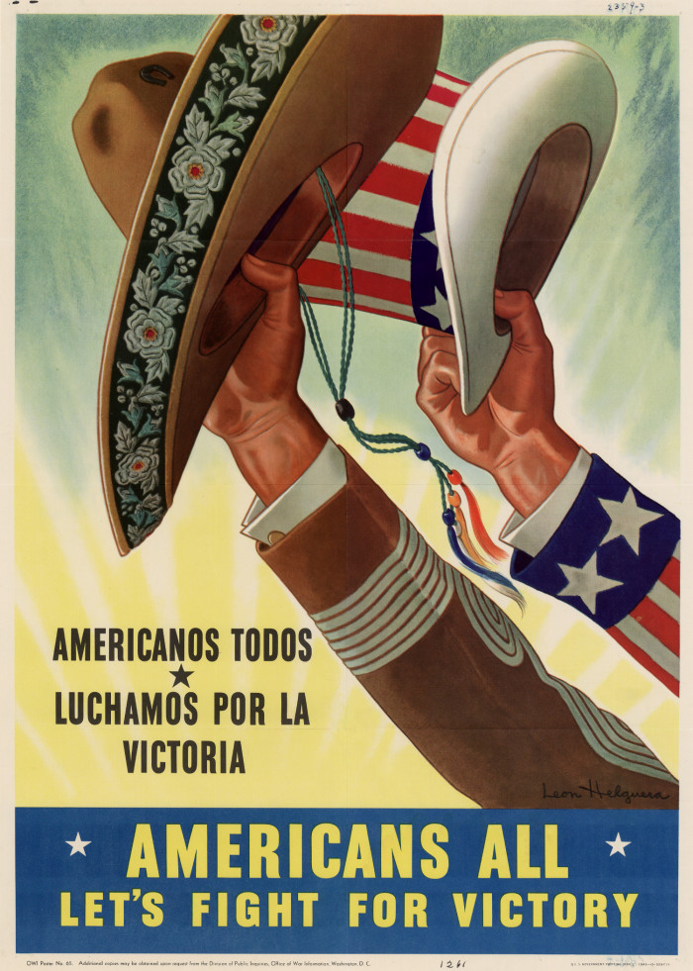

Slide 12
THE BRACERO PROGRAMME
Under the Bracero programme, Mexicans were encouraged to work in the USA to help American famers cope with the shortage of workers. By 1943 it was successful enough to expand to include non-agricultural workers.
Mexican industrialists at home feared labour shortages and a demand for higher salaries. The Roman Catholic Church in Mexico also opposed the prgramme – feeling as it did the effects of an anti-clerical government.
With a shortage of imported goods from the USA there was a market for consumer goods and demands for import substitution.
The Nacional Financiera, Sociedad Nacional de Credito, Institucion de Banca de Desarrollo (NAFINSA) was expanded to facilitate industrialisation. This was a government-owned bank which provided loans to expand industries, of which it oversaw the development.
The government gave tax exemptions and tariff protection to industries, and placed emphasis on Mexican raw materials and natural resources.
During the war, the textile, food-processing, chemical, and cement industries saw rapid growth.
During the war, Mexican national income nearly tripled between 1940 and 1945 from P6.4bn to 18.6bn. Per capita income also increased from P325 to P838. The distribution of income however was not equal and the countryside remained impoverished. An economy focused on economic growth did not necessarily provide social benefits to society’s less affluent.

Slide 13
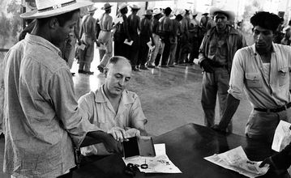
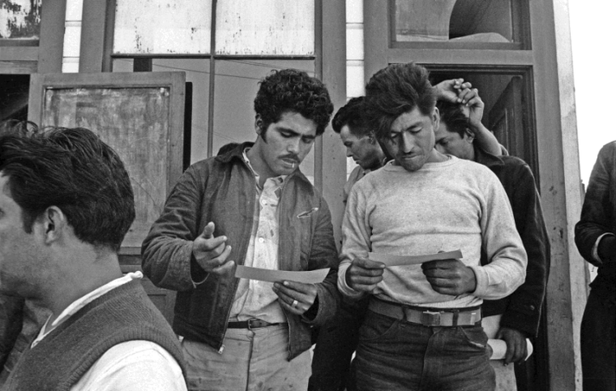

Slide 14
MEXICO AND WARTIME DIPLOMACY
In 1941, Mexico suspended her wartime relations with Nazi Germany, but continued to recognise the countries that the Nazis had invaded and conquered – and did not recognise Nazi Germany’s conquests as legitimate.
After Pearl Harbour, Mexico severed all diplomatic ties with the Axis, and required only simple prior notification for all American countries for use of her ports with boats and naval ships. She also opened her territory for American countries’ forces to cross if this was militarily necessary.
In January 1942, Mexico took part in the Inter-American Conference of foreign ministers of all independent republics of the Americas, and supported all US initiatives for every country to cut ties with the Axis.
Strained relations with the USA improved during the war, and relations with Britain – which had been cut after Mexican nationalisation of British petroleum firms – were resumed, as were relations with the USSR.
Mexico was a strong supporter of the Pan-American Union and in March 1945 was host to conference which led to the Inter-American Treaty of Reciprocal Assistance and Solidarity.
This treaty reiterated the concepts of national sovereignty and non-intervention.
It also reinforced the Good Neighbour agreements of the 1930s.
Mexico approached this agreement with optimism, as the Americas were closer than ever before as the war came to an end.

Slide 15
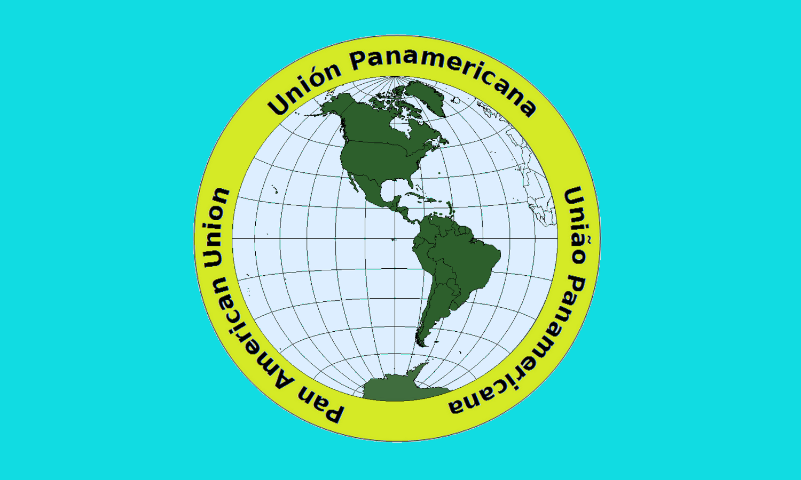

Slide 16
The Diplomatic and Economic Effects of World War II on the United States

Slide 17
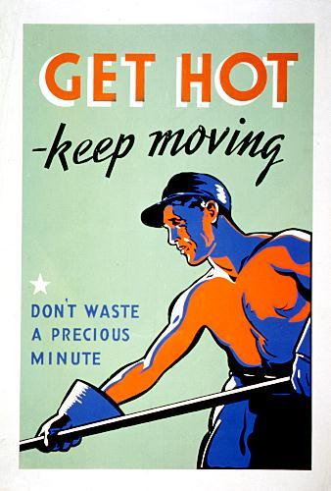
Economic Effects of World War II:
During the war
During World War II, the U.S. economy recovered as war production created millions of new jobs.
the draft effectively employed most of the nation's young men, and many sent their salaries back home.
17 million new civilian jobs
Industrial productivity went up 96%
Corporate profits doubled
Economy grew 11-12% per year
Business enterprises had spirit to beat
competition to be main provider for country -Also, it was an opportunity to profit

Slide 18
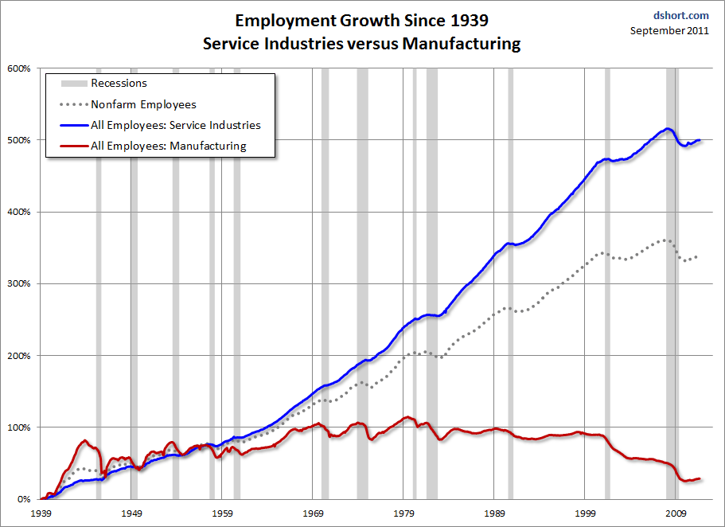

Slide 19
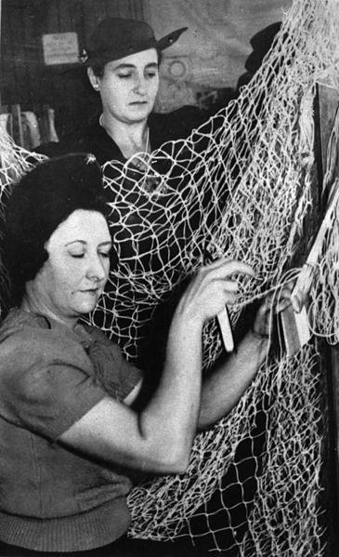
Economic Effects of World War II:
During the war
Increase in government regulation and controls over the economy because laissez faire would not aid the controlled and growing economy.
War needs:
  1/3 of industrial output
  America = only nation with increase of consumer goods
  Full employment and fair income distribution
Roosevelt
Reconstruction Finance Corporation
      advanced money to industry
  Conversion program
      Lingerie factories -> camouflage netting
      Baby carriages -> hospital food carts
      Vacuum cleaner parts -> gas mask parts

Slide 20
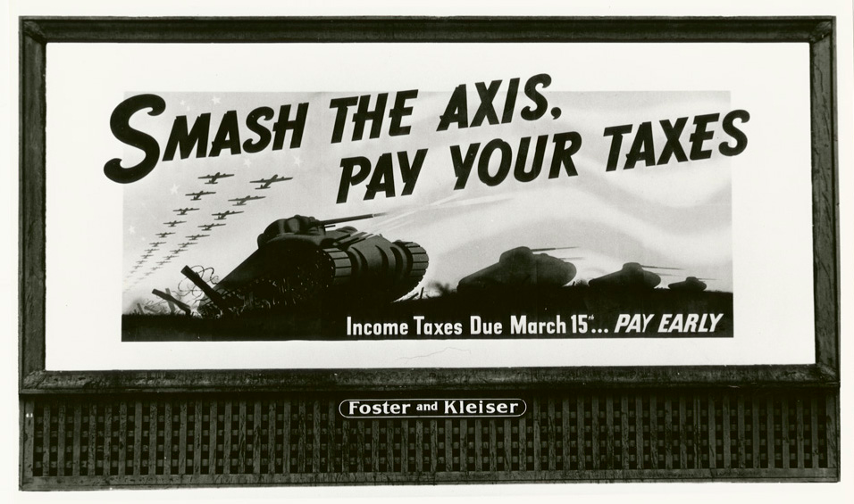
Economic Effects of World War II:
During the war
Government agencies
  oversaw wartime production
  controlled prices as a safeguard against inflation
  focused production on war goods rather than typical consumer items
War bonds sales also aided government revenues
First general income tax was collected during WWII
Cost of the war
  Direct cost of war = $4 trillion
  Virtually all taxes were raised
  5 million people added to tax rolls

Slide 21
Economic Effects of World War II:
Post war
Economically strengthened by wartime industrial expansion
War created the conditions for productive postwar collaboration between the federal government, private enterprise, and organized labor
Local boosters opened South up for industry
  Wages for workers grew most rapidly in South
Modern industrial economy built over old agriculture-based society
  Transformation of southern economy
    Development of Sun Belt
    Rise to metropolitan areas
      Atlanta, Dallas, Houston
Mortgage also became more affordable

Slide 22
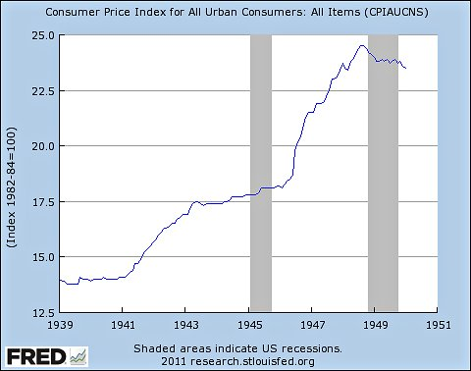
The big rise in prices during and after WWII made it possible for the economy to enter a sustained, non-inflationary boom.

Slide 23
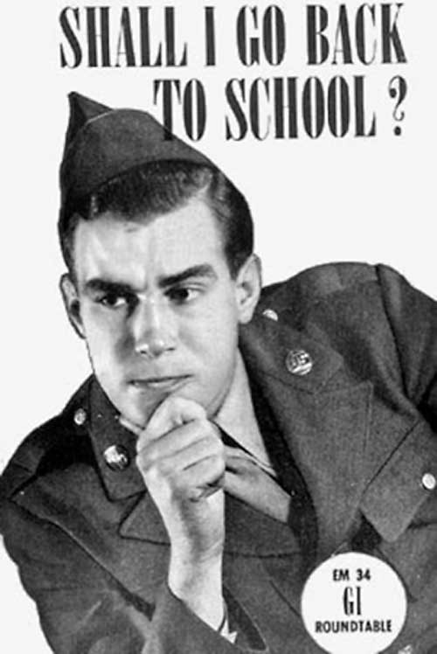
Economic Effects of World War II:
Post war
G.I. Bill
Servicemen obtained numerous other economic benefits beyond their jobs
  educational assistance from the federal government
  guaranteed mortgages and small-business loans
Reconversion
shift away from military production and back to civilian production
restructuring of the American workplace as returning servicemen went back into the workforce and many war workers left
  Many women left the workforce

Slide 24
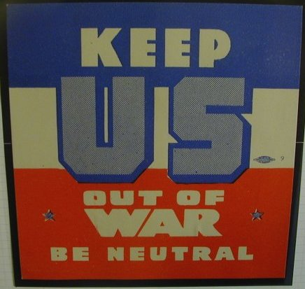
Diplomatic Effects of World War II:
During the War
United States continued to remain neutral until 1941
  Congress passed a series of Neutrality Acts between 1935 and 1939
In 1940 FDR proposed giving the British aid for the war without cash in return (the Lend-Lease Act) and supplied Britain with $7 billion in aid
1940: Bases for Destroyers
  US leases 50 destroyers to Britain in return for bases
December 7, 1941, Japanese attack on the American naval fleet at Pearl Harbor, Hawaii, pushed the U.S. into World War II

Slide 25
Diplomatic Effects of World War II:
During the War
US aid to Britain
Britain depended on North American industries for war supplies
Trade between the U.S. and Britain was vulnerable to the German U-boats
  March 1941, Lend-Lease Act was passed
    Allowed president to sell, transfer, exchange, lease or lend war supplies to any nation whose defense was seen as vital to defense of U.S.
U.S. as “arsenal of democracy”
German attacks on U.S. shipping to cut off line of supply
America sustained Britain and Germany had to confront America in order to confront Britain

Slide 26
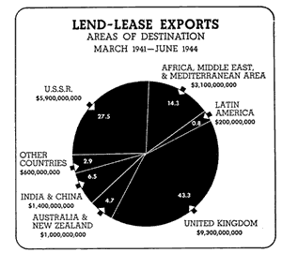
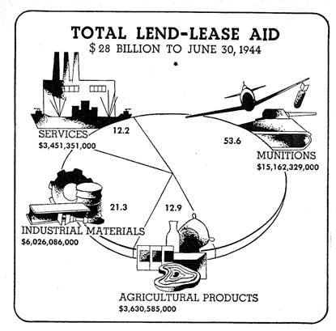
Lend-Lease Act

Slide 27
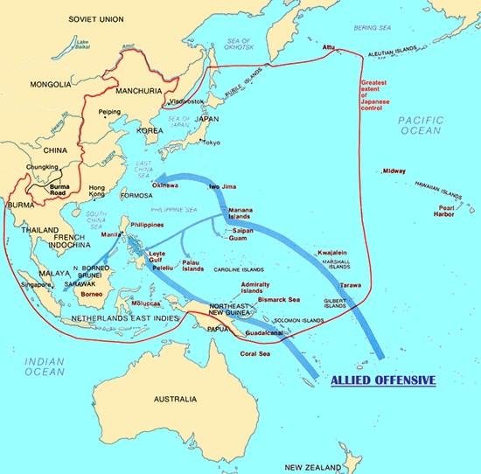
Diplomatic Effects of World War II:
During the war
Island Hopping
  Allies plan to capture islands in Pacific under Japan's hold
Tehran Conference
  Nov. 28- Dec. 1, 1943
  Big Three (Churchill, Stalin, Roosevelt)
  2nd Front against Germany

Slide 28
Diplomatic Effects of World War II:
Post war
Marshall plan: United States offered reconstruction aid to all European countries
  excludes Spain
  USSR offered the aid, but Stalin refused
  sent supplies (ex. grants, credits, supplies) in June 1948 under the terms of the European Recovery Program
Truman Doctrine: United States offered aid to Turkey and Greece because of their crumbling economy
  asked to send over $400 million to Greece and Turkey
  Turkey and Greece were politically and economically weak
  response to Great Britain unable to provide financial aid

Slide 29
Diplomatic Effects of World War II:
Post War
Yalta Conference
  Feb. 4-11, 1945
  Big Three
  Discuss Europe’s post war organization
Potsdam Conference
  July 17- Aug. 2, 1945
  Stalin, Churchill (later replaced by Attlee), Truman
  Discuss Germany’s punishment
  Post war arrangements
  How to counter war’s effects

Slide 30
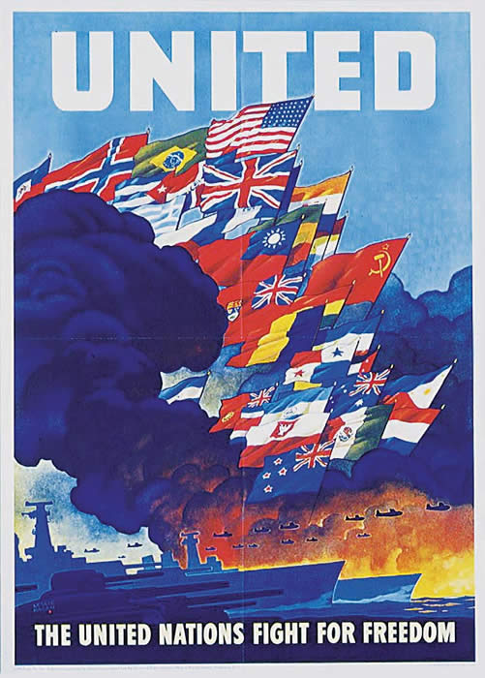

Diplomatic Effects of World War II:
Post War
In 1944, an idea emerged to create a postwar international organization. The United Nations was thus born on October 24, 1945

