Slide 1
List 10 territorial changes created in 1919-1920
http://www.the-map-as-history.com/kiosque/tome_bdd_vimeo.php?tome_num=6

Slide 2
Effects of WWI
Examine the reasons for the failure of one peace treaty in the 20th Century.
Discuss the economic and social consequences of one 20th Century War.

Slide 3
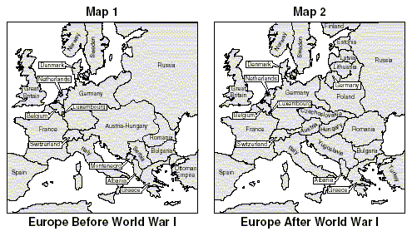
Background – Changes since 1914
German, Russian, Austria-Hungarian Empires – gone
Many successor states struggling to replace them
Communist Revolution in Russia threatened to spread across Europe
Europeans face starvation, displacement, flu epidemic
Was a lasting peace possible? Did the “victors” create a flawed peace? Did they underestimate the challenges they faced?
Notes:
Hohenzollern, Romanov, Habsburg Dynasties ruled over multicultural states, now become many national/multinational states

Slide 4
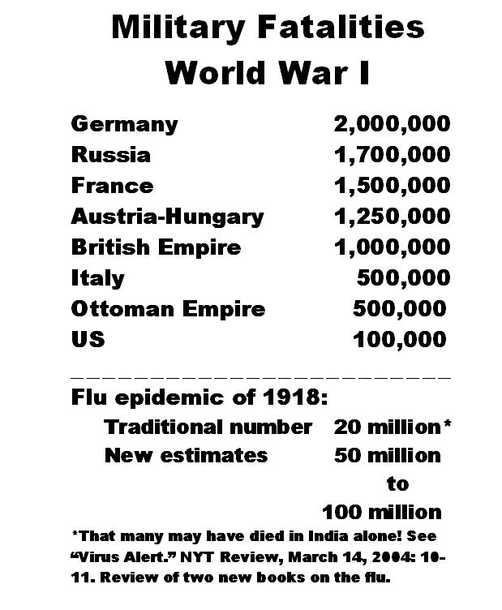
Human Consequences of WWI
9m killed or about 15% of all combatants
“A Lost Generation” (20% of ALL Frenchmen 20-40)
Millions disabled
Civilians targeted (not as much as will be in WW2)
20m die in Spanish flu pandemic winter of 1918-1919

Slide 5
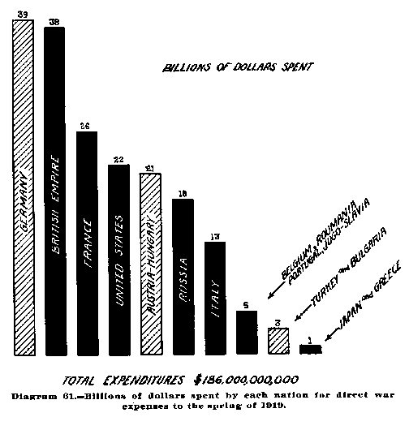
Economic Consequences of WWI
All countries borrowed heavily to fund war
US lent $2B to Britain and France
Both countries will spend about half of total expenditures in ’20’s paying back loans and will never again be major world economic powers
U-boats sunk about 40% of British shipping
Most fighting took place in France
Farmland, factories, railways destroyed
Country littered with unexploded shells
Belgium, Poland, Italy, Serbia faced similar conditions
How many total billion for central powers? Allied powers?

Slide 6
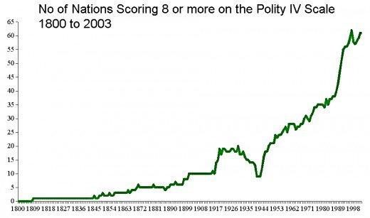
Political Consequences
Central and Eastern Europe was dominated by multicultural monarchies before 1918
WWI, according to Ferguson, “led to Republicanism undreamt of even in the 1790’s”
Notes:
http://www.the-map-as-history.com/kiosque/tome_bdd_vimeo.php?tome_num=6

Slide 7
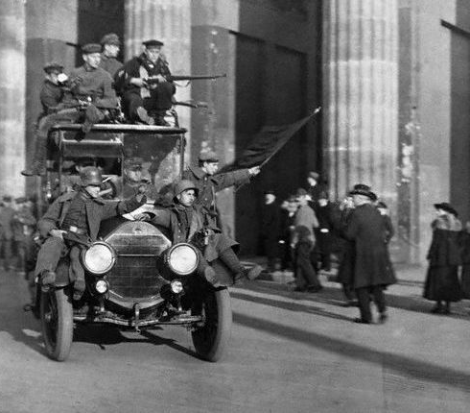
Political Consequences.
Germany
In revolution before war ends
Kiel Mutiny – sailors take over city, inspire other revolts
Socialist revolt throughout the country
Communist/Bolsheviks strike, revolt – Spartacus Uprising
Socialist maintained control under Friedrich Ebert

Slide 8
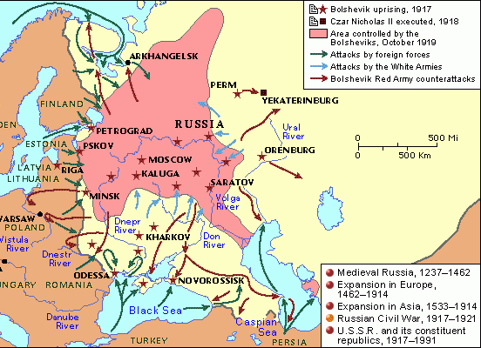
Political Consequences
Russia
Two Revolutions in 1917
Feb. (Old Calendar) – Overthrow Czar Kerensky Provisional Gov’t. continued war
Oct. (Old Calendar) – Bolsheviks seize power, establish dictatorship, sign Brest-Litovsk
Austria-Hungary
Disintegrated, monarchy overthrown, carved up

Slide 9
Political Consequences
Ottoman Empire
Sultanate Collapsed in ‘22, Mustafa Kemal establishes authoritarian regime
Everyone
Collapse of empire left Central and Eastern Europe in economic/political turmoil
Socialist regimes encouraged by Russian regime threatened ruling classes in many of these countries, Western powers fearful of revolution sweeping entire continent

Slide 10
Impacts outside of Europe
United States
Emerge as world’s leading economy
U.S. provided food, raw materials, munitions for war
Took over Europe’s foreign markets
Japan and China
Japan seized German holdings – Shandong Peninsula, Pacific Islands
Presents China with 21 demands – politically/economically dominate China

Slide 11
Challenges facing Peacemakers -1919
Big 3 +1 (Lloyd George, Clemenceau, Wilson, Orlando) dominate conference
Japan only concerned about Asia, racial equality statement
Allied observer “race between peace and anarchy”
Differing aims, Germany, popular sentiments
Notes:
Wilson - he was impossible--prissy, dogmatic, unbearably self-righteous. He would listen to argument until he had made up his mind, then treat opposition as treasonable. He was "intolerant of differences and blind to the legitimate concerns of others,“
"Those who opposed him were not just wrong but wicked."
MacMillan
Clemenceu – “It is much easier to make war than to make peace”

Slide 12
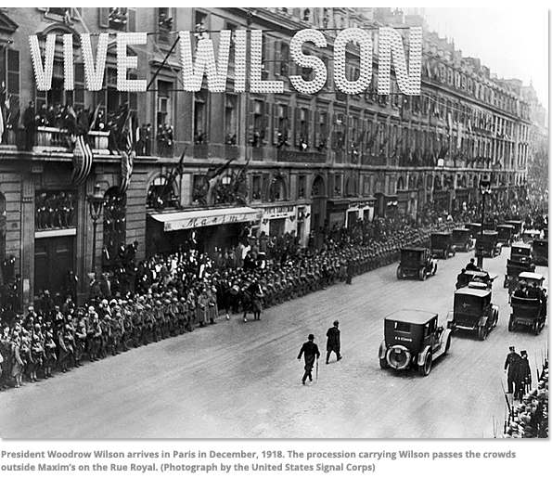
Aims of Peacemakers
How Would Britain and Germany feel about each of these?
Wilson’s Fourteen Points – idealistic? “Make world safe for democracy”
1. No more secret diplomacy
2. Free navigation of seas
3. Free trade
4. Disarmament for all nations
5. Decolonization
6. German troops out of Russia
7. Restoration of Belgium
8. France gets Alsace Lorraine
9. Austria/Italian border decided on nationality
10. Self-determination for people of Austria-Hungary
11. Serbia gets access to sea
12. Self-determination for people of Ottoman Empire, Dardanelles open to all
13. Independent Poland with access to sea
14. League of Nations
Notes:
Groups 1-4 do Germany 5-7 do Britain
“Even God only needed 10 points” - Clemenceau

Slide 13
Clemenceau’s Views
Wanted harsh sentencing of Germany
Economic sanctions – war was fought in France
Would also keep Germany weak
Also wished to disarm Germany, and weaken it territorially

Slide 14
Lloyd George’s Views
“The delegates to the peace conference after World War I "tried to impose a rational order on an irrational world.”
― Margaret MacMillan, Paris 1919: Six Months That Changed the World
“injustice and arrogance displayed in the hour of triumph will never be forgiven”
Less severe conditions
Germany should surrender navy and colonies
Wanted Germany to recover quick economically
Hostage to Britain's successful propaganda – popular support for making Germany pay

Slide 15
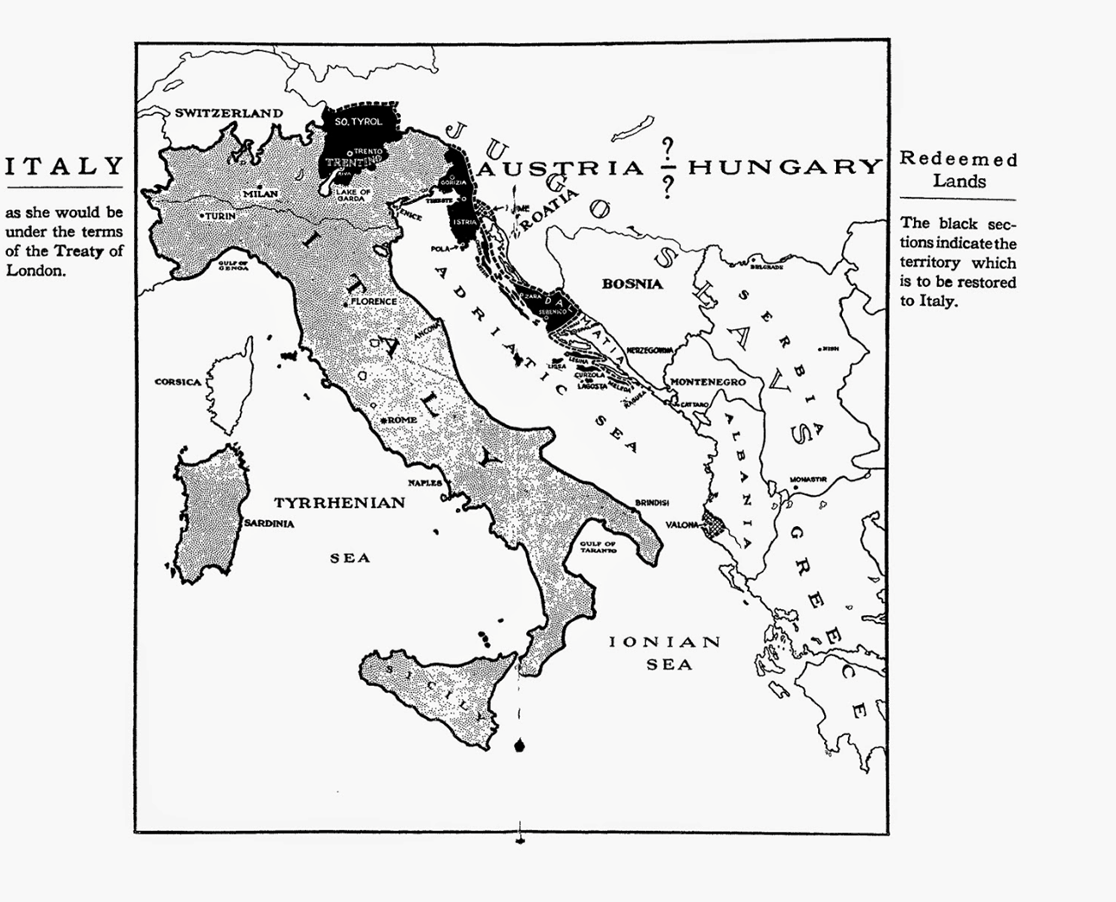
Japan and Italy at Paris
Vittorio Orlando – Allies must keep promises of Treaty of London
And also Fiume, all of Dalmatia
Japan – keep German colonies, racial equality clause
Notes:
Also protectorate status over Albania, Dodecanese islands, parts of German colonies –
Pact nullified by Treaty of Versailles - not given any of these at paris peace conference

Slide 16
Mood of the Germans
Thought peace would be based on Fourteen Points
Not the “total” defeat that the war was becoming
Conditions of Armistice – lost Alsace-Lorraine, evacuate Rhineland, submarines and air force dismantled
German soldiers greeted in Berlin as heroes
Population not aware of scale of defeat – had defeated Russia, occupied Belgium and northern France
Country was never invaded by occupying military
Were told they were on the cusp of victory
Hindenburg “In spite of the superiority of the enemy in men and materials, we could have brought the struggle to a favorable conclusion if there had been proper cooperation between the politicians and the army. The German army was stabbed in the back”.
Blame was put on internal enemies – Jews, socialists, Communists – Hitler’s “November Criminals”

Slide 17
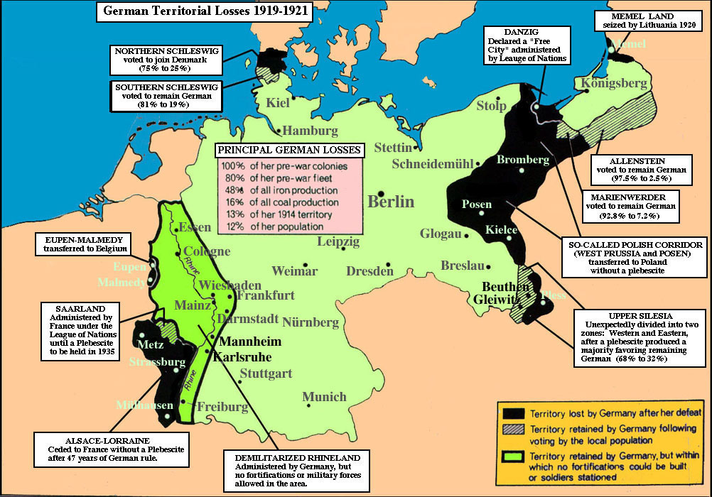
Notes:
25,000 – 40,000 French soldiers temporarily occupy Rhineland, major crossings of the river – until 1930
Many were Senaglese Africans who had babies out of wed lock later used by right wing German radicals as the black shame

Slide 18
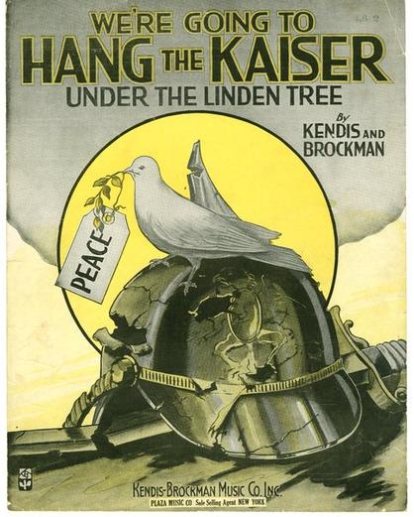
Popular Mood of Allies
People of Britain, France, and Italy expected revenge
Wished to “see the Kaiser hung”
Punitive action against the German people
Clemenceau, Lloyd George, and Orlando knew their political success depended on what they would achieve at Versailles
US electorate lost interest, Republicans gained seats against Wilson’s ideas in 1918 midterms
Could no longer be certain agreement would be supported at home

Slide 19
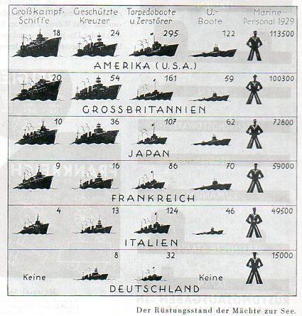
Terms of the Treaty of Versailles
No losing powers were allowed representation during discussions
“diktat”
War Guilt – Art. 231
“The Allied and Associated Governments affirm and Germany accepts the responsibility of Germany and her allies for causing all the lose and damage…”
Disarmament – leaders generally accepted arms race to be major cause of war
Germany forced to disarm, but only general reference to full international disarmament
Germany – 6 Battleships, 100,000 men “for internal security”
Allied occupation of Rhineland – French wanted it taken
US and Britain instead promised to protect France
Notes:
1929 German naval comparison chart

Slide 20
Territorial changes
Alsace-Lorraine – returned to France
Saarland – under League admin. – in 15 years would have plebiscite
Until then its coal would go to France
Belgians gained minor Germany concessions
Germany split by “Polish Corridor” – Danzig “free city” under League mandate
North Schleswig – Denmark
Territory gained by Brest-Litovsk forfeited – became Baltic States/Finland
Memel to Lithuania
Anschluss forbidden
German colonies taken – Germans unfit to govern subject races
Notes:
Carthaginian Peace - forced to demilitarize and pay a constant tribute to Rome and could enter war only with Rome's permission. At the end of the 3rd punic war the Romans systematically burned Carthage to the ground and enslaved its population.

Slide 21
Mandates
Art. 22 of League Covenant – change in attitude about colonies
Required all nations to help underdeveloped countries “not yet able to stand up for themselves”
New countries governing new territories would have to be answerable to League
“A” mandates – Palestine, Iraq, Transjordan to Britain; Syria, Lebanon – France
Should become independent soon
“B” mandates – Cameroon, Togoland, Tanganyika – less developed, not ready for ind.
“C” mandates – Pacific islands, Southwest Africa – need for greatest development.

Slide 22
Reparations
“War guilt” justification
Should pay for material damage done during war
And also future costs of pensions to widows and wounded
Reparations Commission in 1921 came up with sum of $33 B
John Maynard Keynes – “Carthaginian Peace” (meant to destroy Germany)
Notes:
Keynes stormed out of the meeting – Historians agree today Germany could have paid without serious economic suffering if it had the political will to do so.
The Treaty of Versailles confiscated 10% of Germany's territory but left it the largest, richest nation in central Europe.
It was largely unoccupied and financial reparations were linked to its ability to pay, which mostly went unenforced anyway.
The Treaty of Versailles and the 1921 London Schedule of Payments required Germany to pay 132 billion gold marks in reparations to cover civilian damage caused during the war. This figure was divided into three categories of bonds: A, B, and C. Of these, Germany was only required to pay towards 'A' and 'B' bonds totaling 50 billion marks (US$12.5 billion). The remaining 'C' bonds, which Germany did not have to pay, were designed to deceive the Anglo-French public into believing Germany was being heavily fined and punished for the war.

Slide 23
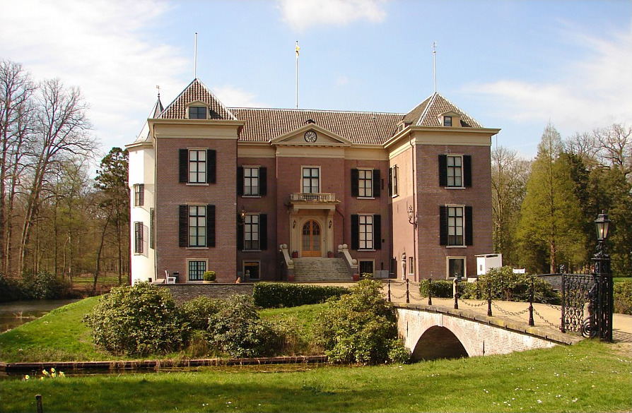
Punishment of the war criminals
Versailles called for extradition and trial of the Kaiser and other “war criminals” – Dutch refused
A few, excluding the Kaiser, were handed light sentences

Slide 24
Paper I Quiz
Notes:
Carthaginian Peace - forced to demilitarize and pay a constant tribute to Rome and could enter war only with Rome's permission. At the end of the 3rd punic war the Romans systematically burned Carthage to the ground and enslaved its population.

Slide 25
Criticisms of the Treaty (double standards?)
War Guilt – undue burden on new republic already facing threats from extreme right
Disarmament – Germans very proud of military, did not see fairness in their disarmament without other nations doing so
Reparations/Resources – Keynes – issues of the settlement lay not with boundaries but “rather questions of food, coal, commerce”
Keynes validated by 1920’s hyperinflation crisis
Self-determination – Danish given plebiscite for northern Schleswig – but Germany does not get one in Austria or the Sudetenland?
Removal of Colonies – states that received German colonies were not model colonizers – Japan, Belgium, South Africa
League of Nations – failure to invite Germany effectively discredited its legitimacy as an international body

Slide 26
Current views on the Treaty of Versailles (Marks, Lentin, Sharp, Henig)
Compared to Treaties German imposed on Russia, Romania – “fairly lenient” – Niall Ferguson
Germany likely would have imposed harsh conditions like this on allies if they had won
Germany only lost 13% of economy, 10% of population.
Left in a strong position
Physically undamaged
Enemies such as Russia and France were significantly weakened by war
Neighbors - Fragmented, weak new states
Lentin – failed to weaken Germany at same time “humiliated and resentful”

Slide 27
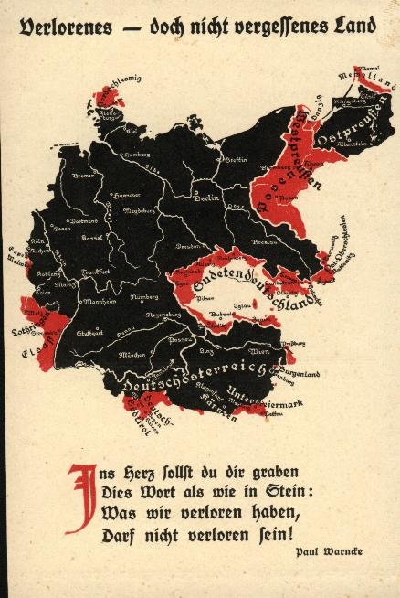
Current views on the Treaty of Versailles (Marks, Lentin, Sharp, Henig)
Reparations were not responsible for 1920’s economic crisis
If it raised taxes to British levels it could pay the 7.2% that the reparation schedule demanded
Chose not to pay, instead printed banknotes
Nonetheless, often cited as a cause of WWII – Why?
Though not extremely unfair, Germans believed it was
Propaganda successful at convincing this
Britain and France forced to revise terms
US and Britain were unwilling to enforce
“It must in fairness be recorded that the Treaty of Versailles proved to be a failure less because of the inherent defects it contained than because it was never put into full effect”. - Kelylor
Notes:
'Lost but not forgotten land'.
You must carve in your heart
These words, as in stone -
What we have lost
Will be regained!

Slide 28
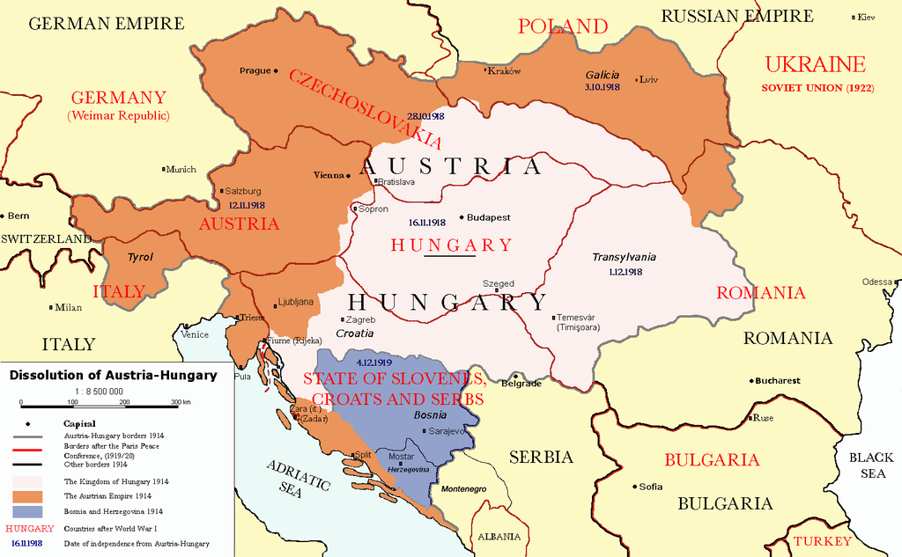
Other Settlements
St. Germain (Austria Hungary-1919)
Austria separated from Hungary
Austria (Tadpole state) – 25% of former area, 20% of former population
Lost Moravia, Bohemia to Czechoslovakia
Dalmatia, Bosnia to Yugoslavia
Galicia to Poland
South Tyrol, Trentino to Italy

Slide 29
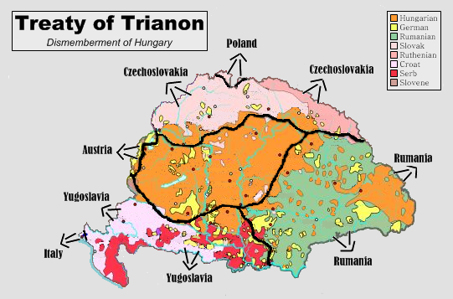
Treaty of Trianon (Hungary 1920)
Recognized independence of Poland, Yugoslavia, Austria
Gave much of its territory to these new independent nations
Lost 75% of land, 66% of pop.
3 m. Magyars under foreign rule

Slide 30
Treaty of Neuilly (Bulgaria 1919)
Lost territory - only sea access to Greece
Lost territory to Yugoslavia
Received land from Turkey

Slide 31
Treaty of Sevres (1920 Ottoman Empire)
Syria and Lebanon – French Mandates
Palestine, Iraq, Transjordan – British Mandates
Straits become demilitarized zone controlled by League
Treaty was accepted by Sultan
Rejected by nationalist leader Mustafa Kemal who takes over, declares war against Greeks and then intended to attack British occupiers

Slide 32
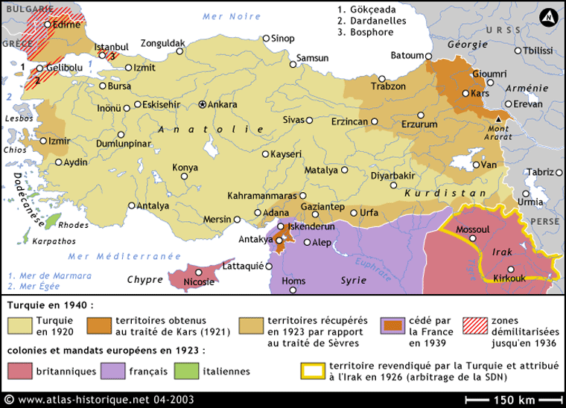
Treaty of Lausanne (Turkey 1923)
Revised Sevres after Allies forced to bargain, made Turkey sovereign successor state to Ottoman E.
Regained minor territories – Smyrna, Eastern Thrace, several Aegean islands
Sovereignty over straits, but must remain demilitarized
Reparations, military restrictions removed.

Slide 33
List all the countries that obtained land from former Austria-Hungary

Slide 34
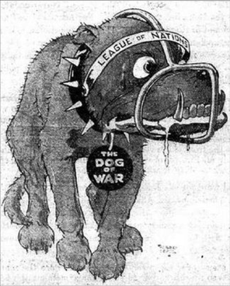
Criticisms beyond Versailles
Alan Sharp “1919 minorities were probably more discontented than those in 1914”
Austrian Sudetenland (3.5m Germanics) given to Czechoslovakia for mountainous defense
Yugoslavia had over one dozen nationalities in its borders
Hungary – bitter over lost territories – Transylvania to Romania
Leads to formation of Little Entente – CZ/RO/YU to protect from Hungary
Turkey Angered – Kemal takes over, dismantled Sevres, renegotiated at Lausanne
Italy – “Mutilated Peace” – did not received Dalmatian Coast, Fiume
Lead to D'Annunzio occupying, later taking Fiume from YU

Slide 35
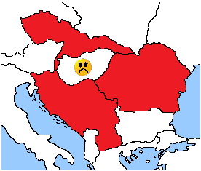
Political Impacts during the 1920’s
Russia becomes internationally isolated due to
Bolshevik Revolution – not a member of League until ‘34
New Eastern Europe map, 9 new countries that become Europe’s new frontier
Countries formed “camps”
Victors and Vanquished
Revanchist (I/H,G) v. status quo (Little Entente – Cz., Yu., Ro.)
Democracy was encouraged in these new countries but
They had little or no experience
Undermined by rivalry between ethnic factions
Hungary surrounded by French supported enemies
Notes:
Revanchist – Revenge or a political policy designed to recover lost territory or status

Slide 36
Political Impacts during the 1920’s
Russia becomes internationally isolated due to
Bolshevik Revolution – not a member of League until ‘34
New Eastern Europe map, 9 new countries that become Europe’s new frontier
Countries formed “camps”
Victors and Vanquished
Revanchist (I/H,G) v. status quo (Little Entente – Cz., Yu., Ro.)
Democracy was encouraged in these new countries but
They had little or no experience
Undermined by rivalry between ethnic factions
Notes:
Revanchist – Revenge or a political policy designed to recover lost territory or status

Slide 37
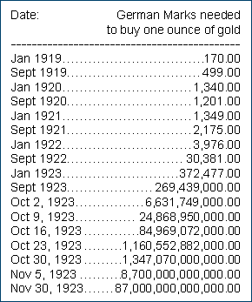
Economic Impacts during the 1920’s
All countries faced rising prices – especially Germany
Middle class was hardest hit - “bourgeois” class
In Germany middle class savings vanished
Trade in former AH Empire disrupted (50m person free trade region)
New countries wished to create own economies – raised tariffs
Limited economic success during this period was erased by Great Depression
Countries reliant on only two countries that benefited from war – US/Japan
Disrupted by Wall St. Crash
Notes:
Revanchist – Revenge or a political policy designed to recover lost territory or status

Slide 38
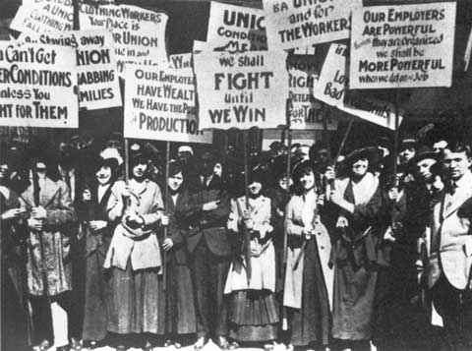
Social Impacts during the 1920’s
Landed Aristocracy – no longer prominent, lost power and prestige
Russian Revolution – rid of aristocracy completely
AH – estates broken up, new countries (Yu.) conducted land reforms
G – Junkers kept land but lost respected position in gov’t. and military
Trade Unions – strengthened due to hard negotiations during war
Standards of health and welfare improved in Western Europe
Britain - Housing Act of 1918 – subsidized housing, Unemployment insurance – 1920
US Women labor protest – 1915

Slide 39
Effects on Women
Britain and US – new roles of women during war changed social norms after
Flappers – changes in fashion and behavior
New professions opened to women – lawyers and architects, serve on juries
In part due to contributions during war – Voting Rights
1917 – Russia
1918 - Austria and Britain
1919 - Cz., G, Ne., Po., Swe.
1920 – US., Belgium
In most cases did have to give up wartime employment opportunities

Slide 40
https://ieper.wikispaces.com/WW43+Versailles

