Slide 1
Italian Expansion (P1) and Authoritarian States (P2) – Mussolini

Slide 3
How did the political and economic conditions in Italy before 1914 contribute to the emergence of an authoritarian regime?
Italy was the first state anywhere in the world in which a Fascist Party developed, and the first to have a fascist dictator, Benito Mussolini
The Problems of Liberal Italy before 1914:
Italy was not officially independent and unified until 1861, which happened through Risorgimento ( a nationalist movement, “resurgence” or “rebirth” ); however people of Italy were far from united, because
1. Italian politics and the impact of trasformisimo (corrupt practice by liberal politicians in Italy; forming coalition governments in order to alternate political control);
After the unification Italian politics were dominated by liberals – who promoted modernization, economic development. Liberals also feared the influence of the Catholic Church, socialists and anarchists - since these groups were opposed to the newly created Italian state
Restricted electorate – initially only 2 % of adult population could vote; by 1912 it was extended to all adult males
Constant disagreements and conflicts between the liberals and the Catholic Church (Conservatives)

Slide 4
2. Regional divisions-largely due to geography/mountains and islands separating people - many people felt more loyalty towards their own town or region than towards the national government
Difference in economic development and in infrastructure – south was very poor and mostly agricultural, while north was well off and industrialized. South lacked roads and received very little investment.
3. The problems of terra irredenta (“unredeemed land”, areas inhabited by many Italians but ruled by Austro-Hungarian empire) and the desire for an empire
After 1870, many Italians hoped that unification would bring them establishment of an empire
1885 – they conquered port of Massawa (Today Eritrea), which became the center of Italian Somaliland
In 1911, they attacked Turkish colony of Libya in an attempt to enlarge their colonial control
They attacked Abyssinia (today Ethiopia), and were unable to control it; Italians angry, and push for more land in Africa to gain land and prestige

Slide 6
How did conditions during 1914-1922 contribute to Mussolini’s rise to power?
The Impact of the First World War and the peace treaties, 1914-1919

Slide 7
Italian participation in WWI:
Initially, Italy was a member of the Triple Alliance (Germany, Austria-Hungary, Italy), (not the Entente- GB, Russia, France), it did not join in when the First World War began in 1914. It remained neutral – most Italians, especially socialists, favored neutrality.
The Treaty of London
Italians ambitions to reclaim the country’s terra irredenta – the liberal government decided to see which side would offer the best terms in exchange for Italian support in the war – Entente promised to give Italy the Austrian-controlled Trentino (Trieste) after the war, as well as South Tyrol, and Istria and Dalmatia.
In May 1915, Italy signed the Treaty of London and promised to join the war on the side of the Triple Entente
Italy’s performance in the War:
The war did not go well for Italy; Italian troops ill-equipped and ill-supplied; fighting the war of attrition (wearing down the enemy by sustained attacks – often sacrificing many lives needlessly)
Battle of Caporetto – terrible loss for Italians against Austrians (40,000 killed, 300,000 taken prisoner)
Nationalists in Italy (Associazione Nazionalista Italiana –ANI) blamed the liberal government for its inefficiency

Slide 9
Paper 1 Practice: 9 A
The Treaty of London, signed by Britain, France, Italy and Russia on 26 April 1915
ARTICLE 4
By the future treaty of peace, Italy is to receive the district of Trentino; the entire Southern Tyrol up to its natural geographical frontier, which is the Bremner Pass; the city and district of Trieste; the Country of Gorizia and Gradisca; the entire Istria.
ARTICLE 9:
France, Great Britain and Russia admit in principle that fact of Italy’s interest in the maintenance of the political balance of power in the Mediterranean, and her rights, in case of a partition of Turkey, to a share, equal to theirs, in the basin of the Mediterranean.
ARTICLE 11:
Italy is to get a share in the war indemnity corresponding to the magnitude of her sacrifices and efforts.
Question 9A:
What, according to the Treaty of London, did Italy expect to gain by entering the First World War?

Slide 10
Economic Impact of WWI:
Significant impact on weak Italian economy – liberal government had borrowed heavily from Britain and US to fight the war and printed more banknotes, causing rapid inflation. Inflation destroyed much of middle class savings, reduced rental incomes of land owners, and dropped real wages for most workers.
Also depended the economic divide between north and south – industry slowed down in the north after the war stopped; south was badly affected by the conscription of large numbers of peasants
Terms of Peace Treaties:
Vittorio Orlando – Italian PM went to the Paris Peace Conference in January 1919 – expecting to receive all that had been promised with the Treaty of London; plus he demanded the port of Fiume (today Rijeka, Croatia), and a slice of former German colonies in Africa
Most of Italian demands were met, however, they gained no African territory, and did not receive Fiume
Since Austria-Hungary was dismantled, Italy became the dominant power in the Adriatic. Italian nationalists thought that Italy was “humiliated” and “cheated”
Gabriele D’Annunzio – famous nationalist – said it was a “mutilated victory”
It was clear that liberal regime would face many problems after the war

Slide 11
The Italian Socialist Party (PSI) – the socialist ‘threat’
PSI – moved to revolutionary position – inspired by 1917 Russian revolution – called for the overthrow of the liberal state; steep increase in party membership by 1919, as unemployment rose after the war
The biennio rosso, 1919-20 – “two red years”, during which many strikes, factory occupations, and organized land occupations took place; in the north of Italy, socialists took control over some local government
Liberal governmental headed by Giovanni Giolitti did little to subdue to protests, rather urged the business owners to give in to some demands – and that led many middle and upper class Italians to view the government as incompetent

Slide 12
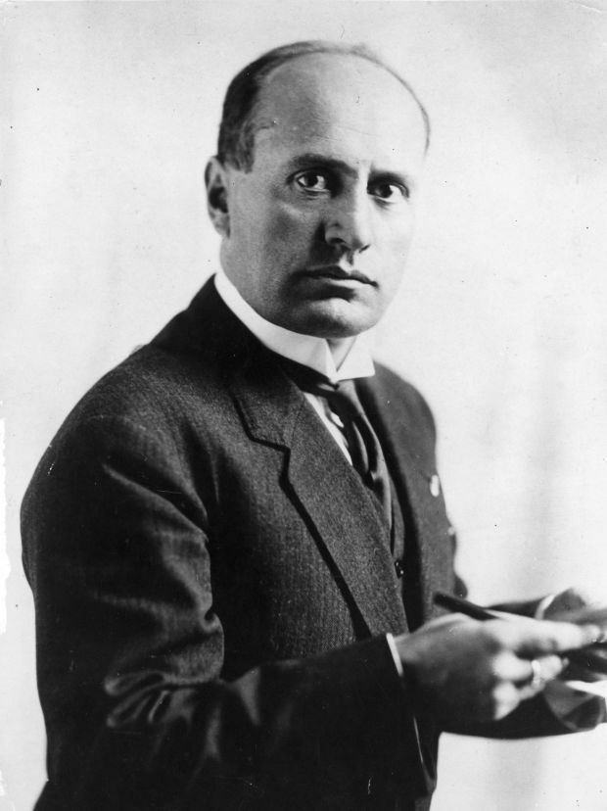
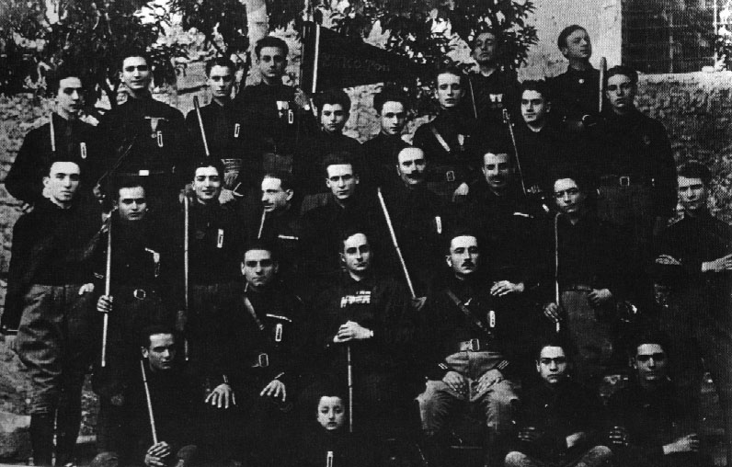
The Threat from the Right
Arditi - “the daring ones” – organized militant groups; anti-liberal government – they used weapons to attack socialists and trade unions
Mussolini was a member of Arditi, tried to bring various groups of Arditi together – Fascio di Combattimento (later became known as Fascists of the First Hour) – he tried to unify nationalists and socialists, which were brought together by their hatred of the liberal state
Gabriele D’Annunzio – and 2000 men, occupied Fiume for 15 months – hero to Italian Nationalists and an inspiration to Mussolini
November 1919 election, showed that Mussolini’s fascists had very little support in Italy- ca. 4,000 throughout the entire country

Slide 13
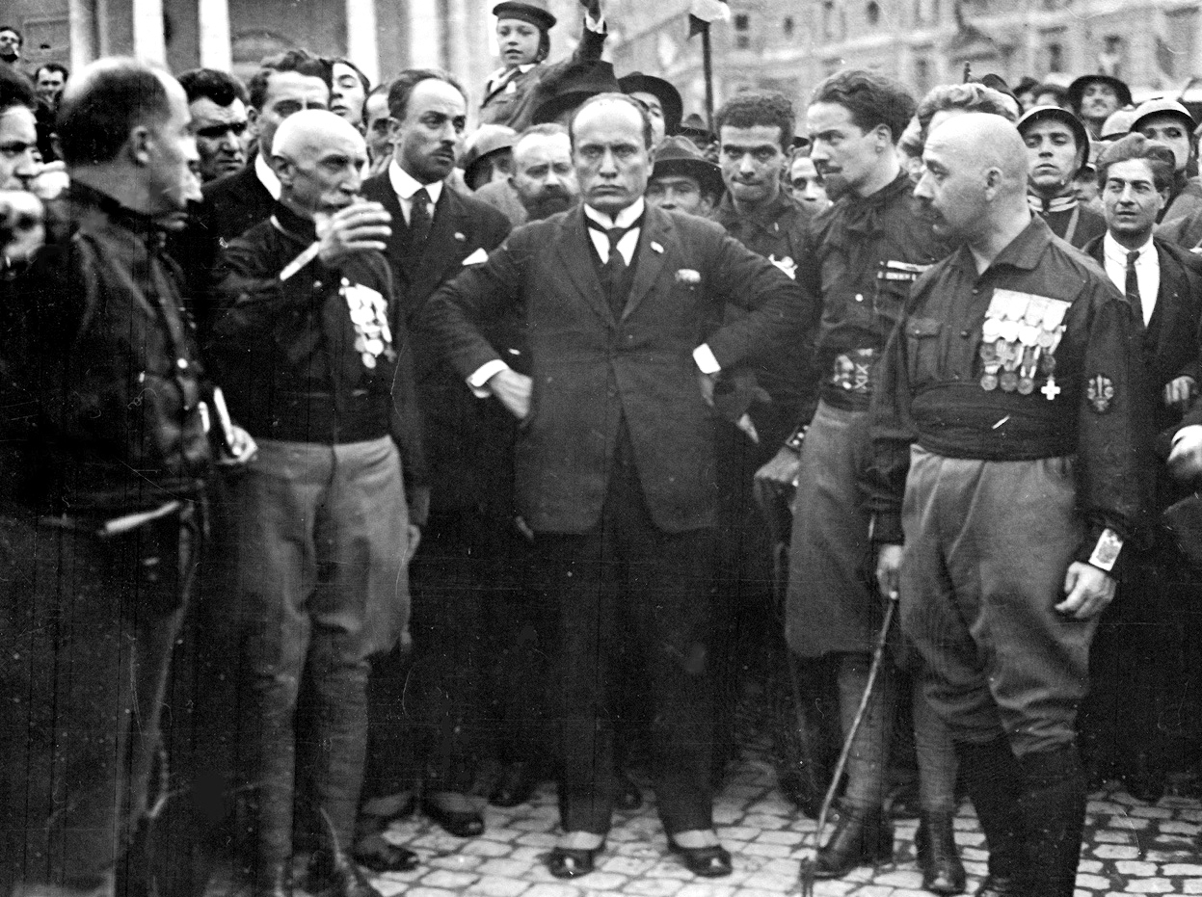
March on Rome
After the 1921 election, Socialists remained the largest party, but fascists managed 7 %, a total of 35 seats, which pleased Mussolini. He backed out of the alliance with the liberals
In 1922, Mussolini pressured by Italo Balbo (a right wing politician) organized the fascists March on Rome to seize power from the liberal government
Once in Rome, the fascists alarmed the government; PM Luigi Facta asked the king to declare state of emergency/martial law – but the king decided not to do so. Rather, persuaded by some politicians, he appointed Mussolini the PM, even though he only had 35 seats (7%) in parliament
March on Rome was more myth than reality - Mussolini himself did not march at the head of Fascists, but arrived to Rome by train, after he accepted the position of PM. The fascist militias did not reach the city until the following day, when about 70,000 Blackshirts celebrated their victory on the streets of Rome.

Slide 15
What were the aims and ideology of the Fascist Party?

Slide 16
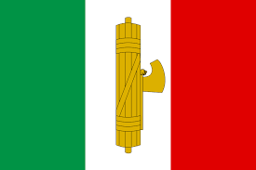
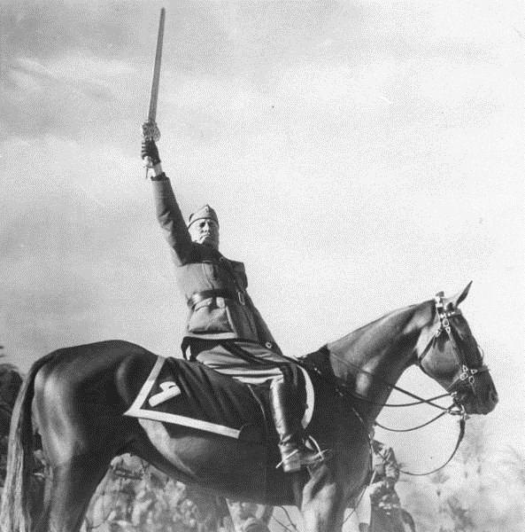
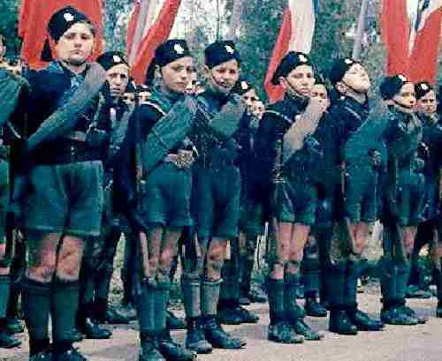
Fascism in Italy

Slide 17
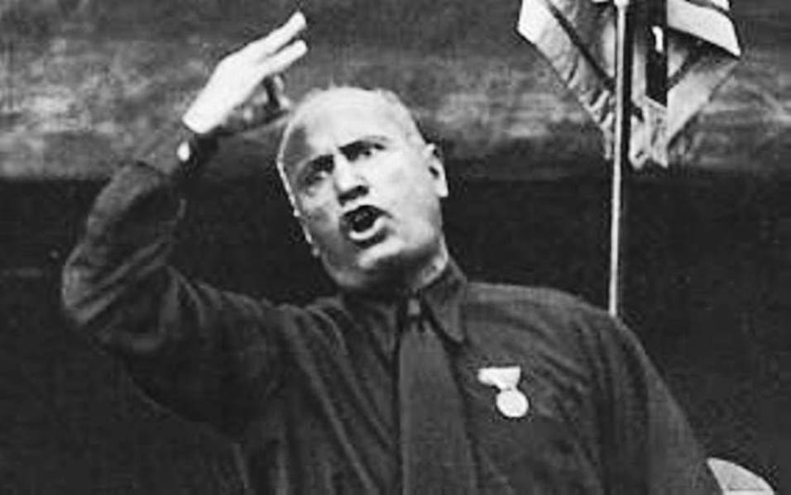
Defining Fascism
Fascism is a nationalistic ideology that is achieved through totalitarian leadership and methodology. It borrowed theories and terminology from Communism but replaced Communism’s focus on class conflict with a focus on conflict between nations and races.

Slide 18
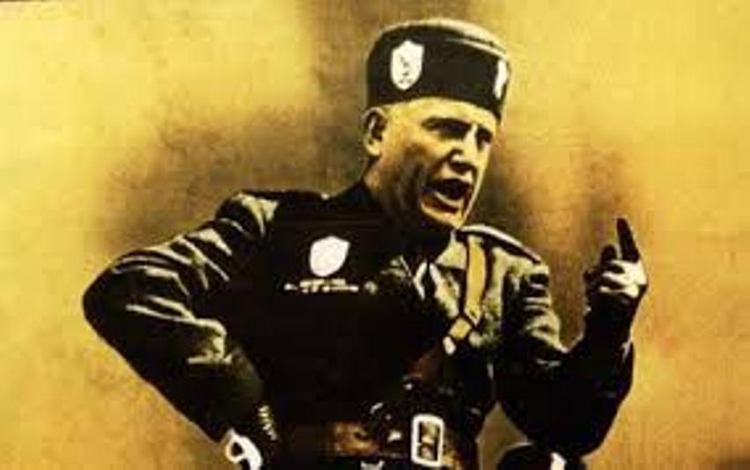
Defining Fascism
In a fascist government system, total power is given to a dictator. Individual rights such as freedom of speech, freedom of religion and freedom of the press are denied. The nation and its power are what counts, not the independence of the individual.

Slide 19
Defining Fascism
Fascism includes the following characteristics:
Rule by a central leader – one leader with total power controls almost everything.
Nationalism – an absolute determination to build up the nation’s glory and power.
Central government control – the unity of the nation is what matters most, not the rights of the individual.
Superiority – a belief in the superiority of the nation’s own race or ethnic group.
Military power – to expand the nation’s territory.

Slide 21
The symbol of fascism, a Roman fasces (fæsiːz), (not faeces) on the Italian flag. Imagery of the ancient Roman fasces was used to suggest that fascism was as powerful as Rome had been. The image was of a bundle of sticks tied together, suggesting strength through unity. In ancient Rome, the fasces was a symbol of power and authority.

Slide 23
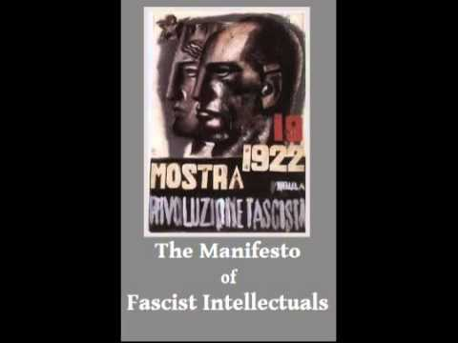
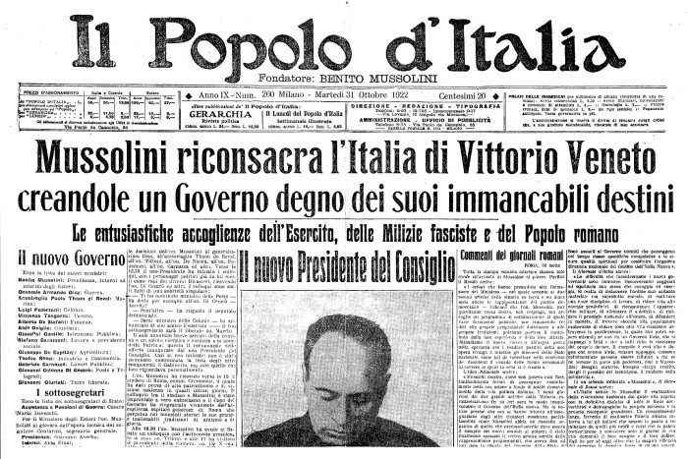
Mussolini & Ideology
Many historians agree that there is no coherent and unified ideology root for fascism – it wasn’t until 1925 that Mussolini started to draw up a clear statement of fascist doctrine
Manifesto of Fascist Intellectuals – meeting of Giovanni Gentile and over 200 intellectuals – this wasn’t particularly effective
Gentile, editor of Enciclopedia Italiana, helped Mussolini publish two articles in 1932 “The Doctrine of Fascism” and “Political and Social Doctrine of Fascism” – both of which clearly defined what Fascism was against (liberalism, socialism, democracy, and pacifism) rather than what it stood for
Mussolini’s early political views
He was involved with the Socialist Party, and was editor of Socialist Party Newspaper “Avanti!” in Milan. After WWI, ideologically he moved towards right – and set up his own newspaper “Il Popolo d’Italia “ , financed by Fiat , and others
It wasn’t until 1918 that Mussolini formally renounced socialism

Slide 24
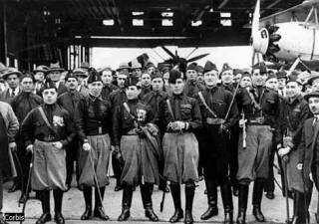
Fascist Beliefs in 1919
Mussolini’s ideology continued to shift – in 1919, after the formation of Fascio di Combattimento the Fascist Program, was an incoherent mixture of left-wing and right-wing policies – designed to hold different groups together and to appeal to wide audiences
By 1921, the list of fascist enemies was reduced to the socialists and the alleged threat of imminent communist revolution.
Fascist ideology, 1921-22
After the 1921 election success, Mussolini became concerned with appeasing the conservatives and controlling the ras.
He established PNF – National Fascist Party, with a clear right-wing platform – it appealed to Mussolini’s capitalist backers, but it angered the ras, who wanted to destroy current political system (liberal democracy)
Made a direct attempt to appease to Catholics, PNF opposed divorce and supported demands for better treatment of peasants
From 1921 Mussolini’s speeches and articles concentrated on what fascism was against – socialism and liberalism- rather than what it was for. Mussolini stressed that fascism is committed to strong government, patriotism, and imperial expansion.

Slide 25
What were the sources of support for Mussolini’s Fascist party?
The economic elites and emerging fascism, 1921-22
Unrest of biennio rosso gave boost for Mussolini’s popularity – he sent in squadre d’azione (action squads) to help factory owners restore order (they were frustrated with government’s inaction)
They were happy to give Mussolini money in return for squadristi’s violent actions against the strikes
These actions squads were controlled by local fascist leaders, known as ras (an Abyssinian word, meaning “chieftain”; regional fascist leaders who commanded their own squads); they broke down protests, burned down newspaper printing offices, etc.
The growing alliance with industrialists, bankers and landowners began building of a mass base for Mussolini’s party; supporters were united by their hatred of socialists and their belief in violent action rather than by any coherent political ideology.
As the fascist action squads proved effective in suppressing leftist action, squadristi numbers were swelled by recruits from the ranks of small farmers, estate managers, etc.
From 1921, Mussolini had hopes of achieving real power; he realized that he needed to convince his supporters of three tings:
That the liberals were finished as an effective political force
That there was a real threat of socialist revolution
Only the fascists were strong and determined to take the necessary action and restore order and dignity to Italy.

Slide 26
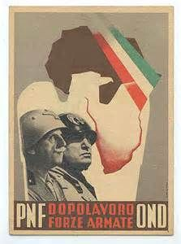
Formation and growth of the PNF
1921 – Mussolini signed a peace deal, Pact of Pacification, with moderate socialists, and resigned from Fascist Central Committee , and formed PNF – Partito Nazionale Fascista . In November, Fascist National Congress elected him as a leader – in return he agreed to end the truce with Socialists - He became a leader of an organized and united political party
He revised program and appealed more to conservatives – he kept fascist policy statements deliberately vague, declaring his party to be against socialist and liberalism and for a strong and ordered Italy.
Despite Mussolini’s growing control of the Fascist party, many of the local ras, including Roberto Farinacci and Italo Balbo continued to endorse the violence of the action squads
Mussolini followed dual policy in order to preserve unity of his party – he encouraged the ras to continue their violent activities, but he made it known to the conservatives that he had no intention of pushing for a violent seize of power.
Success of squadristi to break up socialists protests impressed the conservative middle class and led to renewed relations between Mussolini and formal liberal PMs of Italy – to discuss the possibility of fascists participation in a coalition government. To increase fascist respectability, Mussolini declared he was no longer opposed to the monarchy.

Slide 27
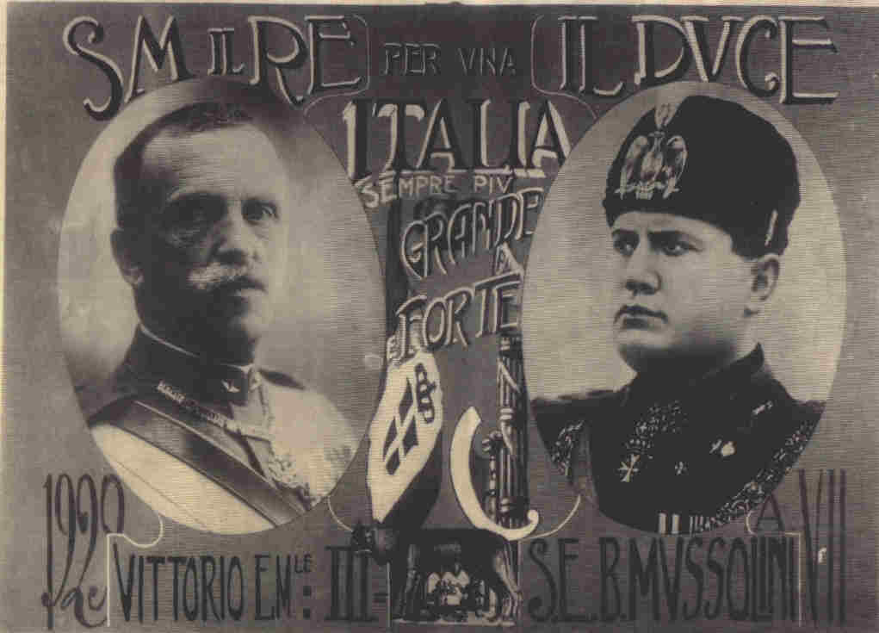
Victor Emanuel III and fascism
Mussolini owed his success in October 1922 (March on Rome) more to the role of the king, Victor Emanuel III, than to the strength of his fascist militias. The king refused to sign declaration of martial law because he could not depend on the army’s loyalty to him.
Historians are still undecided as to why the king acted as he did. Some argue that he was uncertain of the reaction of the military, had he had little faith in liberal politicians, that he feared an outbreak of the civil war, and that he was worried about being replaced by his cousin, a known fascist supporter.
Whatever the king’s motives, he allowed Mussolini to become PM by legal, constitutional means, assisted by the fascist violence.

