Slide 1
Mussolini
Consolidation of Power

Slide 2
How did Mussolini consolidate his power?
The March on Rome gave Mussolini access to political power, but in 1922 his power was not yet consolidated:
He had to devise the structure of the Fascist state
His power was limited – the king had the power to dismiss and replace him
Had to prevent opposition from forming an alternative coalition
He did not have undisputed control within the Fascist Party itself
Mussolini implemented several policies to consolidate his power, which gradually moved Italy away from a democracy towards an authoritarian state.

Slide 3
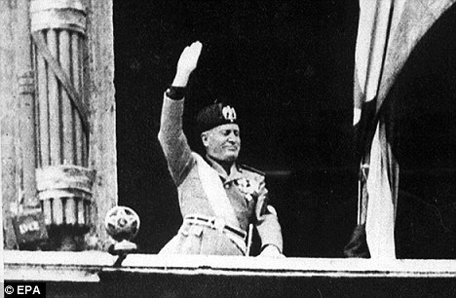
How did Mussolini consolidate his power in the period 1922-24?
Methods: coercion and intimidation
Persuaded the king to give him extraordinary power for a year – granted him relative freedom to introduce significant changes
Months following Mussolini’s appointment as PM, thousands of political opponents were arrested by the government – the local ras also exercised violence against the opposition
Mussolini created Fascist militia, the Voluntary Militia for National Security (MVSN) to work with police and the army to defend “Fascist Revolution.” MVSN responded directly to Mussolini, and swore an oath of loyalty to Italy, not to the king.

Slide 4
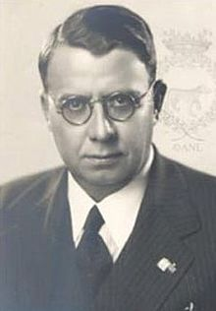
Methods: Reforming the state
Even though Mussolini held the positions of the Prime Minister, foreign and interior minister, in 1922 Fascists remained a very small party in parliament (only 47 out of 535 seats).
Acerbo Law – the task of drafting a new electoral law to enable the PNF to gain a majority in parliament was handed to Giacomo Acerbo . The Acerbo Law proposed that the party gaining the largest number of votes in an election – providing it had reached a minimum of 25 percent- automatically obtained two-thirds of the seats in parliament, while the remaining third were to be proportionally distributed among other parties.
Mussolini claimed that the Acerbo Law would bring political stability in Italy by ending the problem caused by the collapse of coalitions.
Fascists threatened to use force to pass the law; it was in that atmosphere of threat that the Acerbo Law was voted.
During 1924 elections, the PNF gained over 65 percent of the votes, obtaining the largest electoral victory for a political party since unification. The significance of this election was the fact that Mussolini, who did not come to power by popular vote, was now being endorsed by it.

Slide 5
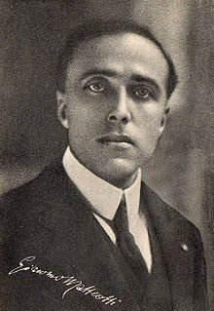
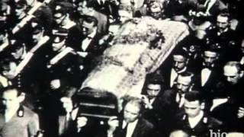
Matteotti Crisis and the Aventine Secession
An independent and much respected socialist, Giacomo Matteotti, openly spoke in front of the parliament about fascist corruption and violence during the election. He was also an outspoken opponent of the Acerbo Law.
1924 –Matteotti was kidnapped by Fascist thugs and beaten to death; his body thrown into the river. His murder constituted a political crisis for Mussolini.
Men who murdered him were associated with fascists- therefore Mussolini bore the moral responsibility for the murder, even though there was no evidence of his direct involvement.
Questionable whether Mussolini can control the most violent members of his own party – it seemed that Mussolini could lose his position during this crisis
Over 100 members of the parliament withdrew in protest, hoping their “Aventine Secession” ( a concept from ancient Roman History, when Romans protested patrician aristocracy by withdrawing to Aventine Hill) would persuade the king to dismiss Mussolini and call for a new government. However, he survived the crisis because with the absence of opposition from the parliament, fascists gave him a vote of confidence, which kept him in the position of PM.

Slide 6
Aventine Secession:
After this incident, Mussolini used terror and intimidation to get rid of opposition in order to consolidate his power; his opponents were either killed or had to leave Italy, censorship strengthened, and anti-Fascist newspapers were taken under control or shut down.
In addition, local elections were abolished and local representatives were appointed by Rome.
By 1926, all opposition parties were banned. Italy had become an authoritarian state.
Further changes in the constitution included:
The Prime Minister (Mussolini) was answerable to the King, not Parliament. (1925).
New press laws ensured that people heard only what Mussolini wanted them to hear. Newspapers contained an exaggerated worship of Il Duce, which was particularly fostered in Il Popolo d'Italia, a newspaper that was edited by his brother in law. Radio, films and the theatre were all strictly controlled.
The Prime Minister could rule by decree, which meant that new laws did not have to be discussed by Parliament. He had used this over 100,000 times by 1926.
In 1927 a secret police, the OVRA, was set up which dealt with those who opposed the regime. It was helped by the existence of special courts that tried enemies of the state. Those accused of crimes were allowed no witnesses, no jury and no rights of appeal.
The electorate was reduced from 10m to 3m (the right to vote became dependent on membership of a Fascist syndicate).

Slide 8
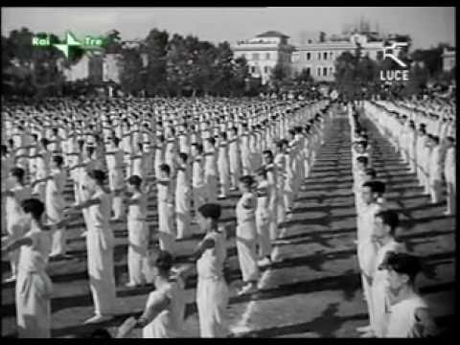
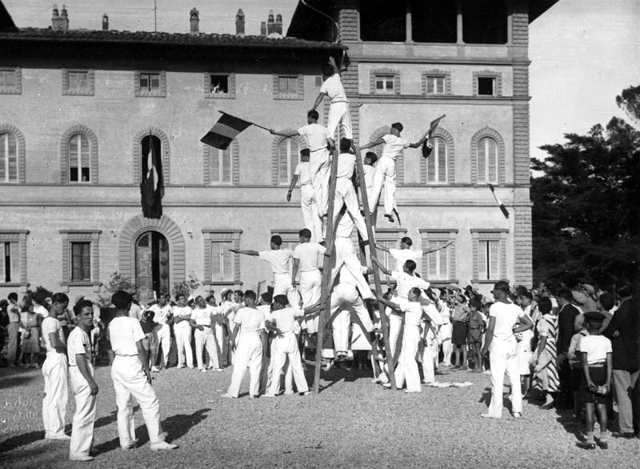
What role was played by personality and propaganda in the consolidation of Mussolini’s power?
Mussolini took additional measures to secure his power – methods of indoctrination and propaganda
Controlling minds:
Opera Nazionale Dopolavoro (OND) – important to influence the minds of adult population – established organization to control leisure activities; it had a vast numbers of clubs, libraries, and sports grounds, it organized concerts, dancing and holiday activities.
Main function of OND was to increase acceptance of Fascist ideology – but most local organizers ignored the indoctrination aspects, and people by and large just enjoyed subsided sports, outings and holiday activities

Slide 9
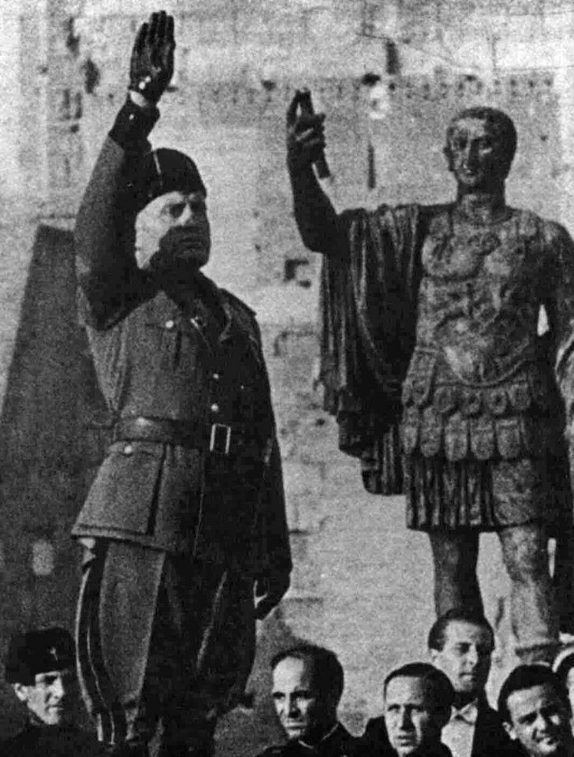
L’inquadramento
Attempt to expand fascist party membership;
1931-37 the Fascist Party established its own welfare agencies to provide extra relief and focused on involving women - however, this wasn’t very successful. According to some statistics, only 6 % of the population belonged to the party
Romanita Movement:
Propaganda ploy to build up the prestige and popularity of Mussolini – linking them to the earlier greatness of ancient Rome and its emperors.
Fascist writers, artists and scholars portrayed fascism as a revival of , and a return to ancient Roman civilization. Mussolini referred to as “new Caesar”.
As part of this cult, Mussolini adopted the “fasces” as the fascist emblem and it had it incorporated into the national flag.
Talking about the “New Man” – modern version of the idealized Roman centurion

Slide 10
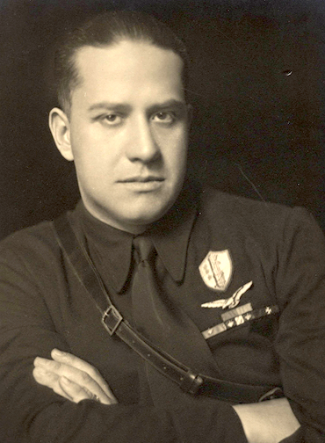
Ducismo: the personality cult of Il Duce
Mussolini projected his own image and widely publicized the “achievements” of fascism
Established press office to ensure that photographs and newspaper articles projected appositive image of Mussolini and his activities
Established a state radio network and film agency to produce documentaries –showing him addressing large crowds (he wanted to be filmed from below, to appear taller)
1933, Mussolini’s son-in-law, Galeazzo Ciano, took over running of the office (later renamed to Ministry for Press and Propaganda, and again to Ministry of Popular Culture - Minculpop)
With time, the focus was to ensure that all films, plays, radio programs and books glorified Mussolini as a hero and the fascists as Italy’s saviors. However, their attempts to regulate the arts were not very successful, since traditional liberal culture proved too strong.
Lights were left on in Mussolini’s office to suggest that he worked 20hrs a day for Italy; posters and photographs of Il Duce appeared in public buildings, streets and workplaces.

Slide 11
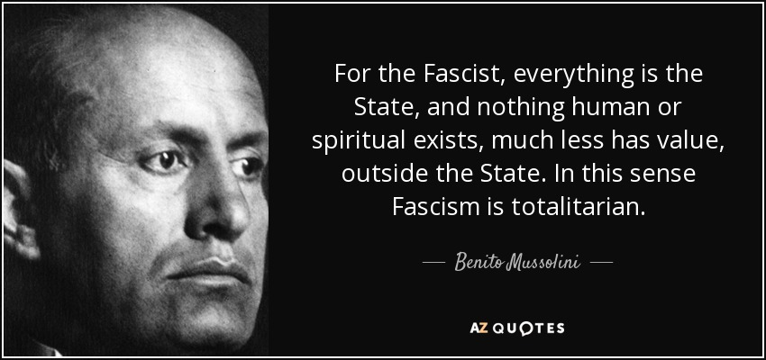
Did Mussolini create a totalitarian state?
Totalitarian state is one in which the government has total control over all aspects of a citizens’ life: political, economic, cultural and social
Under Mussolini – there could be no overt opposition or criticism/ control enforced by the secret police and militia , employees of the state had to swear an oath of loyalty to the regime
However, there were limitations to the totalitarian nature of the Fascist Regime: fascists compromised with powerful non-Fascists, such as the Vatican and the King
Mussolini still could be dismissed by the king
Mussolini never fully gained control over the south Italy

Slide 12
How far did foreign policy help Mussolini maintain power?

Slide 13
What factors influenced Mussolini’s foreign policy?
Mussolini did not take power with a clear set of foreign policy goals already in place. After 1925, he developed a program of action which included the following points:
Increase national pride
Consolidate domestic support for the regime
Revise the post-war settlement of 1919-20
Dominate the Balkans
Dominate the Mediterranean
Build and empire (gain spazio vitale or “living space”), expand its territories in Africa
Foster the spread of Fascism in other countries

Slide 14
Mussolini hoped that his foreign policy, acquisition of spazio vitale (living space), would strengthen his regime, it actually ended up becoming what is generally regarded as the main factor in his downfall.
Peaceful diplomacy 1922-35
Mussolini’s use of force in the Corfu Incident in August 1923 is an example of how foreign policy did help him to establish and maintain power.
In 1920s, Mussolini was still not in the position to achieve his aim of great new empire by force, he followed a largely peaceful foreign policy for the next decade.
However after 1929 and the Great Depression, Mussolini’s foreign policy began to change; he called for the 1919-20 peace treaties to be revised and plotted (unsuccessfully) with Hungary to overthrow the king of Yugoslavia.
Mussolini was suspicious of Hitler when he came to power, so he blocked Hitler’s attempted takeover of Austria in July 1934 and again in April 1935.

Slide 15
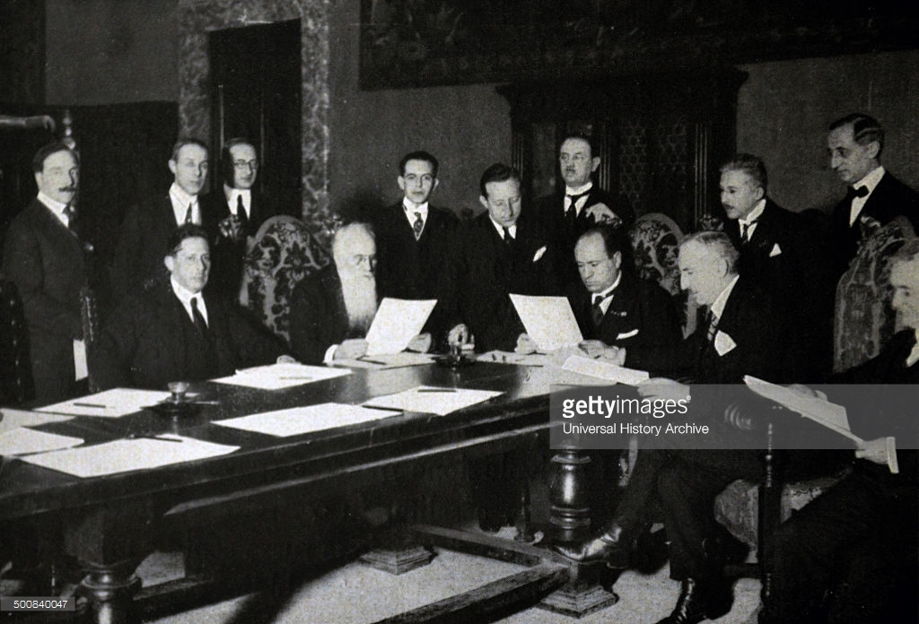
How successful was Mussolini’s foreign policy in the 1920s?
Mussolini used foreign policy in the 1920s to consolidate his domestic control in Italy and by the 1930s his foreign policy becomes more Fascist in character
In 1923 Mussolini invaded the Greek island of Corfu after an Italian official was killed on the Greek border with Albania. The LoN condemned this action and demanded that Italians withdraw.
After Britain threatened to use their navy, Mussolini agreed to withdraw, but he also demanded payment of 50 million lire of compensation from the Greeks
Although the Corfu Affair was seen as a great success in Italy, Mussolini had learned that he could only bully smaller states
In 1924 Mussolini scored a foreign policy victory when he gained control in Fiume through the Pact of Rome with Yugoslavia. He also established good relations with the new government in Albania, led by Ahmed Zog – Mussolini invested in his rise to power, and helped trained their military.

Slide 16
Relations with W. Europe
Mussolini was hostile to France for several reasons:
Italy had claims over the French territories of Corsica, Nice, and Sardinia
Mussolini was jealous of French North Africa /supported opposition movements in Tunisia, Morocco
Mussolini aimed to replace French influence in the Balkans and the Adriatic
Mussolini wanted to present himself as a force for moderation in W. Europe – met with leaders from Britain, Germany, Belgium and France at Locarno (Switzerland), reached 7 agreements that aimed to secure the post-war settlement and normalize relations with Germany – confirmed Germany’s western borders with France and Belgium
Kellogg-Briand Pact of 1928 denounced use of war a s a means to resolve disputes – Italy was one of more than 60 signatories
Despite all the agreements, Mussolini helped fund right-wing groups in Italy and trained German pilots in Italy; he also pursued his aims to expand Italy’s empire in Africa
By the end of 1920s, Mussolini became frustrated with the failure of traditional diplomacy, but had to support the disarmament efforts of the LON due to the weakness of Italian military.

Slide 17
What factors had an impact on Italy’s foreign policy in the 1930s?
The impact of fascism:
Mussolini pursued more Fascist foreign policy: glorification of war for its own sake, pursuit of imperial expansion, and a move away from diplomacy and cooperation.
2. The impact of domestic economic issues:
Italy was affected by the Great Depression; investment from the USA was withdrawn, and Italian farmers were also badly affected by the collapse of grain prices.
Bank of Italy had to be rescued from collapsing, industrialists had to be bailed out- as a result Italy developed the largest public sector in Europe
3. Changing diplomatic alignments in Europe after 1933
Four Power Pact , July 15 1933 – Britain, France, Germany and Italy signed and stated they would adhere to the League’s covenant, the Locarno treaties, and the Kellogg-Briand Pact
Stresa Conference, April 1935 – reaffirmed the Locarno Treaties, and confirmed the independence of Austria (Britain, Italy, and France met to discuss Hitler’s rearmament) – the Stresa agreement was so vague, it didn’t even name Germany

Slide 18
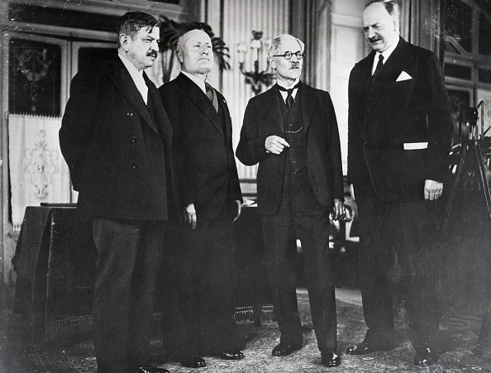
Stresa Conference
Four Power Pact/Treaty

Slide 19
Mussolini’s Fascist Crusades 1935-39
Invasion of Abyssinia, 1935-36
Abyssinia lay between Italy’s two existing colonies in East Africa, Eritrea and Somaliland, and Mussolini has been making plans to invade since 1932
Italian forces clash with Abyssinians at the disputed Wal Wal oasis, which resulted in death of 30 Italians. Emperor of Abyssinia, Haile Selassie, requested an investigation by the LoN. Mussolini did not want an investigation by the Lon, and launched a “total conquest” of Abyssinia.
Invasion began Oct. 2nd 1935 – 500,000 Italian troops invaded – met little resistance (Italian weapons were superior); By May 1936 Abyssinia became a part of Italian East Africa
During the war tensions between Italy and Britain reached crisis point; however GB and France wanted to foster good relations with Italy; they drafted a secret pact which would offer Italy half of Abyssinia ; however it leaked out to the press and they withdrew the deal
On May 5th 1936, Italian forces took the capital, Addis Ababa, and Emperor Haile Selassie fled to Britain
Negative effect: ended Stresa Front (close relationship with France and Britain), and increased Mussolini’s dependence on Nazi Germany
Positive for Mussolini: it was his first successful attempt to create a new Roman Empire, which boosted his popularity. Gained popularity from the Catholic Church, because they saw the invasion as a ‘Christian Crusade’.

Slide 20
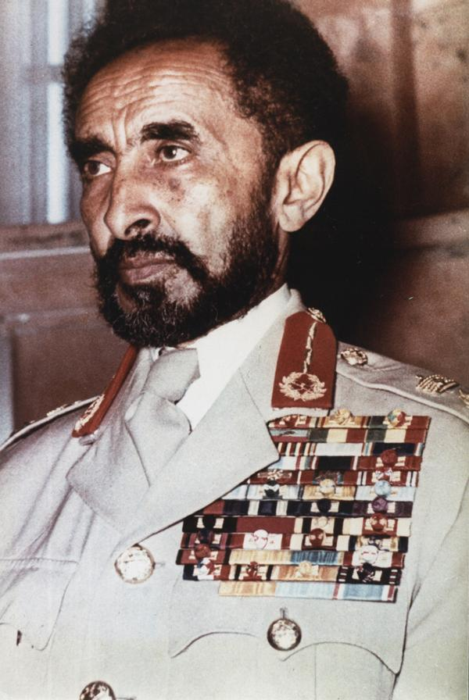

Slide 21
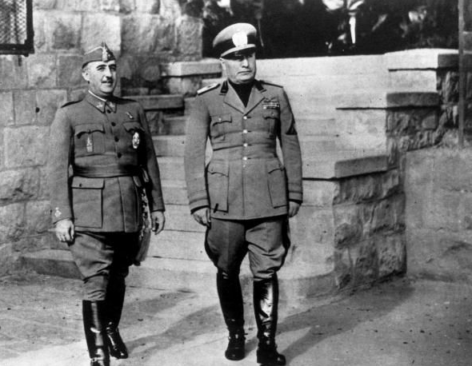
The Spanish Civil War, 1936-39
1936 – Mussolini no longer objected to German Anschluss with Austria; on March 6th, Mussolini followed Hitler’s lead and withdrew from the League
July 1936 – Mussolini agreed to join Hitler in intervening in the Spanish Civil War to Help General Francisco Franco overthrow the democratically elected Popular Front government.
Church supported this move; they supported this move because they saw it as another ‘Christian crusade this time against Communism.
This intervention was also motivated by ideology; Mussolini responded to request for assistance from the militarist rebels to help fight against liberal democracy and socialism
Negative effects: Mussolini committed over 70,000 Italian troops, 1000 tanks, and 600 planes; it cost them 10 billion Lire, and more than 6000 Italian soldiers’ lives.

Slide 22
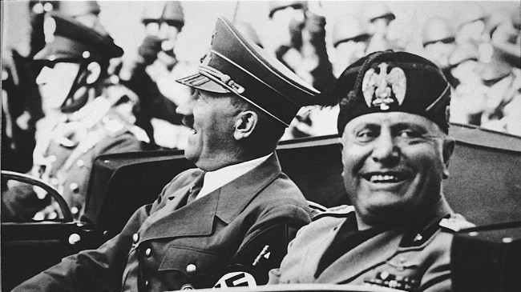
The Rome-Berlin Axis
October 1936, Mussolini signed Rome-Berlin Axis with Hitler, which moved him closer to Nazi Germany. It established cooperation and support between the two nations. In December 1937, Italy signed Anti-Comintern Pact with Germany and Japan, emphasizing that all three are anti-Communist and will support each other.
These steps would soon prove a disaster for Mussolini and his regime.

Slide 23
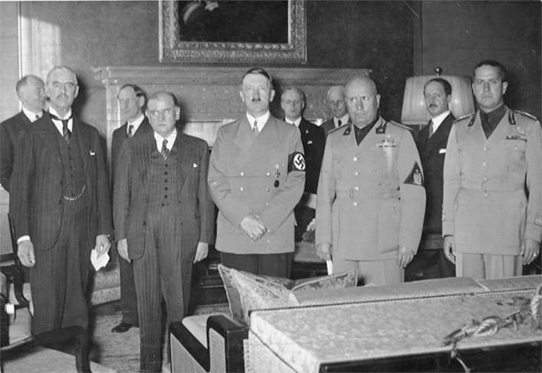
What was Italy’s role during the Sudetenland crisis in September 1938?
During the Munich Crisis of 1938, Mussolini wanted to be seen as a great broker of peace
Chamberlain could not reach agreement with Hitler so Mussolini stepped in as a peacemaker
However, by this time, he was subservient to Hitler; Mussolini just put forward Hitler’s own plan for the Sudetenland. In March 1939, Hitler broke the Munich Agreement and invaded the rest of Czechoslovakia
The Munich agreement highlighted the weakness of Britain and France, and Mussolini was determined to take advantage of the situation - he wanted to annex Corsica, Nice and Tunis from France

Slide 24
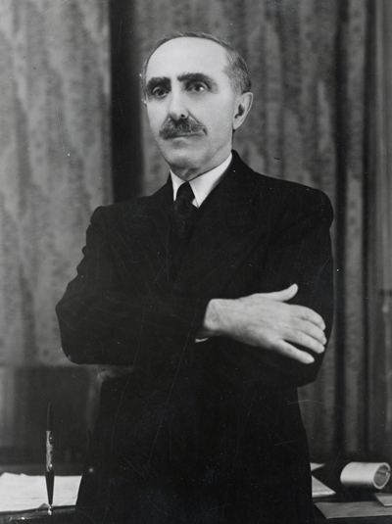
Why did Italy invade Albania in April 1939?
Mussolini believed that Britain and France would never take any firm action against German expansion (they did not with Anschluss of Austria or takeover of Sudetenland in 1938), therefore in April 1939, Mussolini attempted to annex Albania.
Mussolini wanted to assert Italian strength in order to imitate Hitler's successful expansion
King Zog of Albania refused to agree to Mussolini’s ultimatum to Italian occupation of Albania; anti-Italian demonstration followed in Tirana – King Zog broadcasted public statement saying that he would resist Italian occupation.
By the afternoon of the very first day of fighting, all ports were in Italian hands, the King and his family fled to Greece
On April 8, Italian forces entered Tirana and seized control of all government buildings
Albania withdrew from the League of Nations on April 15 1939; the Italians set up the fascist government under Shefqet Verlaci. King Victor Emmanuel, was crowned King of Albania.

Slide 25
The Second World War:
May 1939 Mussolini signed a Pact of Steel with Nazi Germany – which was a formal military alliance that committed Italy to fight on Germany’s side in the event of war – however Mussolini clearly stated that he needed 3 years to prepare; he was shocked when Hitler attacked Poland on Sept. 1st 1939.
Mussolini did not join Hitler due to Italy’s serious weaknesses; he promised to send agricultural and industrial workers – which also was very unpopular in Italy.
Why did Italy join the war in June 1940?
Not to join the war was something of an embarrassment for the Fascist leader; it was contrary to his fascist doctrine
Mussolini did not want Italy to become a lesser power by staying neutral
The war could give Mussolini the opportunity to radicalize the regime
War could bring territorial gains and perhaps control over the Mediterranean
Economic: Germany had been a principal buyer of Italy’s food and textiles; Italy in return became dependent on German coal and in March 1940 Britain blockaded all German coal ports
Italy entered the war in June 1940, and engagement in the war resulted in food shortages and growing dissatisfaction with the fascist regime. It led to the re-emergence of the first serious signs of opposition since the late 1920s.

Slide 26
What was the nature and extent of opposition, and how was it dealt with?

Slide 27
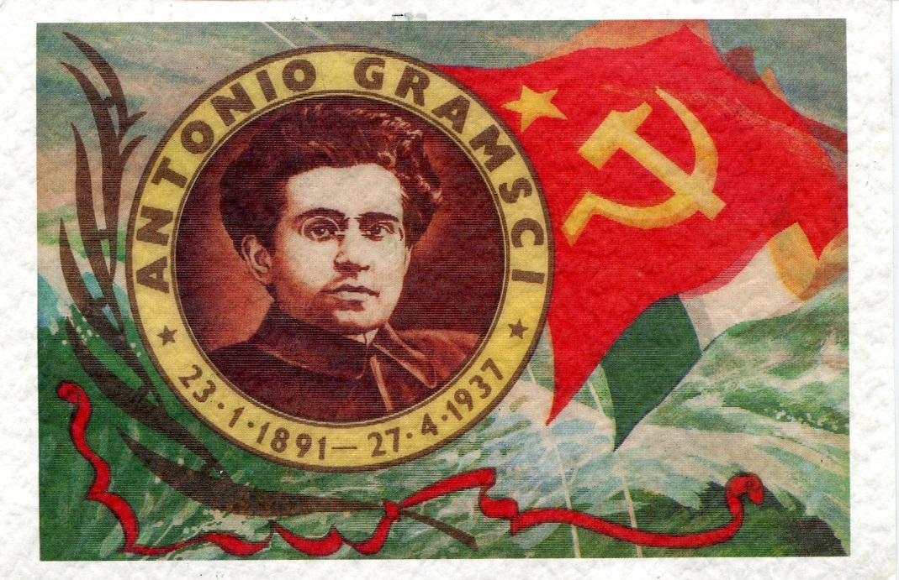
Opposition to Fascist Rule, 1925-40
Although all opposition was banned in 1926, some limited opposition remained
Communist Party of Italy – Antonio Gramsci – became its leader and was elected to the Chamber of Deputies. He set up a newspaper called L’Unita (Unity), and called for united front to defeat Fascism.
Gramsci was arrested in Nov. 1926; he died in prison in 1937
During the late 1920s and 30s, opposition was very weak; it mainly involved isolated individuals, small clandestine groups, and remnants of the trade unions
Fascist treatment of active opposition was brutal, but not as excessively repressive as in Hitler’s Germany or Stalin’s Russia.
Several anti-fascist groups went into self-imposed exiles so that they could organize opposition from abroad – many went to France; they smuggled anti-fascist literature into Italy

Slide 28
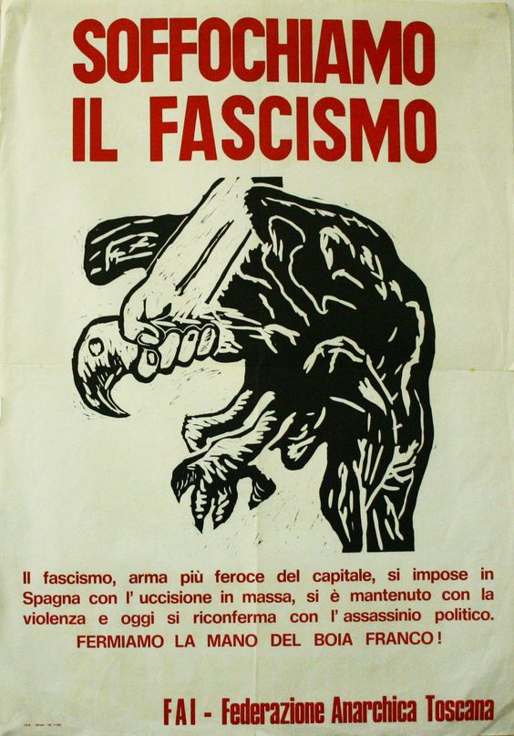
Reemergence of Opposition at home, 1940-43
Germany was taking more from Italy than it was offering in military aid; Italy provided coal and iron ,as well as skilled workers. Food Italy was sending to Germans caused food shortages and rationing in Italy – which was met with opposition at home
By 1942, Allies started bombing Italy, which resulted in widespread destruction – furthering people’s opposition to Mussolini’s regime
Axis troops in Africa had to surrender their territory – which resulted in Italy’s loss of Libya in 1943
Most Italians, including the industrialists and lower middle classes who had been the backbone of fascism , were disillusioned by the regime’s inefficiency and corruption – they strongly opposed Mussolini’s use of Nepotism (promotion of relatives because of their family connection)
Suffocate Fascism – anti-fascist propaganda

Slide 29
The End of Mussolini’s Fascist State, 1943-45
Military setbacks of May and July 1943 finally triggered a coup against Mussolini on 24th of July, when the Fascist Grand Council voted 19 to 7 to remove Mussolini from Power
On July 25 the king formally ordered Mussolini to resign – he was arrested and imprisoned - the ease with which his overthrow was achieved emphasized the fact that Mussolini had never been able to impose a totalitarian regime
He was replaced by Marshal Pietro Badoglio, who, on Sept. 8th, 1943, announced Italy’s surrender to the Allies
Sept. 1943 Mussolini was rescued by German paratroopers; they took him to Germany where Hitler persuaded him to set up the Italian Social Republic – this was a new fascist state in the German-controlled NE part of Italy

Slide 30
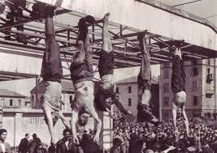
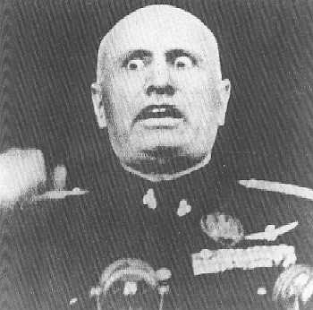
The Italian Social Republic was regulated by Rudolf Rahn, the German Ambassador, and by SS general Karl Wolff – they ordered much SS and Gestapo brutality, especially against Jewish people
In April 1945, Allies captured the northern city of Bologna, and the Germans decided to pull out of Italy.
Mussolini tried to flee with the Germans, but was recognized by a group of Italian partisans and arrested on 27th of April.
The following day, he and his mistress were shot. The bodies were hung upside down outside a garage in Piazzale Loreto in Milan.

Slide 32
Paper 1: Italy
International Responses to Italian Aggression (1933-40)

Slide 33
Appeasement
Diplomatic policy of making concessions to nations in order to avoid conflict
Failed to prevent WW2, yet allowed both Mussolini and Hitler to get away with territorial demands
Reasons for following appeasement policies in GB:
Public Opinion – larger electorate, against war and pro collective security
Demands of the dictators seen as justified – ToV too harsh, communist threat
Lack of an alternative policy
Economic pressures - WW1 & GD- no support for financing rearmament in expense of social benefits
Global commitments – obligations to LoN, imperial commitments/difficult to manage
Defense priorities – no money for additional defense expenditures, priorities – ability repulse air attacks and preserve trade routes / no money for defense of allies
The impact of Chamberlain – PM, looked for policy of conciliation not confrontation with Italy and Germany/ detested war and determined to use diplomacy

Slide 34
France
disagreed with GB, thought ToV was fair; they were economically weak with destroyed infrastructure; frequent changes in government in the 1930s and unable to take action against Germany - military depending on GB’s help
Creation of Popular Front – left-wing alliance, won the election in 1936, wanted stronger anti-Fascist stand
How was the International Response to aggression in the 1930s affected by the weaknesses of the LoN?
LoN lacked credibility and economic power of USA
Council: GB, France, Italy, Japan, Germany (last three were revisionist (for ToV)
Inefficient structure and organization
Impotent in the face of fascist aggression
What was the impact of US foreign policy on the international response to expansionist powers?
US did not join LoN – followed isolationist policy – wanted to trade globally w/o being drawn into conflicts
Policy of “non-involvement” in EU and Asian affairs
1935 Neutrality Act

Slide 35
What was the impact of Soviet Foreign policy on the international response to the expansionist powers?
Western governments cut off diplomatic and economic ties with post 1917 Bolshevik government/ not included in ToV talks, relations remain hostile until the end of 1920s
Under Stalin – focus on USSR until revolution complete – no exporting of revolution; Stalin less hostile against W after being threatened by Japan
1931/32 he signed a number of non-aggression pacts/ shift towards anti-fascist foreign policy
Stalin stopped cooperating after not being invited to Munich Conference

Slide 36
What was International response to the Italian Invasion of Abyssinia in 1935-36?
March 1935- Stresa Front – ties of Italy, France and Britain – Mussolini seen as someone who can contain Germany in obtaining Anschluss.
French give Mussolini the impression that they would tolerate Italian expansion in East Africa/ Mussolini believed they wouldn’t resist; Britain silent on matters of Abyssinia during Stresa conference
British tried to appease Italy by offering Ogaden region and compensate emperor Haile Selassie, Italy rejected the proposal – known as
Hoare- Laval Pact – French foreign secretary Pierre Laval and GB counterpart Samuel Hoare drew up the pact which sought to pacify Mussolini by giving him most of Abyssinia and Selassie would gain access to Sea – the plan leaked to the press and the public was enraged; had to denounce the pact and Laval and Hoare resigned.
After Mussolini invaded Abyssinia in Oct 1935 –widespread international public outrage and condemnation by the LoN, and GB public opinion was pro-league

Slide 37
Response of the LoN
Before attack, Haile Selassie made appeals directly to the LoN due to Italian mobilization of troops in Abyssinia – he asked for neutral observers
LoN responded with arms embargo on both sides (July 25) however that only hurt Abyssinia; however GB removed its warships from the Mediterranean which gave Mussolini access to free movement of supplies to E Africa
Selassie asked in Sept again for help; Oct 3rd Italian troops invaded – Oct 7th LoN found Italy to be the aggressor and began a process of imposing sanctions, which was very slow
Did not embargo key war materials (like coal and steel); GB wanted to maintain strong Stresa Front, and decided not to close the Suez Canal to Italian shipping; Austria, Germany and Hungary decided to ignore sanctions altogether
USA increased exports to Italy
Sanctions did little to impede Italian war effort

Slide 38
Results of the International Response to the Abyssinian Crisis
Hoare-Laval Pact destroyed the legitimacy of the LoN
Attention drawn away from Abyssinia when Hitler remilitarized Rhineland in 1936; France willing to let Mussolini complete his conquest in Africa as long as he stands strong against Hitler
Selassie fled Abyssinia and capital Addis Ababa fell to Italian forces
International response had profound effect on European diplomacy – fatally undermined the LoN as a credible body and it ended the Stresa Front
USA Response:
President Roosevelt sent a personal message to Mussolini on Aug. 18th 1935 advising against aggressive measures; however US would not take any direct action due to isolationist policy

Slide 39
The End of Appeasement of Mussolini’s Italy
Britain and France both condemned the Italian invasion of Albania April 7th 1939; British forces moved to protect Greek borders/ Churchill wants to move the Navy, but Chamberlain refused
When Italy joined WW2 in 1940, they invaded Egypt and Greece, British counter-attacked Italian forces in North Africa and pushed them out, British Navy sunk half of Italian fleet
However, when Germans arrived to N. Africa, British were pushed back out of both Egypt and Greece (in Europe)

