Slide 1
Fascist Policies and their Impact
Mussolini Part 3

Slide 2
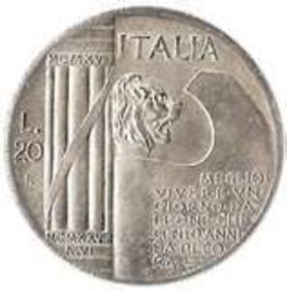
What were Mussolini’s Economic and Social Policies, and what factors influenced them?
Mussolini realized the importance of strong economy for the strength of his regime; he wanted to make Italy economically self-sufficient in food and raw materials (autarchy)
Economic Battles: series of campaigns
1924 Battle over the Southern Problem – to combat poverty in S. Italy; promised building new villages and battle the Mafia
1925 – Battle for Grain – farmers should grow more cereal in order to reduce Italy’s dependence on foreign imports; medals awarded to most productive farmers; in the north farming became more mechanized
1926 – Battle for Land – further effort to increase farm land; draining swamps to establish small farms
8/1926 Battle for the Lira – artificially raised the value of the lira; allowed Italy to continue importing

Slide 3
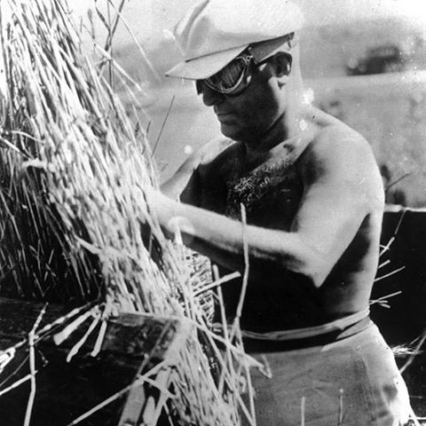

Slide 4
How successful were Mussolini’s economic and social policies?
Most economic battles were far from successful due to inconsistencies (villages never built, etc.); battle of grains almost doubled the production of wheat by 1939 achieving self-sufficiency – but it led to Italy having to import olive oil; also exports of fruit and wine dropped
Battle of the Lira – resulted in declining exports- rose unemployment; since Italian goods became more expensive
As a result many women were forced to give up their jobs to unemployed men
Reform: The Institute per la Reconstruzione Industriale (IRI) – Institute for Industrial Reconstruction, set up in 1933- took over unprofitable industries, by 1939 it became a massive state company
IRI often sold huge industries to private owners cheaply – resulted in capitalist monopolies of steel and iron industries (for example).

Slide 5
Autarchy in the 1930s
1935 LoN imposed economic sanctions on Italy after invasion of Abyssinia – self-sufficiency became more significant
Some moderate achievements:
By 1940 industrial production increased by 9 %
Between 1928-39 imports of raw materials and industrial goods dropped
Overall, fascist economic policy did not result in significant modernization or increase in productivity
Italy experienced slower recovery from the Depression than other European nations

Slide 6
Social Impacts of Fascism
“Third Way Ideal” – fascism was supposed to replace class conflict with class harmony; equal benefits to employees and employers working together for the national good
How were different classes affected:
Industrial Workers:
1922-25 male workers experienced a drop in unemployment and an improvement in living standards (pushed women to give up their jobs)
1925-26 – workers lost their independent trade unions and the right to strike - instead of ending class conflict, Mussolini's fascist state merely prevented workers from defending their interests while employers could manage businesses without the interference from the state or opposition from the workers (resulting in longer work days and lower wages)
Standard of living under fascism generally declined for workers, unemployment increased after great depression
Some social welfare legislation was passed like old age pensions and unemployment and health insurance as well as significant increase in education expenditure

Slide 7
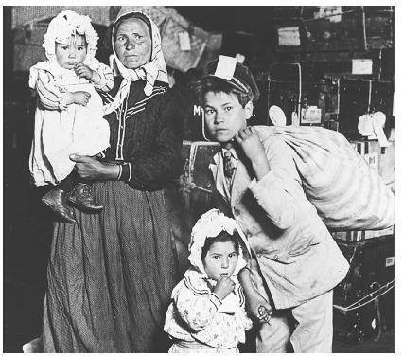
Peasants and Agricultural Workers
Situation in rural Italy worsened under fascism
Mussolini's policies clearly benefited large landowners – agricultural wages dropped by more than 30 % during the 1930s
Many Italians emigrated to escape rural poverty (over 200,000 moved to USA 1920-29)
The Lower Middle Class
Backbone of the Fascist Party – small business owners were hit hard by the Great Depression and by Mussolini’s economic policies; however those who entered the administrative bureaucracy enjoyed relative prosperity
Industrialists and Landowners
Large industrialists and landowners benefited most in fascist Italy – even during the Great Depression, large firms benefited in many ways either through government contracts or IRI
Wealthy landowners flourished under fascism; fascists tried to prevent rural workers to migrate to cities (it kept unemployment high in rural areas – this situation was exploited by landowners in order to cut wages)

Slide 8
What were the main religious policies in Mussolini’s fascist Italy?

Slide 9
The Church
Mussolini was an atheist but he understood he needed to reach an understanding with the church – he presented the Fascist Party as an alternative to anti-clerical liberals and atheist socialists and communists
1929 Lateran Agreements – significant because they ended conflict and bitterness between the papacy and the state; there were 3 Lateran Agreements in all
The government accepted papal sovereignty over Vatican City, which became an independent state and Pope formally recognized the Italian state and its possession of Rome and the former papal states
State paid pope 1750 million Lira
Treaty agreed that Roman Catholicism would be official state religion with compulsory Catholic education in all state schools and sate would pay clergy salaries, no divorce without Church consent was allowed
Catholic Church gave an official backing to Mussolini as Il Duce
Many people regarded the Church as a fascist collaborator (priests would give the fascist salute)
From 1938 on, Church disagreed with fascists on Anti-Semitic policies

Slide 10
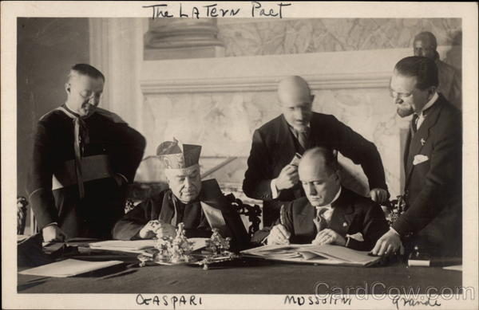

Slide 11
What were Mussolini's policies towards women, ethnic and other minorities?
Women and families:
A group that suffered the most under fascism were women – their status consistently downgraded, especially by the 1927 Battle for Births, which stressed the traditional role of women as housewives and mothers – the goal was to increase the Italian population (for future large army) – to increase population from 40 to 60 million in 23 years
Encouraged early marriage, women should stay home, generous maternity benefits – prizes were given to women who had most children
Taxation policy encouraged large families (bachelors had to pay higher taxes)
1931 same sex relations were outlawed; laws against abortion enacted
Series of decrees restricted female employment – 1933 only 10% of state jobs could be held by women
Despite policies many women were able to retain their positions in the economy – fascist policies failed to meet their target (birth rate actually declined).

Slide 12
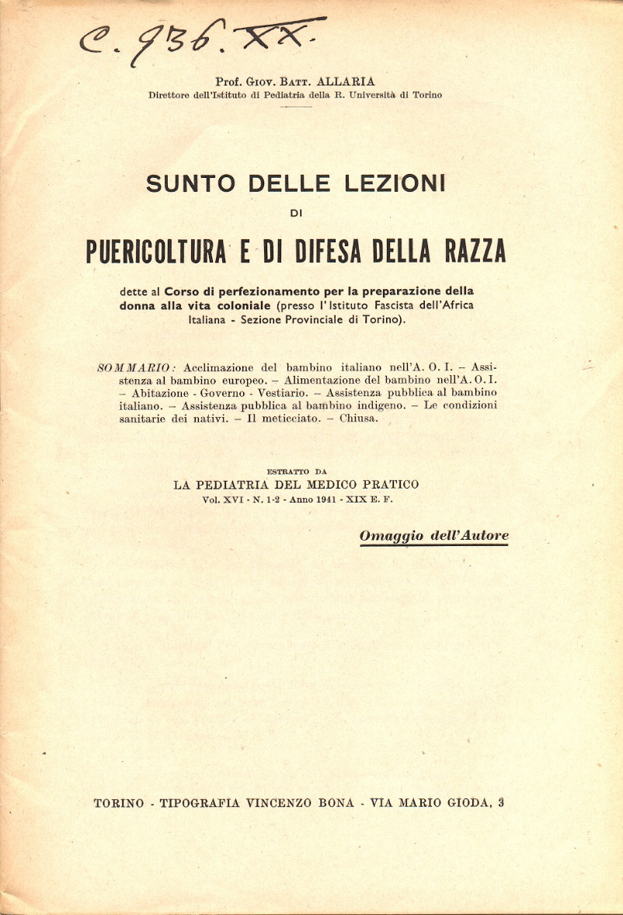
Racism and Anti-Semitism
Racist attitude underlying fascist nationalism and their plans for imperialist expansions (also Romanita Movement) – Italian Race perceived as superior to African races
Until Rome-Berlin Axis anti –Semitism didn’t play a large role in fascist politics; Mussolini even dismissed anti-Semitism as “unscientific”
Some leading fascists were Jewish (30% of Jews were members of the PNF); Mussolini also had a Jewish mistress
1938 Charter of Race – claiming Italians to be “Aryan” –thus saying that Jews were not Italian Race
Charter was followed by series of laws and decrees (Sept. and Nov. 1938) excluding Jewish teachers/children from state schools, banned Jews from marrying non-Jews, and prevented Jews from owning large business and land estates
These laws were never fully implemented and were largely ignored by Italians , and strongly opposed by the Pope

Slide 13
What were main fascist policies on education and young people, and what impact did they have?
Indoctrination as a method – prime importance to younger generations; Mussolini believed they needed to be “fascistised”
Children in schools recited “I believe in genius of Mussolini”, taught that Mussolini saved Italy from a communist revolution
1929 – teachers had to swear in the loyalty oath; textbooks were rewritten
Attempts at indoctrination less successful in secondary education, but fascists did control all textbooks (many were banned)
Youth movements:
1926 ONB (Opera Nazionale Balilla ) all youth groups became a part of it
Some of the groups: Sons of the She-Wolf (Boys 4-8), Balilla (8-14), Avanguardisti (14-18); Girls – Picole Italiane and the Giovani Italiane
1937 ONB merged with Young Fascist to form Gioventu Italiana del Litorio (GIL) membership was compulsory for all young people ages 8 to 21, and all groups had to swear loyalty to Mussolini
Result: not as great as Mussolini intended – many (40%) avoided membership (and Catholic schools did not enforce mandatory GIL membership)

Slide 14
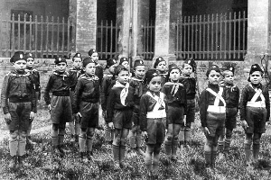

Slide 15
To what extent was authoritarian control established in fascist Italy?
The Main Characteristics of Mussolini’s Fascist State
Initially, Mussolini did not plan to become a dictator; however after the Matteotti crisis, he was pressured to do so (presented with an ultimatum by militant fascists) – Mussolini wanted the dictatorship to be independent of the ras – so it turned out to be personal rather than fascist dictatorship
Declining importance of the Fascist Party
Mussolini deliberately redistricted the influence of the PNF by using non-PNF members to maintain law and order – including police, judicial system, civil service and army
However, he did instigate a purge of the judiciary for lack of loyalty or for being too independent; he frequently intervened in legal cases and imprisonment without trial was common
In the provinces it as the prefects (senior civil servants) who appointed the podesta (local mayors)
The prefects had to be loyal to the government but also had to be local elites – 1922-29 only 29 out of 86 of podesta were fascists; initially ras caused trouble with these developments

Slide 16
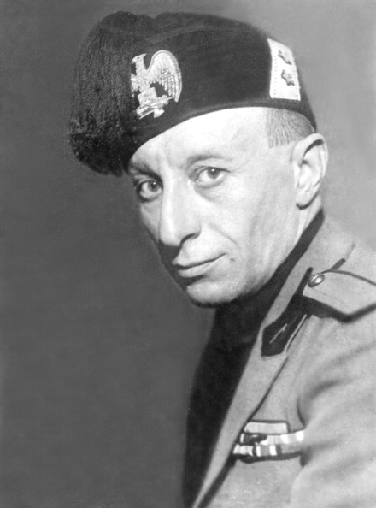
Taming of the PNF
1926, Augusto Turati – became PNF secretary – he began to purge more militant fascists and opened membership to people who wanted to further their career – this led to increased party membership, and many were members of the elite who used to be involved with the liberal government
Many also left the party disappointed with the changes
PNF became a mass party with mostly inactive members, most were white-collar employees
Resulted in gradual weakening of the PNF due to internal divisions
According to a historian Richards Thurlow, there were at least five different factions within the PNF, including the militant ras, and “left fascists”, who wanted to establish corporativist state
Mussolini played the factions against each other to enhance his own power

Slide 17
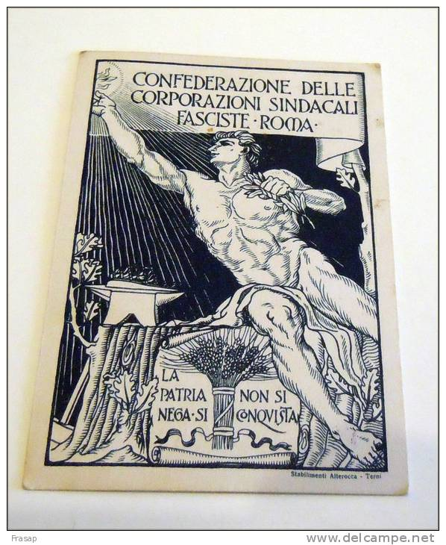
The Corporate State
Fascists who believed that their movement was a “third way” between capitalism and communism favored the creation of the corporate sate
The aim of corporativism was to replace the politics of traditional parliamentary democracy with that of corporations representing the nation’s economic sectors
Those corporations were supposed to overcome “class conflict” and focus on the interests of the nation
There was, however, never a thought of eradicating private ownership

Slide 18
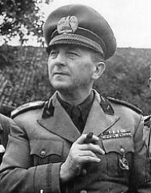
The Fascist Syndicates
Fascists closed down labor movement trade unions and replaced them with fascist-controlled syndicates
Edmondo Rossini – headed Confederation of Fascists Syndicates- he wanted industrialists to give concessions to workers’ demands
Opposed by Confindustria – organization who represented the industrialists
Dec. 1923 – Chigi Palace Pact – industrialist promised to cooperate with the Syndicates but maintaied their own organization
1925 Vidoni Palace Pact – established that workers were not allowed to challenge the authority of employers and managers – all non-fascist trade unions and workers councils were closed down
1926 – Alfredo Rocco’s Law – made all strikes illegal, all industrial disputes had to be settled in special labor courts

Slide 19
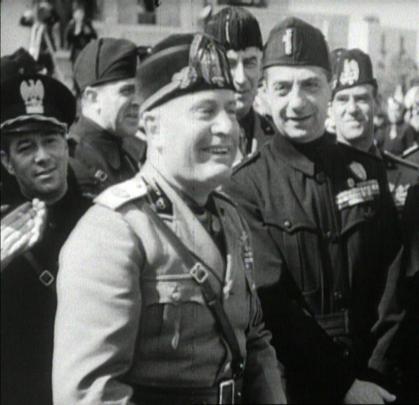
The Corporations
July 1926 – Mussolini established Ministry of Corporations – each corporation was made up of representatives of employers and workers of the same industrial sector, with state representatives acting as referees and final adjudicators
It was run by Giuseppe Bottai
May 1927 - Mussolini said in speech that corporate state had been established
Corporations weakened the fascist syndicates – by 1928 Confederation was abolished and NCC (national Council of Corporations) was created
Despite all reorganizations, Mussolini made all important decisions himself

Slide 20
Was Mussolini an all-powerful dictator?
Despite his claims and control over the PNF – Mussolini had to share power with traditional groups that held power in Italy long before 1922 – these included the monarchy, the Church, civil services and courts, industrial and financial elites
It was the king who ordered Mussolini's arrest on 25th of July 1943 – thus Mussolini ‘s aim to create a completely authoritarian stat was largely unsuccessful

