Slide 1
Involvement of Canada and Mexico (CH. 5) Part II

Slide 2
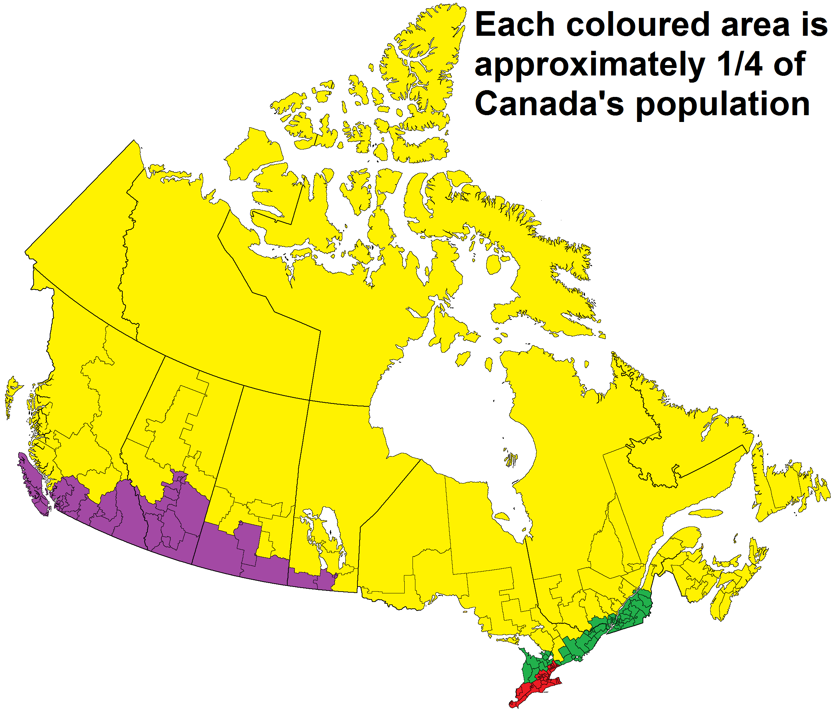
Involvement and Participation of Canada and Mexico in the Second World War
Discuss the economic and political impact of the World War II in one country of the region
What were the results of the Second World War for any two countries in the region?
To what extent were attempts at “hemispheric cooperation” successful before and during the Second World War?
Notes:
Toronto, Montreal, both near the us, are 2 of the 10 largest cities in N. Am.

Slide 3
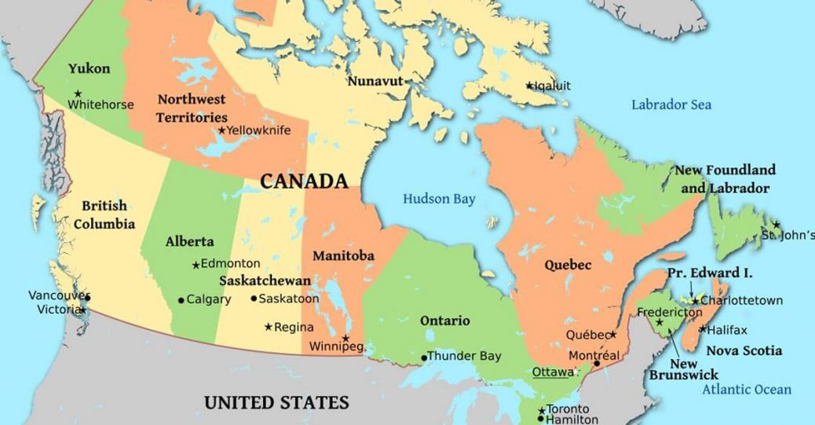

Slide 4
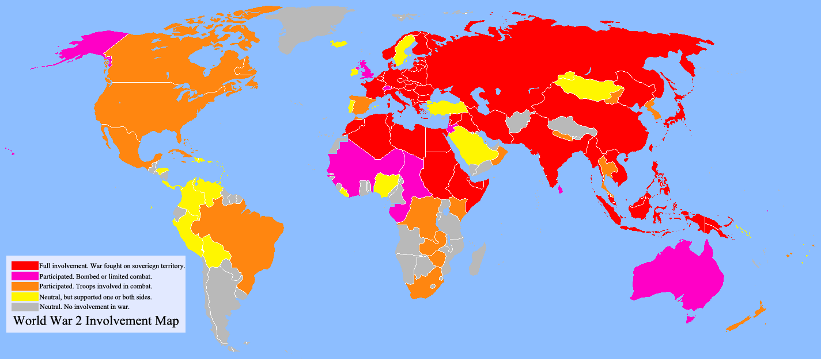
General – Who fought WWII in Americas, Why?
Canada – 1939 – Invasion on Poland
USA – 1941 – Pearl Harbor
Mexico – 1942 – repeated attacks on oil ships in Gulf by U-boats, no apology
Brazil – Aug. 1942 – Seven merchant ships sunk in a week
Brazil and Mexico's participation had significantly less impact than US or Canada
Notes:
Canada – Independent nation – British Monarch was its official head of state, close historical ties – debated for 2 days
Dutch colonies were occupied by US/British forces with approval of Dutch govt in exile (ABC’s dutch suriname)
French colonies originally supportive of vichy gov’t, later supported DeGaule’s Free France as tide of war shifted, nazi racial policies became clearer
(French Guyana, Martinique)

Slide 5
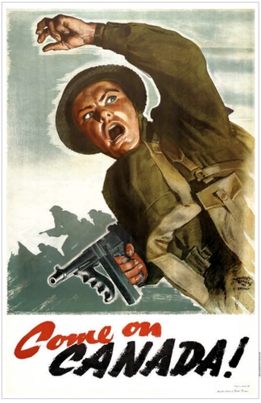
Canada in WWII Fought predominantly in Europe, but also in Asia, and Alaska
Population 12m – 1m served (8%)
US Comparison – 132m – 16m served (12%)
Navy
Started with 15 ships, 1800 personnel
467 ships, 100,000 personnel by 1945
Worlds 4th largest surface fleet
Notes:
Started with 15 ships, eventually would have 400 – mostly small destroyers, corvettes for convoy duty – Win Battle of Atlantic
Industry built 400 surface ships – 25,000 trips across Atlantic during war – feed and supplied allies in Europe (esp. UK)

Slide 6
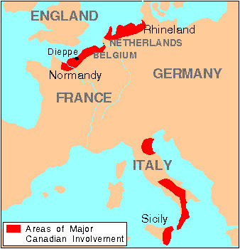

Slide 7
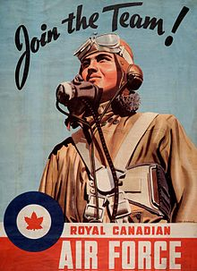
Canada in WWII
Airforce (RCAF)
Had 19 modern aircraft in 1939
1945 – had produced more than 16,000 aircraft
3rd largest air force
major training facilities for all commonwealth nations
Trained 50,000 pilots, + 80,000 crew during first years of war
Eventually 232,000 men, 17,000 women served
17,000 die in battle
Notes:
Airforce was primary service, then Navy, lastly army

Slide 8
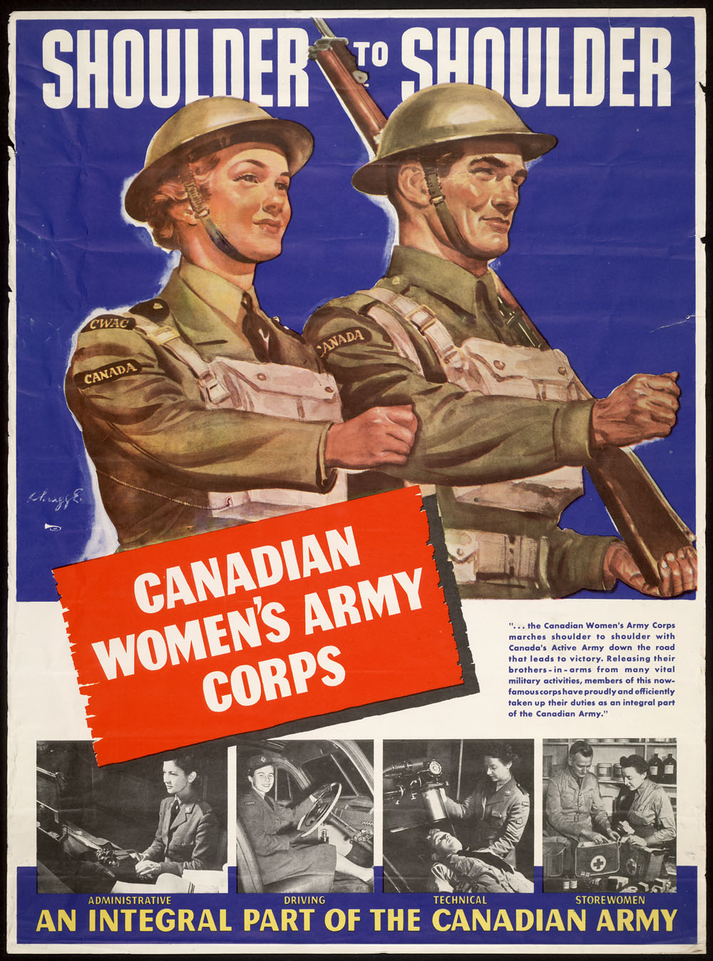
Canada in WWII
Army
5000 well-trained soldiers in 1939 + 16 light tanks
1945 - 700,000 men + 15,000 women
Notes:
King had tried to keep the Canadian Army out of action to avoid casualties that might require a difficult decision on overseas conscription, but in the spring of 1943 with the Allies clearly winning the war, he was seized with the fear that the war might end with Canada winning no battles on land, something that was certain to hurt his party in post-war elections.^{[41]} Accordingly, King demanded that the 1st Canadian Infantry Division, which had been sent to Britain in 1939, be included in Operation Husky, the invasion of Sicily

Slide 9
Canada in WWII – Preparation
1939 – little military spending due to depression
War initially unpopular – soldiers had option to stay home – National Defense Force
Canadianization – fight with British, but control own army, navy, air force
1941 – fears of conscription, 250,000 volunteers + 2000 women
Almost entirely from English Canada
Notes:
1917 Conscription Crisis – almost all French Canadians refused Military Service Act– after battle of Somme – Catholics, speaking different language, being controlled by English speaking protestants.
45,000 men at start, mostly outdated equipment
Mackenzie King had displayed what the Canadian historian Colonel John A. English called "an abiding aversion to conscription" and "an apparently unshakable conviction in appeasement" as he regarded another world war as "the ultimate catastrophe" for which no price was too high to avoid.^{[4]} In 1935, King had been opposed to sanctions on Italy for invading Ethiopia, in 1936 he had stated that Canada would not take part if Britain decided to take military action in response to the German remilitarization of the Rhineland and in 1938 he had warmly supported the Munich Agreement as the necessary price for peace
King even went as far to say privately that the Poles were at fault for starting the war by not giving the Germans Danzig.

Slide 10
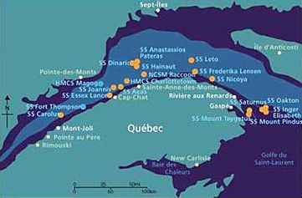
Canada in WW2 – Battle of the Atlantic
German attempt to starve Britain into submission
Canada proved pivotal in keeping British morale from collapsing
1939 – 6 destroyers
1945 – 471 warships, 100,000 sailors
Sank 33 U-boats during battle
Many loitered outside St. Lawrence Seaway (Atlantic Gulf) – gateway to Montreal
More shipping from this one city than all on Canada’s Eastern seaboard, combined.
Germans kept about 25% of all materials from arriving
Sank about 100 Canadian ships, killed 3600 Canadians
Ships sunk by U-boats ‘42-’45 in Gulf of St. Lawrence
Notes:
Montreal- key city in industrial heartland of Canada – shorter run than NYC to Liverpool
In Montreal alone…
Canadian Vickers, Noorduyn, and later Canadair, built aircraft. Railway’s produced Valentine tanks and self-propelled guns. Employees at Canadian Vickers and United Shipyards built and repaired warships and cargo vessels.
Other factories produced essential supplies ranging from uniforms to ammunition. Including 1.5 billion bullets
6-8 mins
How did Canada assist in the battle of Britain?
23:00-32:30
Why were the convoys so important? Provided supplies Britain depended on for its survival – food, phosphate's, ammunition.
What tactics did Canada use to defend them? Convoys, rows of merchant ships protected by warships
What dangers did they face? Cold, uboat wolfpacks,

Slide 11
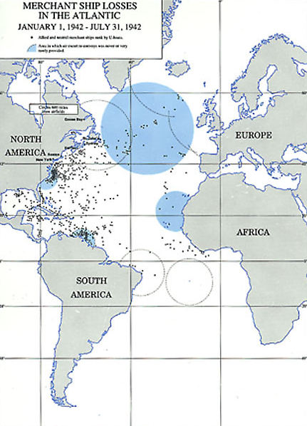
1943 Convoy Conference – Halifax become Canadian NW Atlantic Command
Canadian Navy – responsible for patrolling north of NYC – only area of operation commanded by Canadian (Rear-Admiral Murray)
Helps establish Canada as junior member of Grand Alliance
“Progress was made against the submarine only by cooperation between the US, British, Canadian, and Brazilian navies” Ad. Morrison
Notes:
Green circles indicate air coverage from bases, blue indicate area with little coverage
US wanted to delegate so it could focus on the mid atlantic route and patrols

Slide 12
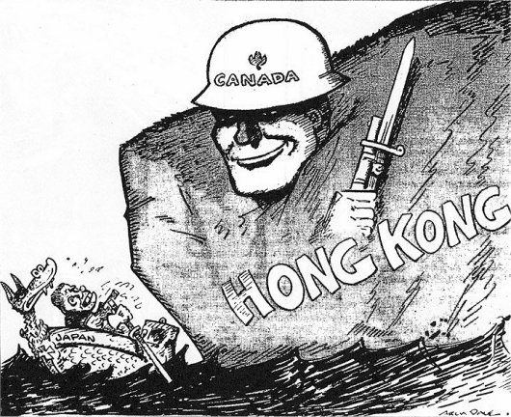
Canada in WW2 – Hong Kong (Dec. ‘41)
British Colony in China
Nov. 1941 – 1,975 Canadians boost defense of island (20,000 British stationed)
Overwhelmed, abandoned by British leadership – Dec. 25 1941
Many Quebecois felt Britain had abandoned their forces, sparked outrage in French Canada
Canadian propaganda expecting easy victory over Japan – instead nation felt betrayed by British surrender of the island
Notes:
Play video – 2:00-4:00, 45:30-47:00 about 300 Canadians killed in combat, another 300 die in Japanese prison camps – malnourishment, disease, torture.

Slide 13
Canada In WW2 – Dieppe raid (aug. 1942)
Major failure for Canada/Allied forces
Attempt to see if a latter major landing would be feasible, collect intelligence, destroy German defenses, lure Luftwaffe into battle
Failed on all accounts
Egged on by Stalin – rapidly losing territory to Germany.
5000 Canadians land in coastal town
900+ killed, 2400+ wounded, nearly 2000 taken prisoner – all in 10 hours
Fiasco proved allied forces would not be landing in France anytime soon
Lessons learned would be utilized at Normandy landings
Notes:
https://www.youtube.com/watch?v=N7dY2X2oD7I play to 10:30
What was the plan? For what reasons did it fail?
Canadians thought they were being under utilized by British strategist, emphasized their superior training.

Slide 14
Dieppe Failures
Lost element of surprise by firing on German ships
Poor landing site, guarded by high cliffs
Poor communication
Notes:
German smokescreens forced bombers to call of their attack of the beach fortifications
RCAF lost 13 RAF lost 106 aircraft – highest single day loss for both

Slide 15
Canada in WW2 – Italy (July ‘43-Feb. ‘45)
1943 - Dispatched to N. Africa – participated in landings of Sicily(July), Italian mainland
Sept. 3 Italy surrenders, Germans take over defense
Long singular battle, unlike Hong Kong, Dieppe
Fought for 20 months, city by city, mountains
Left before final surrender, relocated to Northern Europe
Notes:
2-8:30 minutes
In what ways did Canada assist allied forces in Europe?
What challenges did they face?

Slide 16
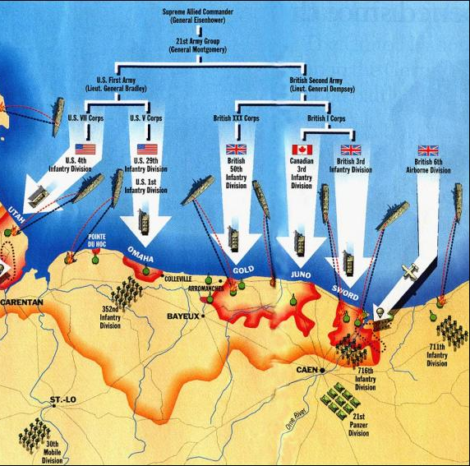
Canada on D-Day (June 6 ‘44)
RCAF participated in inland bombing runs to soften beachheads
Paratroopers land to assist amphibious landings
Take bridges, roads, knock out com., artillery positions
Juno Beach – pushed further inland than any other landing force on D-Day
Navy contributed 131 warships to the armada (destroyers, frigates, landing ships, minesweepers, torpedo boats)
Naval bombardment practically left beach fortifications intact
Assault Brigade – Royal Winnipeg Rifles, suffered heavy casualties
Queen’s Own Rifles – faced most tenacious defenses, suffered highest casualties
340 Killed, 600 wounded, captured
Notes:
4-6 minutes

Slide 17
Canada – D-Day Historian’s Perspectives Why were landings difficult? Why were they so successful?
John Keegan "the prevailing low, thick cloud frustrated its [Bomber Command's] efforts“
Colonel Stacey—the official historian of the Canadian Army in the Second World War—considers the effects of the bombing runs to have been "spotty“
British historian Max Hastings notes that because of the delay in landing times by ten minutes, a substantial gap existed between the cessation of bombardment and the actual landing of the first waves of infantry, meaning that platoons of the 716th had ample time to return to their positions.
Mark Zuehlke "the Canadians ended the day ahead of either the US or British divisions despite the facts that they landed last and that only the Americans at Omaha faced more difficulty winning a toehold on the sand", suggesting that the caliber of the training the 3rd Canadian Infantry Division had received beforehand explains their success.

Slide 18
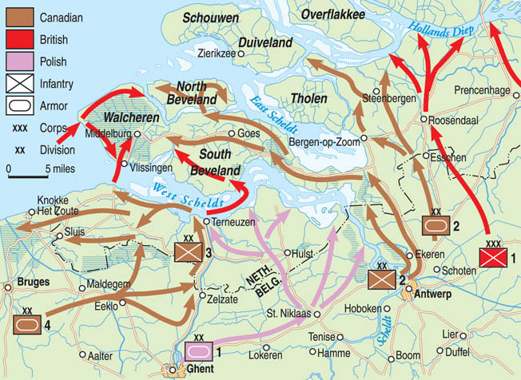
Canada WW2 - Battle of the Scheldt (Oct. 44)
Mission – to take important Belgian/Dutch Ports
Well fortified German positions along Scheldt estuary
Reclaimed land was flooded by German’s busting dams making advance difficult
5 weeks of bitter fighting end in Canadian victory
Sign. – shortened supply lines to sea, gave allied access to large port facilities
Notes:
Antwerp, Rotterdam, Amsterdam
13-16 minutes
Characteristics of the fighting of the Scheldt?

Slide 19
Canada in WWII – Second Conscription Crisis
PM – Mackenzie King resisted conservative urging of new conscription act
In 1942 plebiscite was held to release government from “no conscription” pledge
70% of Canadian approved, only 20% of Quebecois
Enough volunteers were found until 1944
High casualties in Italy, France, Low Countries put pressure on gov’t to impose conscription
Nov. 1944 – gov’t authorized 16,000 conscripts to go abroad
Only 2500 conscripts saw action before war ended
Canadian effort was almost entirely a volunteer force
Notes:
Easter Riots in 1917 – 105 casualties, $300,000 in damage
1940 Mobilization Act – allowed for forced recruitment into industries, home defense only – King adamantly opposed conscription.
Zombies – those recruited under the mobilization act, who defended Canada – home defense, esp in B. Columbia, ran Japanese internment camps, but did not fight overseas – resented by most officers and volunteers who did fight overseas.
Because Quebec voted no, King refrained from conscription until necessary.

Slide 20
Canada IN WW2 – The End of the War
Canadian forces were responsible for liberation of Netherlands
Assisted in defeat of Germany
Asia – assisted US forces in retaking Attu and Kiska in Alaska
Notes:
King used the “Home defense” Battalions. Argued it was part of the continent, so soldiers were defending Canada. Nearly all conscripts, landed on Kiska after Japanese evacuated the island.
Biggest battle these men fought was with the “Tax Man” If they could prove they were overseas their pay would be tax exempt. They were on other side of international dateline so argued they were in Asia, government did not see it that way, they paid their taxes.

Slide 21
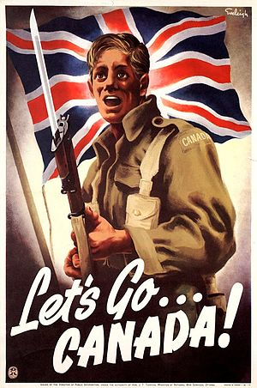
WWII – Results for Canada
Government spending – $118 million in 1939
$4.6 Billion in 1945 or 40x fold spending in 6 years
42,000 died in war, + 54,000 casualties
Conscription Crisis – highlighted tension between French/English speaking regions
Came out of war with one of most modern, advanced, efficient economies in the world
Industry recovered from G. Depression
Country itself untouched (minus a few U-boat raids)
Considered important due to large navy and airforces
Consolidated idea of a national identity – regardless of language, ethnic backgrounds

Slide 22
Mexico in WWII- Background
Tried to remain neutral in early stages of the war
Germans became more aggressive in gulf waters, Atlantic – Mexico began to side with U.S.
Late 1930’s - Populist Pres. Cardenas – supported U.S. efforts to support British, ousted German agents in 1940
Replaced by Avila Camacho in ’40 – even more anti-fascist
Argued Nazi racism would certainly oppress indigenous/mestizo populations in Hitler dominated world
1941 – Reciprocal agreement – mutual defense, equal use of U.S./Mexican airbases
Aug. 1941 – Mexico closed all German consulates, recalled Mexican diplomats from axis controlled countries
Nov. 1941 – Mexican oil issue resolved, Mexico offers sale of any strategic materials
Notes:
There was some support for Axis, mostly rooted in anti-Americanism, resolution of oil expropriation, bracero program, good neighbor polciies would help alleviate this support.
Aug. 41 – Cardenas removed all Mexican diplomates from axis held states, was first country in LA to cut all ties with axis, was vocal proponent of all Pan American countries doing so.
Us guaranteed long term purchase of Mexican silver, issues $40m loan to mexico, both of these were an ecomomic boon to the country.

Slide 23
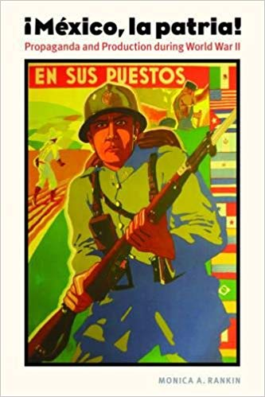
Mexico in WWII – Pearl Harbor (Dec. ‘41)
Policy – remain neutral unless directly attacked
9000 Japanese Mexicans in Baja California forced to relocate
Became one of largest supporters in Pan-American Union of severing ties with Axis (Jan. ‘42)
Avila Camacho saw war as a way to unify his population
Catalyst for economic nationalism
Show patriotism through increased productivity
Yet Mexicans remained reluctant to get involved
Notes:
Provided 40% of all raw materials in US manufacturing
En sus puestos – To your post

Slide 24
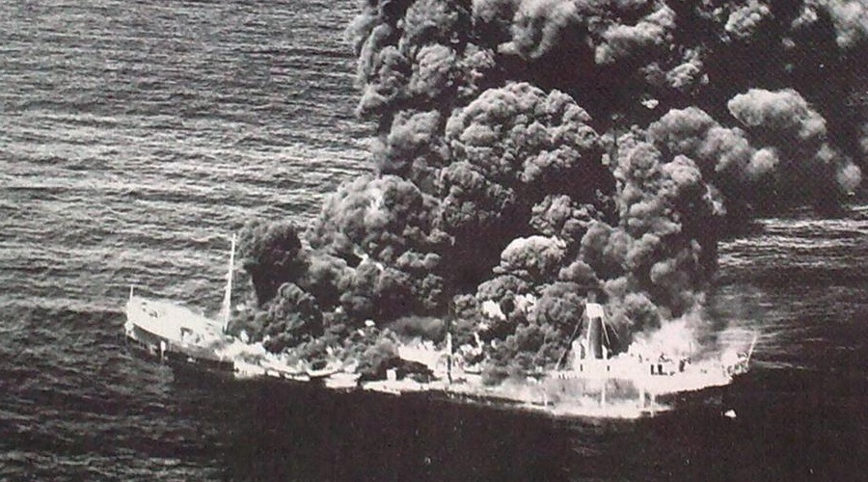
Why Mexico Entered WWII?
May 13th, 1942 - Potrero del Llano – Mexican oil tanker sunk by U-boat – 13 killed
Mexico demands apology and compensation
Germans reply by sinking another ship a week later, killing 7
Notes:
Potrero del llano
SS Faja de Oro was sailing in ballast from Pennsylvania back to Tampico when she was sighted and sunk by U-106 on the 21 of May.
Quickly found secret uboat radio tower in mexico, and stopped its broadcast.

Slide 25
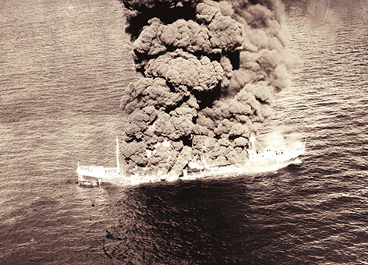
Why Mexico Entered WWII?
Mexican opinion rapidly changes, Camacho calls for delaration of war
But would not commit its military to fight in European theatre
Notes:
Mexican society was skeptical of this war, Camacho convinced them that this would be their fight – focused on morality of fighting fascist racist regimes.
15,000 would eventual fight in many different theatres

Slide 26
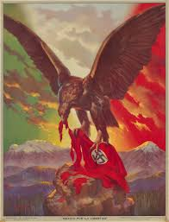
Mexico IN WWII
Camacho called a state of emergency, limited freedom of press, argued German was strong enemy due its national unity, calling on Mexicans to also nationally unify
Navy Patrolled Gulf of Mexico
Notes:
Many Mexicans volunteered and joined the US armed forces, These participants can be numbered in the thousands; round 1
15,000 Mexican nationals served in the U.S. military during World War II, many of whom may have been motivated by the offer to apply for U.S. citizenship in return for their service. Of these, some 1,492 are believed to have been killed, imprisoned, injured or disappeared.
300,000 worked in US industry – most sending remittances – money back to their families in mexico
Counterintelligence information was freely shared by officials from the US and Mexico.
As a result, the spy rings that had been working from Mexico with the intent of sabotaging US vital installations were rounded up and put in prison.

Slide 27
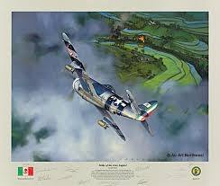
Mexico IN WWII – Esquadrón 201
Threat of Japanese invasion subsided after U.S. victory at Midway (1942)
Intensive training and preparation subsided.
Only one service would see overseas combat – Esquadron 201 – Aztec Eagles
300 men trained in U.S. airfields
Flew 59 missions in the Philippines, assisted in taking of Luzon in Philippines, Formosa
Sign. – increased domestic support for the war
Contributed to sense of national identity
Hoped this would give them a voice in post-war settlement
Did not seek territory, or reparations, hoped to improve relations with U.S.
Notes:
left Mexico for final training in the US (texas) in July 1944, with a total of 300 volunteers of which 30 were pilots and the rest were ground crews. Became an achieve of pride for Mexican Nationalism.
attached to US 58th Fighter Group based at Luzon.
7 Mexican active combat soldiers die in ww2, gave legitimacy to being part of the countries that would create a new world through a series of post war conferences.
they flew 795 combat sorties and logged almost 2,000 hours of flying time, including conducting bombing missions over Luzon and Taiwan and providing support for U.S. airmen. Seven pilots from Squadron 201 died in the conflict;

Slide 28
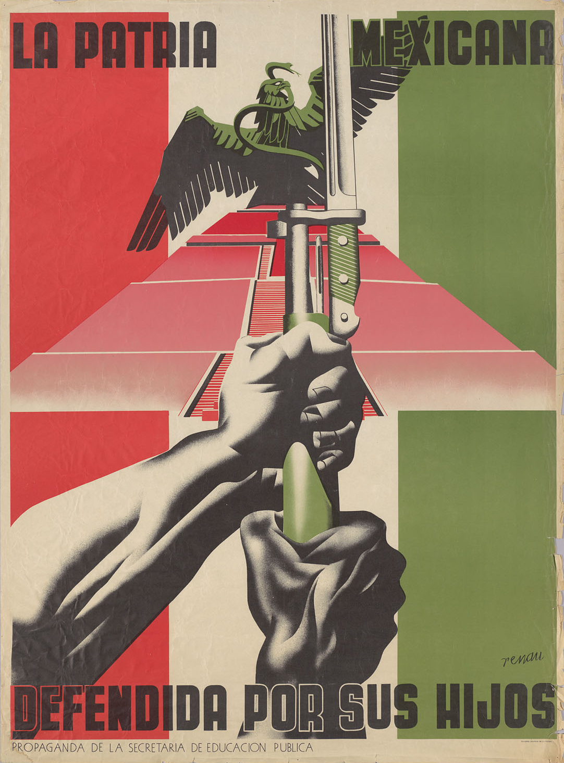
Mexico IN WWII – Results
Esquadrón 201- distinguished itself in the 6 months that it fought in Asia
War put Mexico on path towards industrialization
Negatives
Large contracts, limitations of freedoms lead to corruption
Mexico became more dependent on U.S.
High inflation due to shortages, shipping cost, rising prices.
Notes:
The Mexican fatherland defends/fights for its children.
Mexico signed the United Nations Charter and the following year, it became the headquarters of the Inter-American Conference about War and Peace
The Cardenas government was able to help create friendly relations with US. The United States provided Mexico with financial aid for improvements on the railway system and the construction of the Pan American Highway.
provided more strategic resources to the United States than any other Latin American nation, including vital minerals such as copper, zinc, mercury, cadmium, graphite and lead. To do this, it underwent a period of industrial and economic development during and after the conflict that became known as the “Mexican Miracle.” – national income triped, wealth inequality also grew

Slide 29
Historian Rankin on “Mexican Miracle”
“Mexico got a lot of aid from the United States to develop industries that were vital in helping to support the war, and those industries stayed once the war was over,” she says. “There's a lot of infrastructure development and creation of industry that becomes a fundamental part of Mexico's economic growth in the second half of the 20th century that has its roots in World War II.

Slide 30
Canada in WW2 Video
https://www.youtube.com/watch?v=PqhdrIQYVXo

