Slide 1
World War II in the Americas (ch. 2)
Paper 3 topic

Slide 3
Old Paper III Questions
1. 'By December 1941, the United States was a belligerent in all but name.' Comment on this statement with regard to United States foreign policy in the decade before Pearl Harbor.
2. “The Second World War greatly transformed inter-American diplomacy and economic interaction in the years 1939–1945.” To what extent do you agree with this statement?
3. To what extent were attempts at “hemispheric cooperation” successful before and during the Second World War?
Notes:
Unpack each question. Define terms, contextualize question. Scope? Organize?

Slide 4
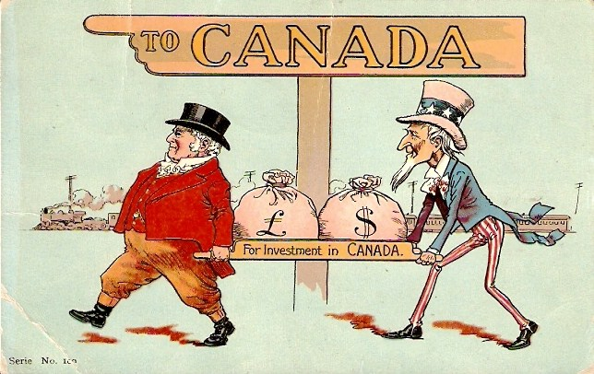
Global Context Of Americas in WWII
Americas F.P. was oriented inward during 1930’s
Dealing with Great Depression
Canada – the most international – focused on trade with U.S. during this period
Britain no longer dominate in its F.P., though was first American country to declare war in support of Britain
Americas otherwise neutral (through Barbarossa) until attack on Pearl Harbor
Limitations US - Lend Lease, Atlantic Conference - 1941
From 1900-1914 Canada had world’s fastest growing economy in part due to U.S/U.K. investment
Notes:
“Bell of the ball”

Slide 5
A Short (un-neighborlike) History of the U.S. in the Americas
Monroe Doctrine (1823) – Guiding Principle of U.S. Policy in Americas
Efforts by European nations to take control of any independent state in North or South America would be viewed as "the manifestation of an unfriendly disposition toward the United States.” (US REGIONAL HEGEMONY)
U.S. will use military force to stop Europe from asserting itself -Roosevelt Corollary (1904)
Crash Course – Imperialism
https://www.youtube.com/watch?v=QfsfoFqsFk4
Notes:
James Monroe referred to these principles in his inauguration speech
Filibuster William Walker overthrew the gov’t of Nicaragua created Southern supported slave empire, was executed in 1860
US War with Spain 1898 – Took P.R./ hegemonic power over Cuba
Panama
Gunboat diplomacy 1903 – spark civil war in colombia, support rebels in exchange for canal zone.
Violations of Monroe Doctrine
– French empire in Mexico during US Civil War
German designs with Mexico during WW1
The existence of British controlled Canada until 1930’s

Slide 6
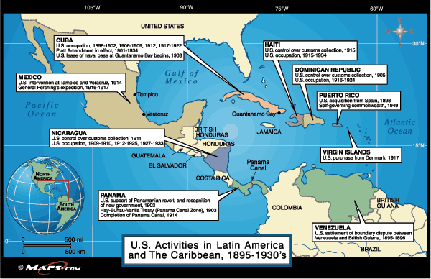

Slide 7
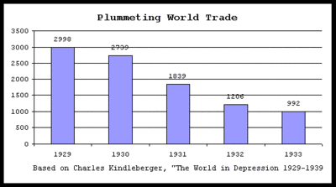
1920’s
Hoover tried to improve U.S. relations with region – Failed
Wall St. Crash, Great Depression, Smoot-Hawley Tariff

Slide 8
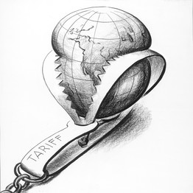
Smoot-Hawley Tariff- 1930
US protectionist law raised duties on over 20,000 goods
Meant to protect U.S. agriculture and industry from effects of G.D.
Many economist and historians argue its effectiveness – other countries also raised tariffs in response – prolonged global depression?
Reciprocal trade agreements latter lessened the impact.

Slide 9
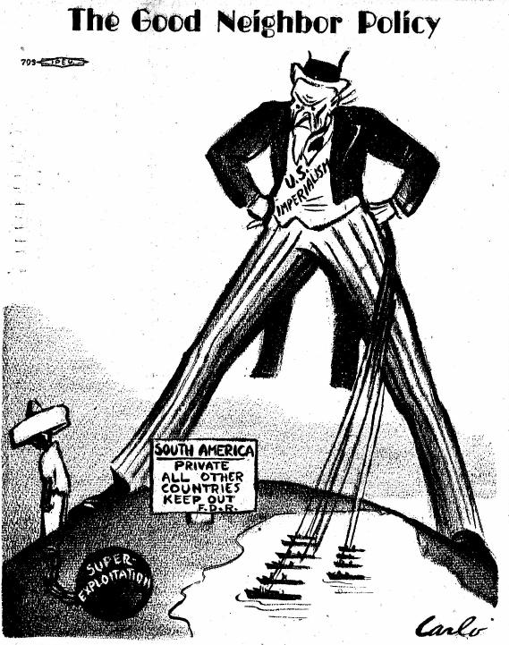
Good Neighbor Policy (1933)
FDR also wished to improve relations – Presidential inaugural – U.S. would become “good neighbor”
U.S. would not intervene unilaterally in L.A.
Montevideo Convention on Rights and Duties of States
19 countries (U.S. included) signed – asserted sovereignty of nations in region
S.o.S. Hull – “no government need fear any intervention on the part of the U.S.”
Notes:
Shortly after hitler becomes chancellor, Reichstag fire
FDR was famous for being an anti-imperialist
Open up trade relationships
Secure the panama canal
Stop the the spread of fascism in L.A.
Good Neighbor Policy - Definition “non-intervention and non-interference in the domestic affairs of Latin America. ”
US troops quickly left Haiti, DR, Nicaragua.

Slide 10
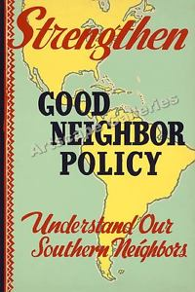
Good Neighbor Policy
Abrogated(repealed) Platt Amendment – Cuba could now control its own affairs
Cuban Dictator – Ramon San Martin comes to power – U.S. doesn’t send troops
U.S. marines leave Haiti, Nicaragua
Also renegotiated Panama Canal Treaty
No more right to seize land, control politics
Notes:
1933 - Ramon Grau San Martin takes power in Cuba – US does not engage military, instead follows policy of non-recognition – confirming new policy
Platt Amendment – conditions in which had to be met before US would let Cuba be independent – prohibited the Cuban Government from entering into any international treaty that would compromise Cuban independence or allow foreign powers to use the island for military purposes. The United States also reserved the right to intervene in Cuban affairs in order to defend Cuban independence and to maintain “a government adequate for the protection of life, property, and individual liberty.”

Slide 11
Platt Amendment abrogateD (1934)
Signed 1901 – After Spanish-American War
Conditions that must be met before Cuba could be an independent country
Cuba could not sign treaties that would compromise own independence
US reserved right to intervene in Cuban affairs
Lease bases on island to US in perpetuity – Guantanamo Bay
Used in 1906-1909 US occupied Cuba when its gov’t collapse to prevent fighting on the island
Historian Louis A. Perez Jr. has argued that the Platt Amendment resulted in the conditions it had hoped to avoid, including Cuban volatility
Notes:
Us still gives cuba 4,000 dollars a year for leasing the base, castro used to stuff all of the uncashed checks in his desk.

Slide 12
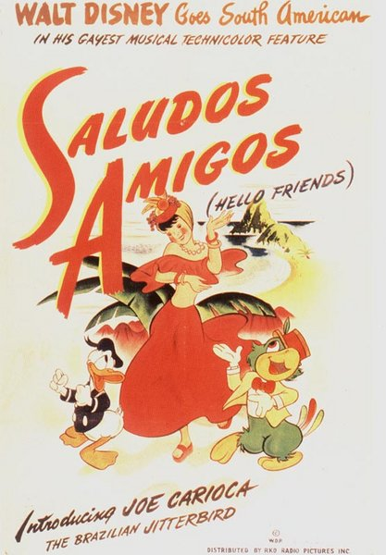
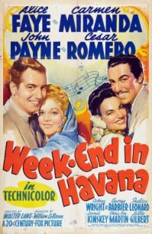
Good Neighbor Policy
1936 – Buenos Aires Conference – U.S. will not use force to protect business interest
U.S. would use political pressure, non-recognition of states
Reciprocal Trade Agreements – U.S. lower tariffs/duties with specific country in exchange for trading rights.
Ex. 90% of Brazilian exports became duty free, U.S. became largest trading partner of all L.A. countries (except Argentina)
Declaration of Solidarity of America - at the Eighth Pan American Conference in Lima, 1938 – 21 American republics agreed they would continue to cooperate, work to defend each other against all foreign interventions.
Notes:
Peace w LA so important to FDR he organized the B. Aires Conf. spent a month visiting S. Am.
Argentina had duty free export of meat and cereals to Britain, in exchange would receive duty free British Goods
Week-end in Havana, Down Argentina Way, That night in Rio – 20th C. fox movies produced to help assist FDR to showcase latin America lush landscapes, vibrant cultures, build friendly relations to keep much needed resources away from Axis powers in WW2
US State Department commissioned Disney good will tour throughout latin America, provided loans to movie producers
Non recognition – removing embassies and consulates, refusing to deal with country

Slide 13
FDR at Buenos Aires - 1936
According to Roosevelt, for what reasons should the Americas work together? Give 3
“Three years ago, recognizing that a crisis was being thrust upon the New World set an example to the whole world by proclaiming a new spirit, a new day, in the affairs of the Hemisphere. You who assemble today carry with you in your deliberations the hopes of millions of human beings in other less fortunate lands. Beyond the oceans we see continents asunder by old hatreds and new fanaticisms. Can we, the Republics of the New World help the Old World to avert the catastrophe which impends?
Yes, I am confident that we can.”

Slide 14
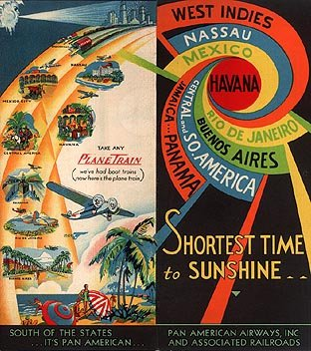
Good Neighbor – Limits
Argentina still closely aligned to UK, Germany
American economies became reliant/connected to U.S. economy
Directly and indirectly supported pro-US dictatorships such as those in Nicaragua, Dominican Republic, and Cuba
Notes:
US run Pan American Airways begins to link American business interest, tourist with LA – links countries together

Slide 15
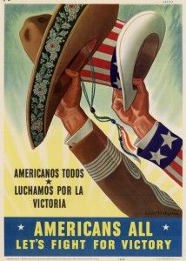
OIL and Good Neighbor Policy
Nearly broke “Good neighbor” but eventually resolved
Mexico and Bolivia both had large reserves owned by foreign companies such as Standard Oil
Bolivia confiscated Standard Oil’s assets w.o. compensation
pretext was that the company was illegally selling to Argentina
U.S. then stopped providing all bank credit
Eventually U.S. received 1.5m for the company’s loss - 1940
Notes:
FDR took no aggressive actions even though US oil companies heavily pressured him. Showed he would keep his Montevideo conference promise. – the us would not interfene in domestic affairs of American nations

Slide 16
American Cultural Exchange
U.S. wanted to promote positive portrayal of itself throughout hemisphere
Wanted to negate pro-axis sentiment in region by
tourism via passenger ships between U.S. and Arg./Brazil/Uruguay
Cultural exchange/understanding
Motion pictures, radio, press portraying L.A. culture positively
Debate - Was the U.S. being benevolent? Or only self interested?
Peruvian leader Raul Haya de la Torre – The U.S. was “the good neighbor of tyrants”
Just another way to maintain regional dominance?
Many dictatorships were allowed to form in this region before 1939
U.S. historian Peter Smith – “golden era of U.S. relations with region”
Notes:
US government subsidized Hollywood movie producers who made movies that encouraged cultural sharing in the Americas.
State department created a “cultural division” focused on LA
- Time magazine published in Spanish, Portuguese
Limits -
US support for Trujillos, Vargas (Brazil) Somoza (Nicaragua) regimes in order to support stability/unity in the region

Slide 17
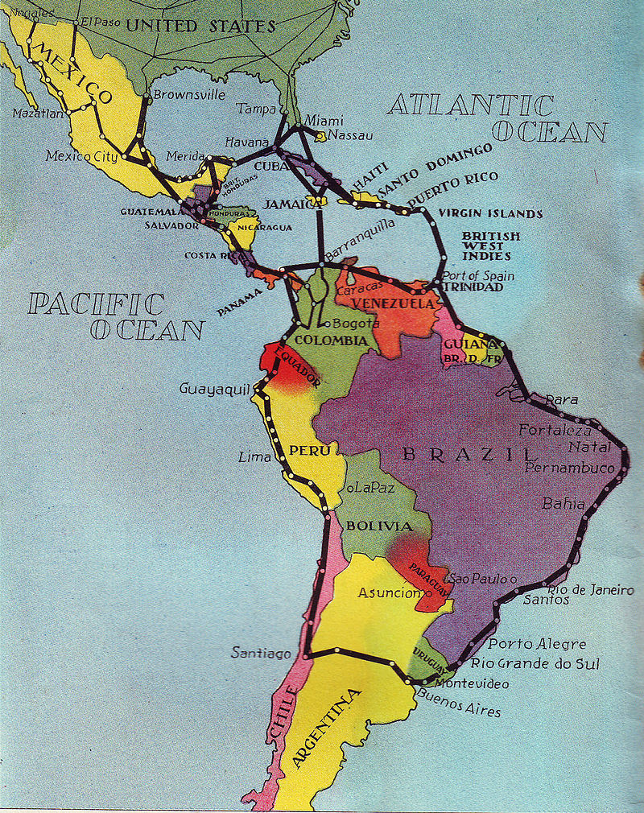
Pan American Airways
Largest US international airline carrier for many years
Catalyst for inter-American economic/social/political integration
Originally created to counterbalance German carrier in Colombia - 1927
Worried that control of airbases and planes could lead to German control of skies near Panama Canal
US government and others gave large contracts to business creating near monopoly in L.A.
1936 Routes
Notes:
Colombian-German Air Transport Society- worlds second commercial airline company, first in Latin America, greatly weakened by US LA policies by start of WW2
St. Pete – Tampa line Jan 1 1914

Slide 18
Canada – Independence Timeline?
July 1 1867 – Dominion (self-governing within British Empire)
1931 Statute of Westminster – British parliament can no longer legislate for Dominions – become equal Commonwealths of British Empire (can still make “request” in Canada's constitution)
1939 – First American country to declare war on Axis
1982 – total independence – with British Crown as head of state
Notes:
Canada dominion model – “responsible government” – first example of “devolution” peaceful gradual independence
- Sets precedent for other colonies gradual move towards independence.

Slide 19
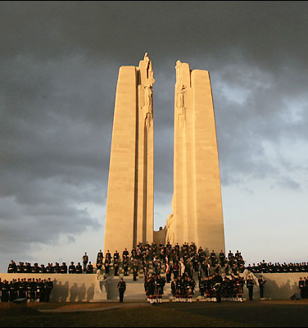
Canadian-American Diplomacy
Before WWI – Canadian F.P. was subordinate to the U.K.
Significantly changed during interwar period
Mostly due to Battle of Vimy Ridge
Canadian divisions overran German strategic position, created a sense of national unity and earned a seat at the Paris Peace Conference and within the League
By 1920’s it was in control of own F.P. and military affairs
Codified by Statute of Westminster – dominions of Canada/Aus./N.Z./Ireland/S.A. became commonwealths – “equal in status but closely related to the mother country”
Notes:
Canadian vimy ridge memorial –
Brigadier-General A.E. Ross declared after the war, "in those few minutes I witnessed the birth of a nation.“
became a Canadian national symbol of achievement and sacrifice. France ceded to Canada perpetual use of a portion of land on Vimy Ridge on the understanding that Canada use the land to establish a battlefield park and memorial

Slide 20
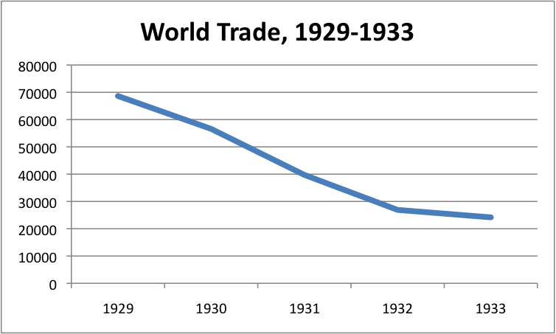
Canadian-American Diplomacy
U.S. instead of U.K. now became primary trading partner
Logical, less expensive
U.S. provided manufactured goods for resources
G.D. and Smooth-Hawley tariff resulted in Canadian tariffs on U.S. goods
Trade dropped by 75%
Reciprocal Trade Agreement resolved some, but not all of trade conflict

Slide 21
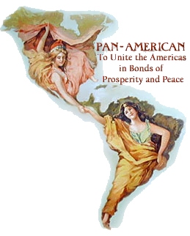
Canadian Diplomatic Challenges
Pan American Union – 1890 - Canada denied entrance into “League of Nations for America” by U.S. veto – invoked Monroe Doctrine
Canada was not an independent republic
Canada’s trade in L.A. amounted to 2-3% of its total trade
Wanted to remain deferential to British interest in the region
Notes:
Will later be allowed into successor organization OAS (Org. of American States) – 1972
US scared of Canada as a British backdoor into the Americas.

Slide 22
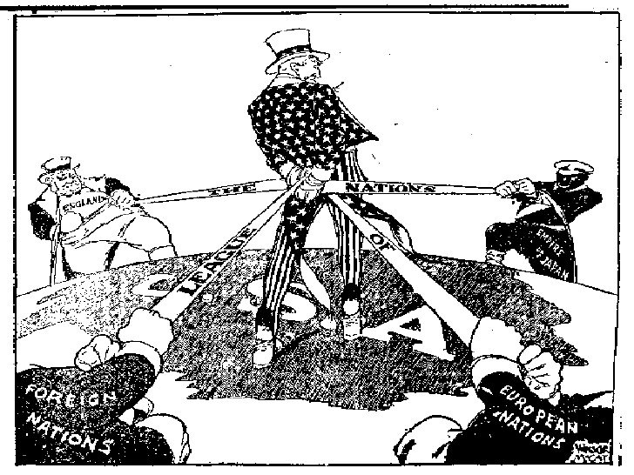
The Americas React to Europe and Asian Conflicts
Would eventually be drawn in during the ‘30’s
US – not part of League but heavily influenced the League’s decisions
What would happen if U.S. policy conflicted with League’s decisions?
World Conflict was Secondary – most concerned about suffering of own people, not Europe/Asia
Notes:
15 of the countries were drawn into Europe’s problems as part of the League of Nations

Slide 23
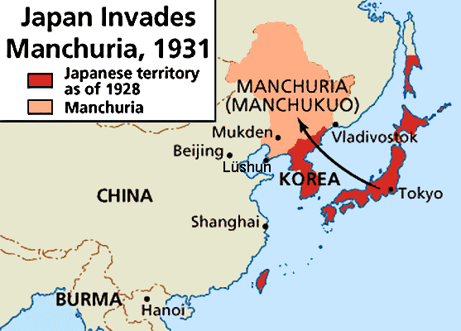
The Americas React to Europe and Asian Conflicts
Manchuria Crisis(1931) – US pushed for League’s intervention
US refused to recognize it as Japanese territory – non-recognition
Diplomatic disapproval – swayed League to form Lytton Commission
USA appointed a member – Frank McCoy to serve on League commission
Notes:
“Stimson Doctrine” – us would not recognize changes imposed by force – refuse to respect any treaties made through force, would refuse to work diplomatic channels, close embassies, consulates – justification – Kellogg Briand pact, us open door policy.

Slide 24
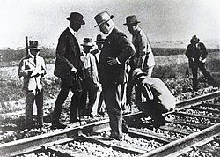
Commission – Japan was guilty – what to do next?
Hoover – no economic sanctions, they would cause war
Irrelevant anyways – League decided to do nothing
Britain – sanctions would threaten stability in region – Our colonies threatened?
League countries unwilling to sacrifice own economy at expense of U.S. increase in trade without hurting Japan
M. Crisis Conclusion – US F.P. was pivotal in avoiding international sanctions against Japan’s aggression

Slide 25
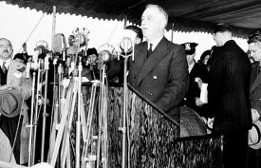
The Americas React to Europe and Asian Conflicts
Canada in Manchuria
P.M. Bennett – Saw Canadian F.P. as British as part of Commonwealth, but was pro US
Many Canadians disagreed
Canada could serve as a middle ground between U.S. and U.K. policy towards Japan
U.S. – moral condemnation, UK – conciliation
U.K. did not want to look weak and asked Canada’s government to give speech accepting Lytton Commission recommendations.
Japan withdrew from League in ‘33, U.S. shifts toward hardline against Japan
Notes:
British decided to use Canadian representative in the League to demonstrate Britain’s morale condemnation, while Britain itself could remain conciliatory and not anger the Japanese into threatening Britain’s Asian colonies.

Slide 26
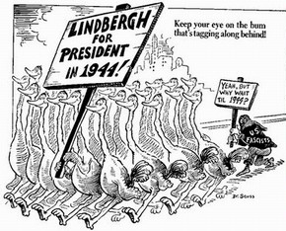
The Americas React to Europe and Asian Conflicts
Hitler appointed Chancellor
Americas mixed – many saw him as Germany’s savior – wished to emulate populist movements in own countries – no consensus in any country
Fervent Nationalism more prominent in countries with German immigrants
Getulio Vargas in Brazil
Others feared racial and authoritarian policies – FDR

Slide 27
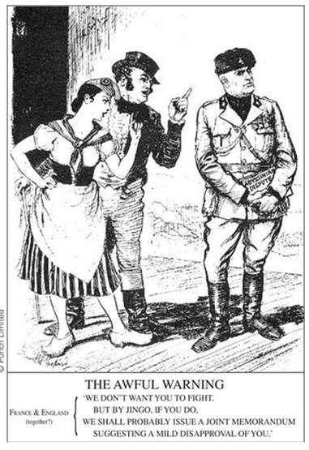
The Americas React to Europe and Asian Conflicts
Abyssinia Crisis
1935 – U.S. passed first of a series of Neutrality Acts
No trade with any country at war
U.S. promised no aid to Abyssinia– assisted in death blow to League?
Canada divided
Bennett’s gov’t. in Ottawa wished to abstain from condemning Italy
Would place Canada on side with Germany, Austria, Hungary
Foreign delegation to League broke with own government and imposed sanctions
Sided with Britain against U.S. – wanted to impose some actions, not just condemnation
Bennett’s government was then ousted
Notes:
US action arguably caused the collapse of the League. Canada vacillated between US position of “do nothing” and Britain's position of economic sanctions” Canada demonstrated independence from both.
Bennet Gov’t told its members in the League to abstain from any votes condemning Italy
Canadian members appalled – did not want to look pro-fascist
Canada ultimately sided more with Britain and not US, Bennet removed, replaced by King

Slide 28
The USA's policy of neutrality
Feeling that participation in WWI was a mistake/ Congress passed a series of Neutrality Acts from 1935 onwards which intended to keep the USA out of future wars. Policy was problematic, difficult to follow/apply
The Neutrality Acts:
First Neutrality Act 1935: gave president the power to prohibit US Ships from carrying us-made munitions to countries at war. Could also prevent US citizens from traveling on ships of those countries at war.
The Second Neutrality Act 1936: banned loans or credits to countries at war
The Third Neutrality Act 1937: forbade the export of munitions for use by either of the opposing forces in Spain (During Spanish Civil War)
The Fourth Neutrality Act 1937: authorized US president to determine what could and could not be bought, other than munitions, and made travel on ships of countries at war unlawful.
The Fifth Neutrality Act 1939: President could authorize the “cash and carry” export of arms and munitions to countries at war, but they had to transported in the counties’ own ships. It also proclaimed the North Atlantic a combat zone (due to U-Boat activity)

Slide 29
US Neutrality – Evidence
Neutrality Justification - Nye Commission – Republican Senators led investigation into why U.S. join WW1 – U.S. capitalist had invested into nations at war, profiteering war companies – Dupont, JP Morgan Banking.
Ludlow Amendment – popular proposed change to constitution – national referendum to declare war – but does not pass
Gallup Poll – 70% of Americans thought Us involvement WWI was wrong
Roosevelt’s Quarantine Speech – wanted to alert population to world danger
Newspaper, population highly critical
FDR – “It is terrible to look over your shoulder while trying to lead and find no one there”
Panay Incident – Japanese sank US Navy ship and 3 standard oil ships on Yagtze River in Nanking. US demanded apology and compensation, incident then closed.
Led To “moral embargo” American businesses encouraged to refrain from Japan.
Notes:
FDR - October 5, 1937
"quarantine of the aggressor nations" as an alternative to the political climate of American neutrality and non-intervention that was prevalent at the time.
Not popular with American public, backs down
Quarantine Speech – after Guernica, Japanese full-scale invasion of China.
“Without a declaration of war and without warning of justification of any kind, vast numbers of women and children, are being ruthlessly murdered from the air…If those things come to pass in other parts of the world, let no one imagine that America will escape. War is a contagion, whether it be declared or undeclared. We are determined to stay out of war but we can not insure ourselves against the disastrous effects of war.
Boston Herald the next day – for the sake of millions of American mothers, confine your crusading to the continental limits of America!

Slide 30
Views On US Gov’t (FDR) Neutrality
Gov’t. was Isolationist
Divine – “Americans threatened by complex forces threatening peace, sought escape in ironclad neutrality”
Snowman “The more dangerous events became the more Gov’t. wanted cut off from world
Congress Passed, FDR signed 5 different Neutrality Acts.
FDR was Gradualist
Dallek – FDR’s inclination was to move slow in F. Affairs.
HW Brands – FDR declared war after “stretching authority, bending truth to educate American people
FDR was Pragmatist
Most agree he was closely tied to Public Opinion
Dallek “He would only move once “an unequivocal popular consensus”

Slide 31
The Americas React to Europe and Asian Conflicts
Spanish Civil War
USA invoked neutrality act
US businesses nonetheless overtly assisted nationalist
Texaco supplied gas on credit to Franco
Mexico participated actively in the Civil War
Cardenas gov’t supported Republicans
Contributed little – negligible $2m, mostly moral support
Notes:
German aircraft bombing civilian targets like Guernica, Barcelona, Madrid were filled with us supplied fuel
Texaco provided 20m in oil on credit, 300 shipments with no pay
Ford GM provided Franco regime with 1000’s of trucks.

Slide 32
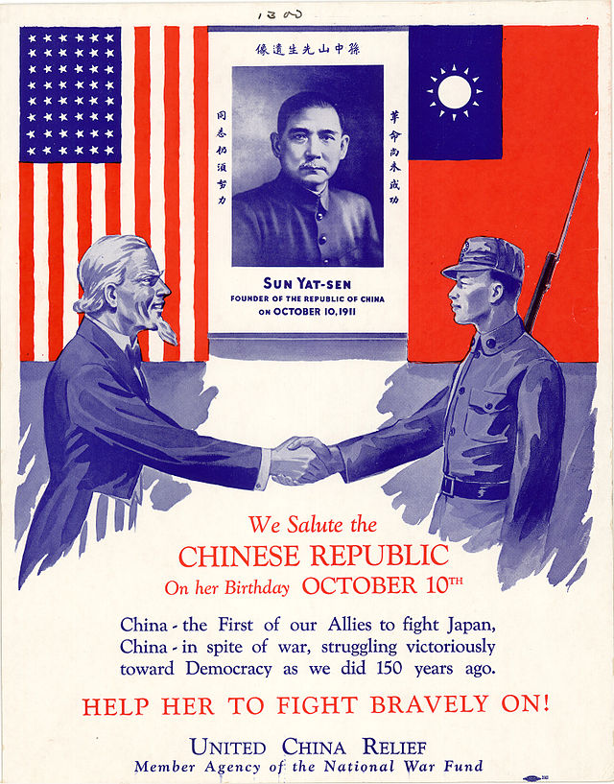
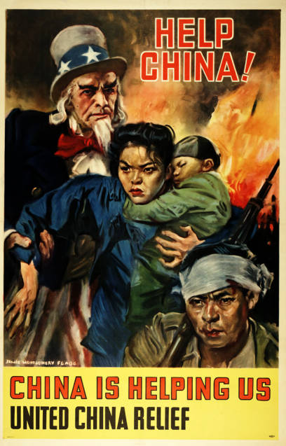
The Americas React to Europe and Asian Conflicts
Chinese Civil War
Roosevelt did not follow Neutrality Act – no declaration of war = not a war
Sympathetic towards nationalist (Goumindang)
Notes:
25m in aid, but did not send troops, military advisors.

Slide 33
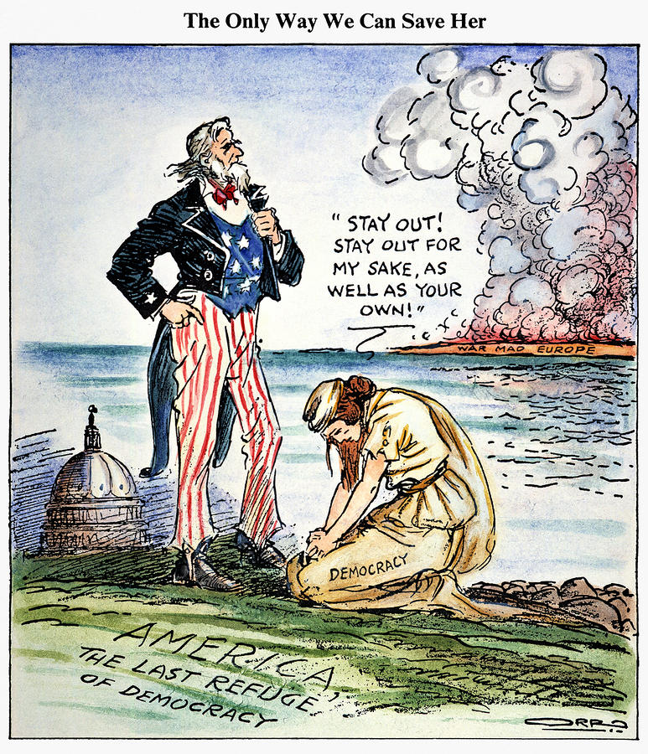
The Americas React to Europe and Asian Conflicts
Munich Conference – 1938
Roosevelt increasingly on side of intervention – but persuaded into appeasement by world opinion
Conference was hailed a success – Chamberlain a hero
FDR writes Hitler letter after invading rest of Czechoslovakia demanding no more intervention
Hitler read it to his government and made a mockery of it
Invasion of Poland – 1 Sept. 1939
Hemisphere now mostly anti-axis even thought neutrality was maintained
Only Canada enters the war

Slide 34
Neutrality and US rearmament
Reduced forces after World War I (to ca. 19000 officers and 205,000 enlisted men); 1922 reduced further to regular army of 12,000 officers and 125,000 enlisted men
Budget of war department fixed ; US Naval expansion restricted by agreements made at the Washington Naval Conference
Growth of the Navy: only branch that grew at all until the mid-1930s;
1934 NIRA provided the navy with $237 million for warship construction: navy ordered 20 destroyers, four submarines, four light cruisers and two aircraft carriers.
From 1935 armed forces’ budget was increased because of changes in Europe
After the Munich Crisis in 1938, Roosevelt said he would spend another $300 million on armaments - asked Congress for $552 million for defense expenditure to prepare the country for the war.

Slide 35
Canada at War
Canada’s participation after British declaration of war seemed to be foregone conclusion
Westminster Statute – unlike in WWI it would be Canada’s own decision
Decision was decided in Canadian parliament after debate – first independent Dec. of war – 10 Sept. 1939
Ill-prepared for war – economic depression made military spending very unpopular
Had doubled in ‘38, doubled again in ‘39
Half going to the RCAF
Created British Commonwealth Air Training Force – most advanced air training throughout the British Empire was conducted in Canada
Canada trained 13,000 pilots a year and sent many to fight in Battle of Britain
Notes:
Canadian bacon – myths about Canada, demonstrates how little US actually knows about the country. Gruff old time military leader find evidence that the Canadians used these biases to cause the us to let its guard down.
Had 19 modern aircraft at start of war, would produce 16,000 during.
Trained about 130,000 pilots and aircrews, half of which were Canadian.

Slide 36
Canada at War
Canada’s Navy
Battle of the Atlantic – pivotal battle after the defeat of most of Western Europe
Canada’s small navy was responsible for patrolling N. Atlantic, protecting convoys
Notes:
Build a fleet of small escort ships - corvettes to protect sea lanes to UK – became the lifeline of the UK during her time of ultimate crisis.
15 ships before war, 400 during

Slide 37
Hemispheric Neutrality – 1939-1941
USA hoped to remain aloof
Nonetheless, FDR requested billions in defense spending and naval development
Two Ocean Act – add 201 ships(70% inc.) at $8b
Advocated removal of neutrality laws – not helping allies indirectly supported enemies
Instead “Cash and Carry” was agreed – sale of arms paid in cash and transported by allies
After winter 39-40, Fall of France, Britain became reliant on colonies/commonwealth for aid
Ships constantly crossed Atlantic to facilitate trade of war materials and commodities with Americas
Hemispheric Neutrality Belt – 300 mile neutral zone declared – violated
Germany torpedoed any ship they suspected of transporting these goods
Many U.S./Mexican/Brazilian ships sunk, all remain neutral nonetheless
Notes:
C and C – part of 1936 neutrality act – must assume all responsibility for transport
History of caudillismo
FDR - "if German or Italian vessels of war enter the waters, the protection of which is necessary for American defense, they do so at their own peril.”
The US seized all German and Italian ships in US ports, froze all assets.
Denmarks gov’t in exile and US hand over Greenland to US protection, US occupied Iceland
US attacks German weather station there
US destroyer attacks uboat off of Ireland
Nazi uboats killed 93 American sailors in one attack, sank multiple US merchant ships, infiltrated US coast, us in return located uboats for british, on rare occasions also attacked – undeclared war – one reason Hitler declared war is he could openly confront the Americans in the Atlantic, cut off Lend-Lease to Britain/USSR
US attacked uboats

Slide 38
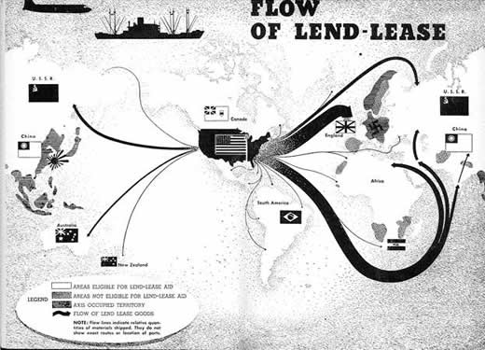
U.S. moves towards War
Winston Churchill wrote Roosevelt and informed that Britain could no longer afford war materials, needed assistance
Sept. 1940- Destroyer for bases deal – to circumvent Neutrality Laws “traded” 50 US destroyers for 99 year leases on British bases in Americas.
Lend-Lease Aid – Borrow equipment to British for fight against Germany (March 1941)
Circumvent Neutrality Acts
$50B eventually allocated to program
Canada afraid it would lose out on its economic ties to Britain
US/Canada make mutually beneficially deal – Hyde Park Declaration
US war materials made in Canada could be included in Lend-Lease
Some Lend-Lease money went to L.A.
U.S. saw this region critical to its own defense
Notes:
The Hyde Park Declaration of 1941 detailed an agreement between the United States and Canada to allow American-produced war materials made in Canada, for Britain, to be included in the Lend-Lease agreement.
Us quickly sent 1,000,000 rifles, 100,000 machine guns, 1000 artillery pieces

Slide 39
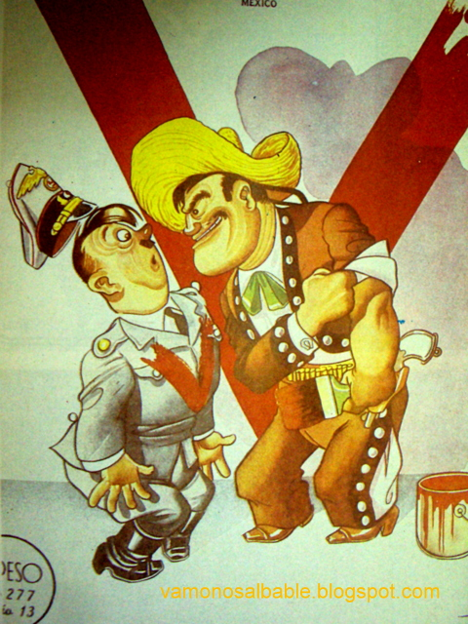
Nazis in Latin America
After Fall of France, Dutch and French possessions in Americas were handed to Germans
Pan-American Union stated that in adherence with Monroe Doctrine these possessions would not be recognized as Axis possessions
Only Argentina dissented – felt it was a U.S. excuse for annexation

Slide 40
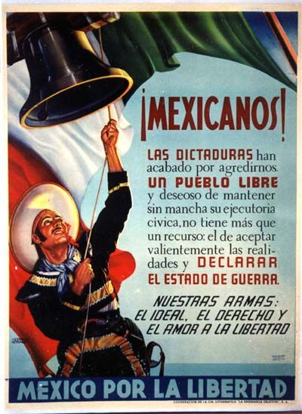
Nazis in Latin America
Office of the Coordinator of Inter-American Affairs (CIAA)
Prevent/eliminate Axis espionage in Americas through propaganda
Motion pictures, radio, press, museum displays dedicated to American solidarity, cultural similarities, distinctness from European/Fascist culture
U.S. as open/egalitarian sympathetic towards southern neighbors
Targeted Brazil – large Japanese/German pop. and Arg./Chile – pro fascist regimes with German populations
Notes:
Cultural influence was effective at persuading all of Americas against Nazism
“Mexicans – declare a state of war!”
CIAA grew to be a large Federal agency with a budget of $38 million by 1942^{[4]} and 1,500 employees by 1943.

Slide 41
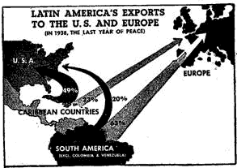
American Solidarity?
Cultural solidarity - Good Neighbor Policy was effective domestically in U.S. –
In 1940 - 72% of Americans thought Cuba should be defended
53% would defend “Brazil, Chile, any South American country”
Only 17% would defend U.K.
Economic Solidarity
LA Economic goods now came almost exclusively from the US (and Canada)
US raw material imports from LA grew – Chilean Copper, Peruvian Cotton, Mexican Oil
According to this chart how significant of a change will war bring to LA economies?

Slide 42
American Solidarity?
Military Solidarity – US air bases and ports in Brazil for mid-Atlantic patrols
Colombia, D.R., and Ecuador given aid to build militaries(primarily air forces) to protect Panama Canal routes
Atlantic Charter – summer 1941 – US will seek the final destruction of…Nazi tyranny
Road map to the UN
Anti-imperialist document, legally supported by most LA countries by 1942

Slide 43
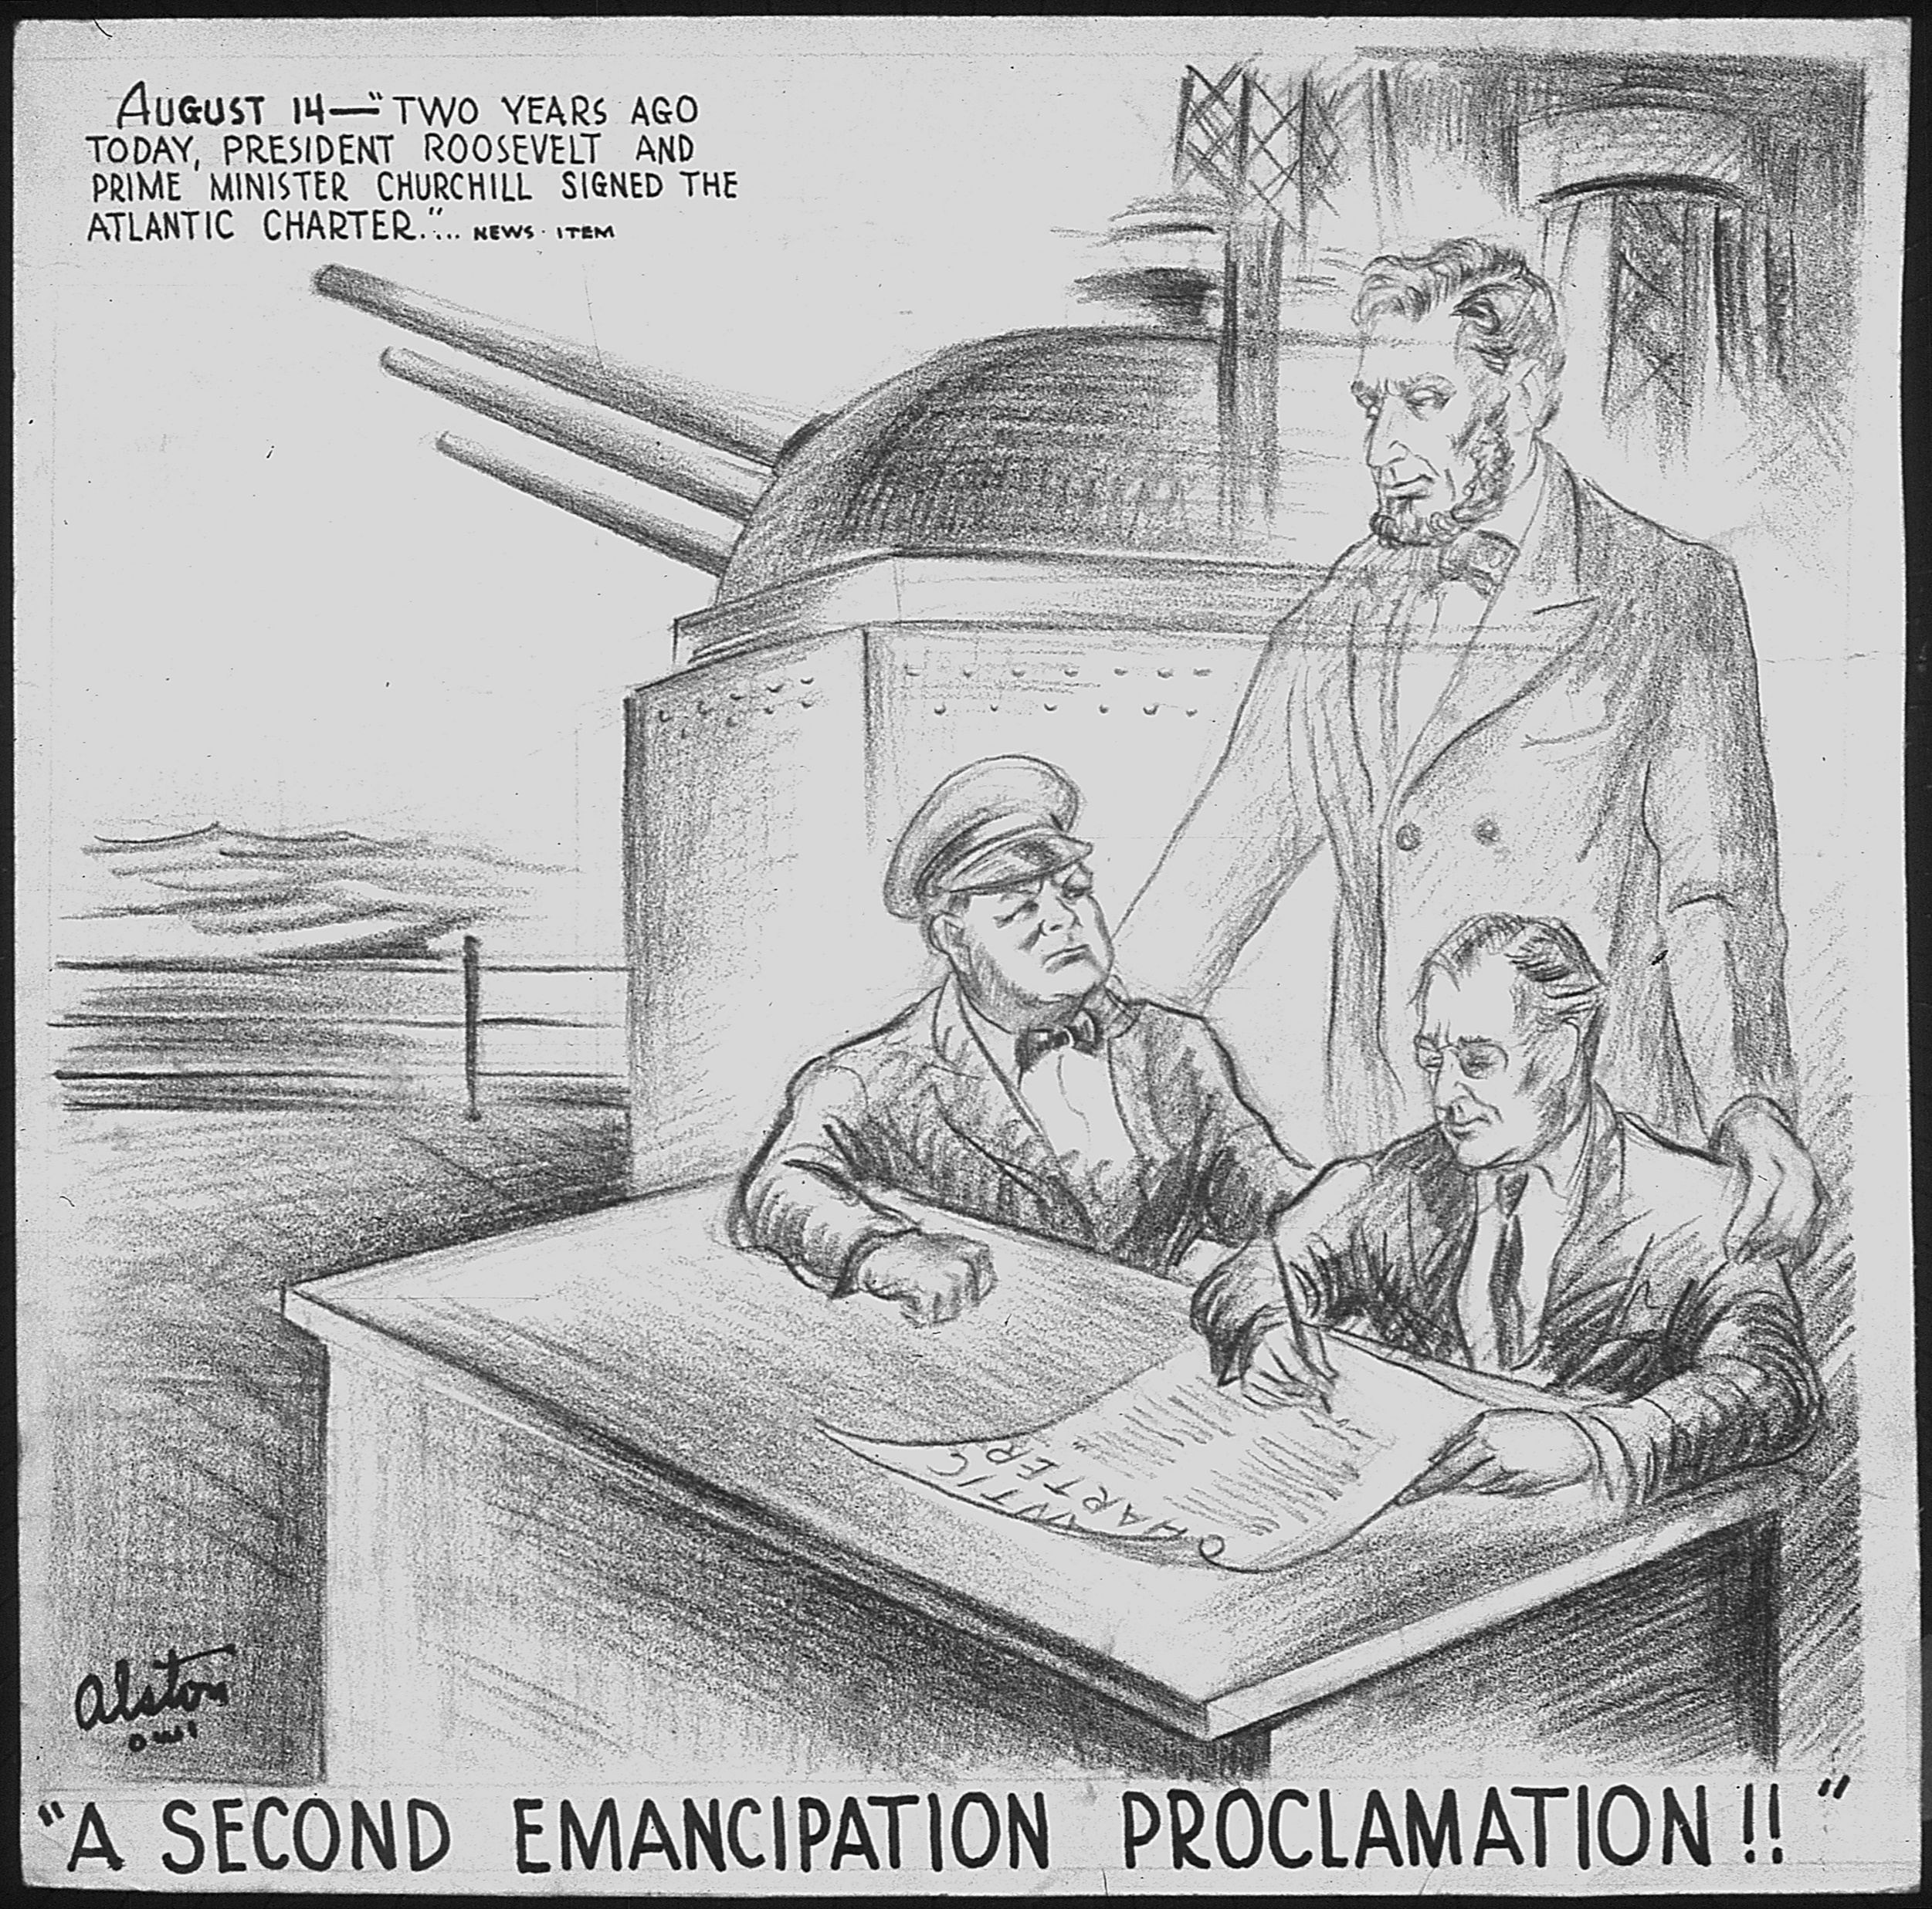
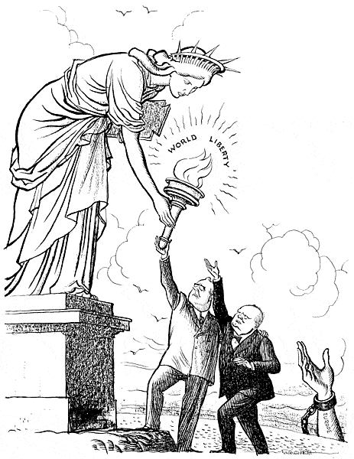
US Moves Towards War
FDR/Churchill secretly meet to decide “New World Order” all allies eventually sign pledge.
Atlantic Charter Aug. 1941– ORIGIN OF THE UN - broad set of goals for Western democracy, before us intervention – allies would not seek territorial gain, would grant self determination, lower trade barriers, adv social welfare, provide freedom from want and fear, provide freedom of the seas.

Slide 44
Solidarity? - Attack on Pearl Harbor
Japanese Aggression unchecked in Asia
With fall of France, new French gov’t allowed Japan to build bases in Indochina
Would allow Japan to attack British colonies
US decided to stop shipment of steel and scrap iron, renounce Commercial treaty w Japan
At least half of all oil, iron, and steel was coming from US
Notes:
U.S. by now had a peace time draft of about 900,000 men, but FDR in multiple public speeches had proclaimed “your young men will not go to war”
US also had taken over control of Greenland from the Danish and built airbases there, also stationed troops in Iceland.
Was training 9000 British pilots

Slide 45
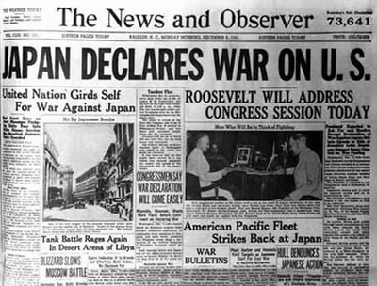
Attack on Pearl Harbor
Perspective on US role in Japanese Aggression
Charles A. Beard argued, in 1948, that the note was an ultimatum that meant unnecessary war. He suggested it was part of a conspiracy by Roosevelt to get the US into a war in order to help Britain fight Germany
Some modern Japanese commentators say that the Hull note was designed to draw Japan into war in such a way as to allow Japan to be presented as the aggressor nation.
These interpretations could have gained widespread support in Latin America expect for effectiveness of Good Neighbor, CIAA
Notes:
Hull Note- On November 26, 1941, (one day after Japanese Kio Butai fleet left its port, but could still be recalled) Hull presented the Japanese ambassador with a note, which, as one of its conditions, demanded the complete withdrawal of all Japanese troops from French Indochina and China. US had already known through operation magic that the end of November was Japans deadline to resolve this issue through diplomacy. PM Hideki Tojo said to his cabinet that "this is an ultimatum.”
No direct evidence of an attack, when or where, us would not expect something as audacious as attack at pearl harbor 4000+ miles from Japan

Slide 46
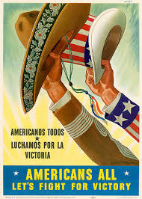
Attack on Pearl Harbor
Dec. 7th (8th In Japan) devastating attack against U.S Naval Base in Hawaii
U.S. Guam, Midway, and Philippines also quickly attacked
U.S. declares war next day, Germany declares war against US per Tripartite Pact
All nine independent Caribbean countries also declare war on Axis Powers
All Countries in Americas sever ties with Axis (Except Arg./Chile) – Rio 1942
18 Brazilian ships sunk by Germany motivates Brazil to create Expeditionary Force (25,000 troops will fight in Europe)
Notes:
Rio Conference
After attack conference of all nations in pan American union met in rio
The meeting was organized in the wake of US intro into WWII, and the USA intention to use the occasion to offer additional economic assistance to Latin America countries, in return for security cooperation and the severing diplomatic ties with Axis powers.
Immediately after Pearl Harbor - The Dominican Republic, Haiti, Cuba, Panama, Costa Rica, Nicaragua, Honduras, El Salvador, and Guatemala had declared war on the Axis powers prior to this conference, Mexico, Colombia, and Venezuela severed diplomatic relations.
As a result of the conference, Brazil, Ecuador, Peru, Paraguay, and Uruguay severed diplomatic relations with the Axis powers, and Mexico declared war,
German reaction was to target Brazilian and Mexican ships in addition to US
-

Slide 47
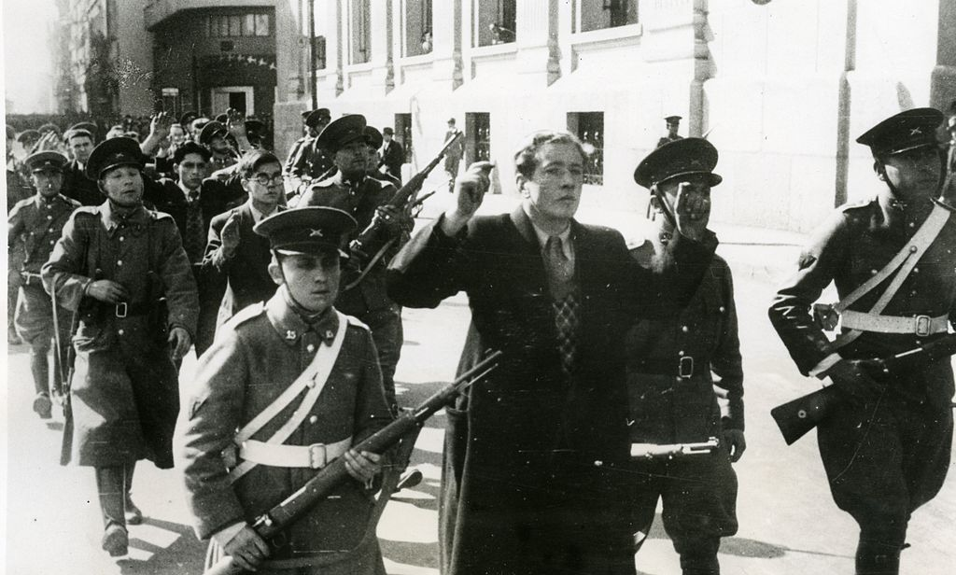
Chile
Gov’t resisted Allied cooperation – large German population, long coastline made it vulnerable to Axis
Santiago, Chile becomes hotbed of Nazi spies in Americas
Allied success, and German attacks in Atlantic convince Chile to move away from Neutrality – though spying continued
Finally declared war in 1945 (would be denied UN membership otherwise)
Chilean Nazis attempted Coup in 1938 – 60 of the conspirators were lined up and shot after being promised their lives for cooperation in turning in the others

Slide 48
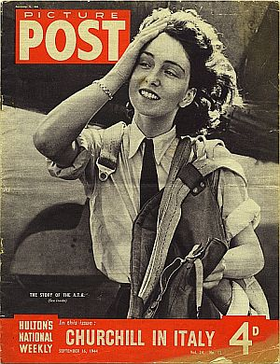
Argentina
Firmly pro-Axis due to Fascist tendencies of its government
Also feared US domination in the region
Peron consolidated power in 1944 and maintained neutrality and consolidated power by keeping pro-Axis and pro-Allied factions at ill ease
Last American country to declare war against Axis in March ‘45
Notes:
Argentine military were extreme germanophiles since 1900 – worked closely with german military
Becomes a haven for Nazi war criminals including Adolf Eichmann – major organizer of holocaust
as many as 5,000—relocated to Argentina.
Before the war Argentina hosted a strong, very-well-organized pro-Nazi element that was controlled by the German ambassador.
4,000 argentinas served with british armed forces

Slide 49
Hemispheric Neutrality – 1939-1941
L.A. was ambivalent towards Germany
Germany had indirectly helped many countries out of G.D. through trade
Countries such as Peru had used German officers to train own troops
Nazis were admired for strong policies
But countries were discomforted by brutality of regime and thus remained neutral

Slide 50
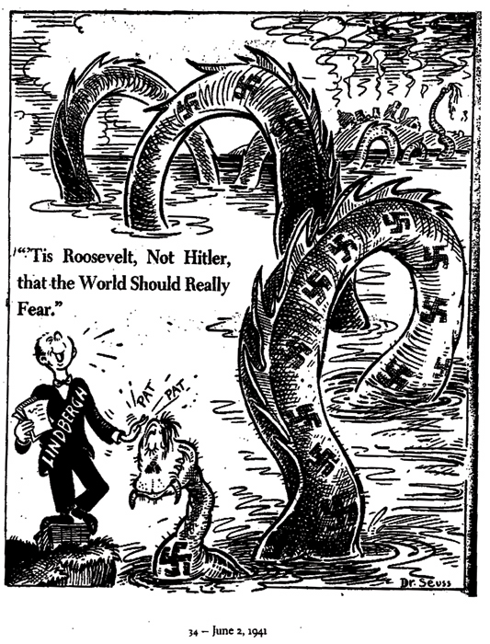
U.S. moves towards War
FDR elected for unprecedented 3rd term (1940)
Running as a wartime president before declared war? (Quarantine Speech)
As President of the United States and commander-in-chief of its forces, he became the main factor in winning the greatest war of all time. ~ Bernard Baruch

