Slide 1
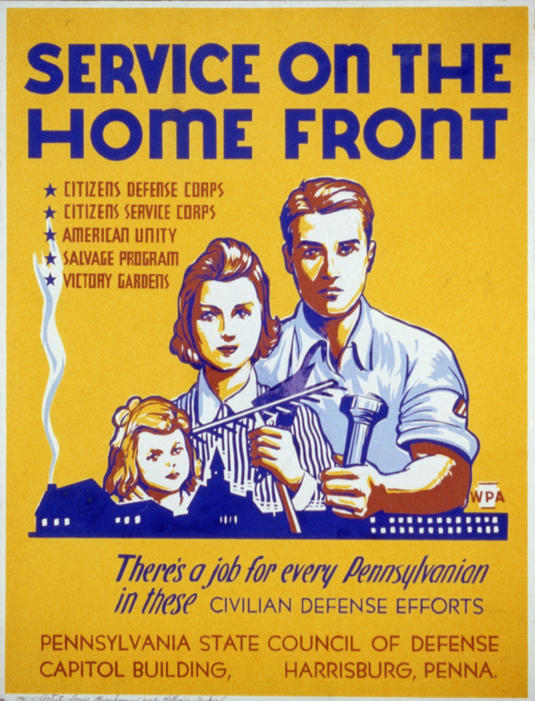
Social Impacts of World War II in the USA – minorities, Women, Conscription
Notes:
Total war meant that opportunities would have to be given to groups who were normally barred from entering from fighting in war or participating in the workforce. These new opportunities created conditions for larger changes to take place later – awareness of racial and gender inequalities especially after ww2.

Slide 2
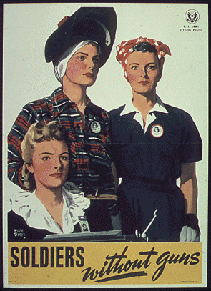
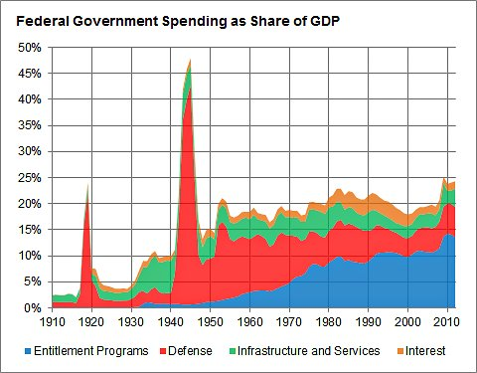
FDR’s “arsenal of democracy,” the country experienced a fundamental reorientation of economic and social patterns at home that provided the template for the postwar years.
vindicated the theory of English economist John Maynard Keynes, who had earlier argued that sizable government spending could end a depression if the private sector was unable or unwilling to engage in such spending itself.

Slide 3
Evaluate the social impact of the Second World War on women and minorities in one country (USA)
Examine the involvement and participation of any two countries in the Americas (USA, CA)

Slide 4
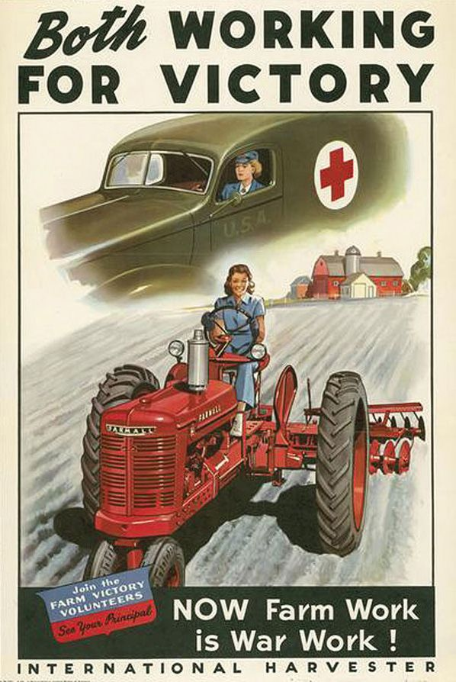
Demands of WWII caused countries to mobilize their economies by…
Granting concessions to industrial workers and appealing to patriotism (Latin America)
With so many men mobilized, enlisting groups otherwise not recruited to work in the formal economy (USA and CANADA)
Women
Minorities
immigrants

Slide 5
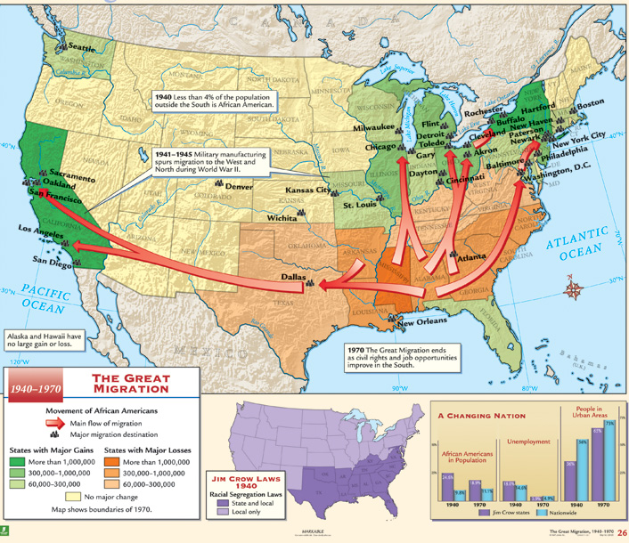
USA – 1940 – Total War?
Population – 133m
16m men and women served in military
With men absent women had to become de facto head of households
Run finances
Make executive decisions
Demographic shift(especially minorities) towards Midwest/Great Lakes – large factories
1:10 Americans moved permanently to new state during War
Notes:
Great Migration – starting during WW1 and more rapidly during ww2 millions of southern rural African Americans moved to mostly large northern cities in what is demand one of the largest internal migrations in history – became more politically relevant but this movement also led to tension as white workers felt threatened by new neighbors.

Slide 6
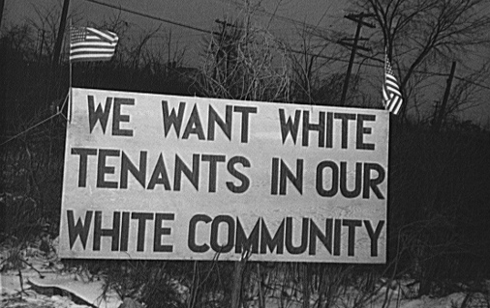
Great Migration – during WW2 about 5m rural southern A. Americans moved to large industrial cities in North and West.
Faced de facto segregation – not Jim Crow but racial tension still existed, and were relegated to lower wage, dangerous work, poorer schools, communities.
But did gain ability to vote in elections, most became politically active for first time.

Slide 7
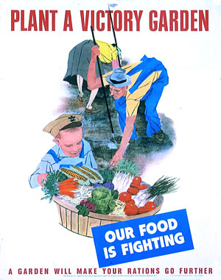
USA – 1940 – Total War?
President Roosevelt – widely popular
Effectively appealed to patriotism – war was seen as good versus evil (runs 3rd term 1940)
Home Front totally mobilized
Victory Gardens – small produce “farms” in urban areas
20m created in front yards, rooftops, local parks
Produced 9-10m tons of produce – most canned and preserved
Rationing, scrap iron collection, recycling
Attacks on mainland? – Limited
Japanese balloon bombs (killed 6 Americans in Oregon)
German subs in Atlantic, Gulf
Occupation of Aleutian islands (Attu and Kiska)
Nonetheless, war was unavoidable – news, ent., lifestyle
Notes:
First intercontinental weapons – Japan launched apx 6000 of these from across the Pacific, hoped to set fire to Pacific NW forest
only known deaths in the contiguous U.S. as the result of enemy action during World War II and the only civilian casualties on American soil after the US entry into the war.

Slide 8
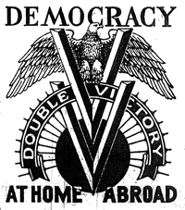
Minorities in USA – Social Impacts? African Americans - background
Hypothetically equal – 14th Amend.
Segregation throughout U.S., not just South
Ex. “white” and “colored” establishments, Red Cross separated donated blood
Great Depression disproportionally affected minorities/poor
Their jobs were usually first to go, lacked savings, support
Notes:
All people born in us are equal citizens under the law – can not be deprived of life, liberty property without equal due process,

Slide 9
Minorities in USA – Social Impacts? African Americans – War Advances
African American leaders saw war as opportunity to bring equal rights
Agitated to be drafted in equal proportion (to be seen doing their part)
700,000 in army, 187,000 in naval
Remained segregated, but unlike previous wars fought on front lines
Still sometimes relegated to menial task – ex. Alcan highway
Race riots (68 acts of racial violence in ‘45 for example)
Military advocated separate but equal – barracks often similar conditions
Commanders were overwhelmingly white, assaults on black soldiers often went unpunished
Booker Spicely – murdered by bus driver for not moving to back of bus quickly enough – murderer was acquitted
German/Italian prisoners often received fairer treatment
Notes:
Wanted to fight on front lines, demonstrate duty, patriotism, courage and valor.
Spicely incident - victim of racial violence whose murder in North Carolina, United States is considered to be one of a series of outrages that contributed to rising activism in the Civil Rights movement.
"I thought I was fighting this war for democracy". The bus driver then said "shut up or get off".
Spicely continued arguing with the bus driver until he departed the bus. When he did, the driver followed him off the bus and shot Spicely twice when the soldier turned around

Slide 10
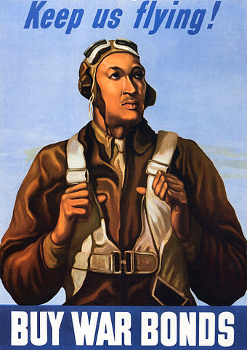
Tuskegee Airmen
1939 – War Dept. appropriated funds for African American Air unit
Most Americans did not think they could perform
99th Pursuit Squadron – myth - never lost a bomber it escorted – evidence today refutes this.
Many distinctions – many German jets ME-262’s shot down by 99th. Over Italy
At wars end, they were considered “trainee’s” so officers could be treated as subordinates, not officers (which they were qualified to be considered due to experience and training)
Notes:
Tuskegee University in Alabama – HBCU – trained many pilots through civilian program before war funding
179 bomber escort missions, with a good record of protection, losing bombers on only seven missions and a total of only 27, compared to an average of 46 among other Air Force P-51 groups
Investigate the record of the 99th pursuit – their effectiveness, their significance in civil rights.
On 29 March 2007, the Tuskegee Airmen were collectively awarded a Congressional Gold Medal
^{Later,} bomber groups requested their escort due to their strong record

Slide 11
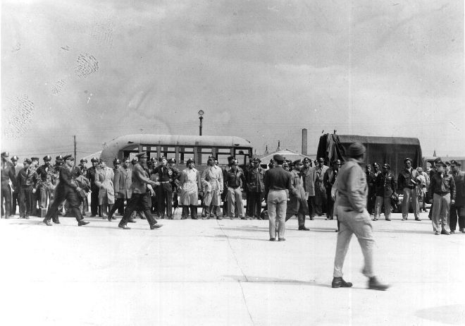
Tuskegee Airman – Freeman Field Mutiny -1945
African American officers tried to integrate into all-white officers club
Put under arrest(162 arrest were issued) for disobeying local segregation policy at airbase
In response 2 airwings disbanded, rest put into a composite group – disbanded in ‘47
1948 – Truman desegregated all armed forces
African American Officers under arrest for minor crimes relating to civil disobedience
Notes:
Thurgood Marshall – major figure in civil rights movement – (B. V Board) – first A Am. SCOTUS. Got his start with this case.

Slide 12
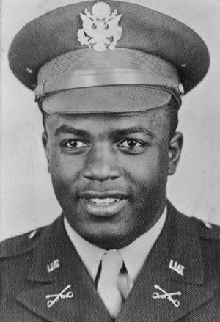
Minorities in USA – Social Impacts? African Americans – War Advances
Jackie Robinson – A. American who was arrested in 1944 for refusing to move to segregated section of a bus, acquitted for his actions.
“More even than either Abraham Lincoln and the Civil War, or Martin Luther King, Jr. and the Civil Rights movement, Jackie Robinson graphically symbolized and personified the challenge to a vicious legacy and ideology of white supremacy in American history,” - Philosopher Cornel West
In 1942, Jackie Robinson was drafted into the Army. He was assigned to a segregated Army Cavalry unit in Fort Riley, Kansas.
Notes:
He was sitting with another African American who passed for white according to the bus driver
His number 42 retired by all of baseball – due in part to breaking the color barrier

Slide 13
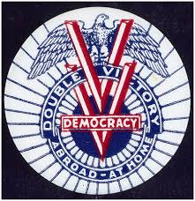
Double Victory
NAACP – war an opportunity “to persuade, embarrass, compel and shame government and our nation”
Membership grew from 50,000(1940) – 450,000(1945)
Empowered workers more insistent about their rights
Executive Order 8802 – any business accepting gov’t contracts had to make jobs available without discrimination
Around 500,000 became active in unions, many became Democrats due to FDR’s policies
Became more politically relevant
Could not vote in South (Jim Crow) but often were an important swing constituency in North
Notes:
over enemies overseas, and prejudice at home
Port Chicago disaster – 320 longshoremen, munitions loaders were killed in massive explosion, many of whom were A. Am. 50 of whom refused to work in same conditions, without regulatory changes(banning speed contest, providing adequate training. Were sentenced to 15 years hard labor, freed after a year but never exonerated.
The mutiny trial was seen as underscoring the tense race relations in the armed forces at the time

Slide 14
Race Violence during WWII
1943 – 250 conflicts in 47 cities
Detroit Riots – Causes? Results?
Government did little in response to protect A. Americans
A. Americans learned lessons about passive resistance, strength in numbers, power of working class when labor is scarce
Early Civil Rights movement?
Notes:
Causes
Working conditions
segregated housing – threat to long time residents
Demands for better working conditions – labor had upper hand
Hot weather
Results
-34 killed, 433 injured
1000 arrest
2m in damage
1m manpower hours lost

Slide 15
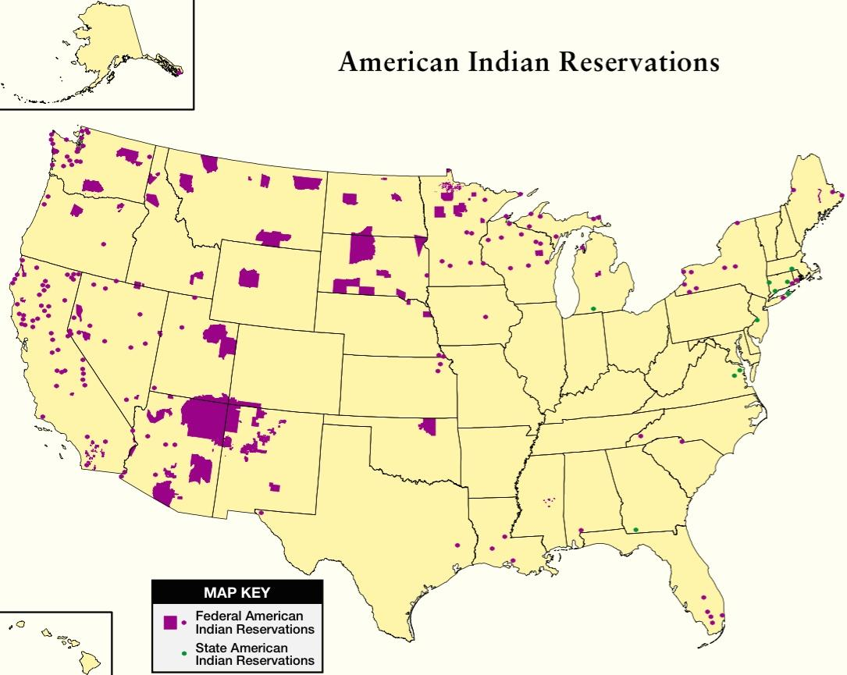
Native Americans in WWII Background
1940 – Nationality Act – Native Americans = US Citizens
Over 300,000 N. Americans – living mostly in the West on reservations
During war many reservations were deemed “essential natural resources” for the war
Appropriated by federal government, sometimes for building of Japanese Internment camps
Notes:
Asbestos, coal, copper, zinc, gypsum, helium, lead, natural gas, oil,

Slide 16
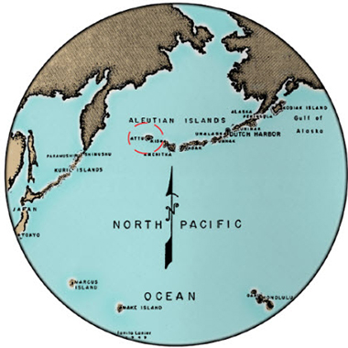
Japanese Invasion of Aleutian Islands
Eight villages Inhabited by Unangax people burned by U.S. military
Prevent occupation by Japanese on Aleutian islands
Nonetheless, Aleutians were incredibly useful to U.S. military
Patrolled outlying islands
Kayak and tracking skills incredibly useful in aiding U.S. military liberating major islands – Attu, Kiska
Attu – 1700 miles from Alaska mainland, 700 miles from Japan
Notes:
“Aleut” people
In 1942, during World War II, Japanese forces occupied Attu and Kiska Islands in the western Aleutians. They later transported captive Attu Islanders to Hokkaidō, where they were held as prisoners of war. The United States government evacuated hundreds more Aleuts from the western chain during WWII, placing them in internment camps in southeast Alaska, where many died.

Slide 17
Native Americans in WWII
40,000 left reservations to work in war industries
10% of total population served in war – similar to overall rate
Speculation – though resentful towards U.S. government, warrior culture made up the difference
World War I – Choctaw language “unbreakable” code during WWI
German “anthropologist” came over during interbellum period to study their culture
Idea used again during WWII – Navajo language had only 30 outside speakers worldwide
2 Navajo speakers appointed to each U.S. marine battalion in Pacific
One on shore, one on ship so amphibious operations could be tightly coordinated
Participated in every battle in the Pacific, also D-Day in Europe
Notes:
Remained classified until 1968

Slide 18
Native Americans in WWII
Nearly half of Native Americans participated in the war, many left reservations and permanently assimilated into white culture
If they did return, they often brought back new techniques to be integrated into reservations
Became more aware of lack of rights and equality with mainstream culture

Slide 19
Hispanic Americas WWII
500,000 served
Heavily employed in California shipyards/factories
Bilingualism heavily valued
Women took up head of house hold responsibilities, worked in auxiliary duties, cryptology, comm.
Notes:
Mexican-Americans actually were overrepresented in the armed forces (more likely to join than average)
Latina Women - cultural barriers that had in the past prevented them from leaving their families and traveling long distances alone. Bilingualism was highly sought after during the war and so they found important work in cryptology, communications and interpretation. As linguists, nurses and Red Cross aids, and in the WAACS, WAVES, and Marine Corps Women’s Reserve, Latinas broke through both gender and cultural barriers to serve their country

Slide 20
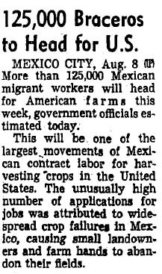
Hispanics in WWII Bracero Program
Many deported to Mexico during G. Depression (including US citizens)
War labor shortage caused many to return
Program started in Aug. 1942
Temporary, short term contracts
Primarily agriculture, later other unskilled labor (rail workers, shoremen)
Businesses required to provide a min. wage, decent housing, med. Care
Notes:
in the early 1930s the United States deported between 500,000 and 2 million people. Estimates point at over 1m were us citizens.

Slide 21
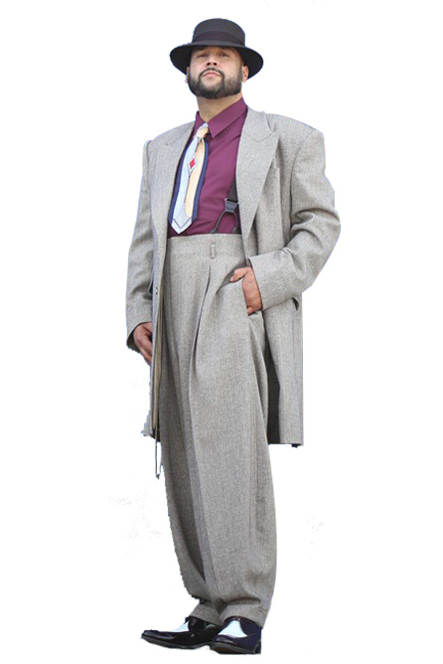
Hispanics in WWII Zoot Suit Riots (June ‘43)
Already ethnic tension in LA between 17,000 Latinos and the Anglo sailors working at naval bases around the city
Pachucos –underaged Hispanic men (not drafted)many wore flamboyant outfits as part of their culture
Many Anglos on shore leave deemed it inappropriate after the war board issued rations on elaborately tailored suits
Combined with little understanding of culture and ease of identity led to them being a target of violence
Riots broke out in other large cities with Latino populations
Wrongly accused -Sleepy Lagoon murder – 9 young Latinos convicted of murder, making national headlines
Gov’t insisted on an ending of riots – loss of productivity, stability
challenged US/Mexico relationship
Notes:
Context - United States deported between 500,000 and 2 million people of Mexican descent (including the illegal expulsion of up to 1.2 million U.S. citizens
LA experienced incredible growth during the war, large influx of Hispanics through bracero program – media described Mexican youth in an inflammatory fashion.
Many saw those that wore the suit as gang elements, violent criminals or at least less than patriotic – the community organization that helped support them in trial was labelled a communist front
The suits were argued to be unpatriotic due to the extra fabric that was used in them while the war board rewrote fabric regulations to reduce consumption – most legitimate tailoring companies followed these standards
LA Sheriff - E. Duran Ayres, to testify as an "expert witness" that Mexicans as a community had a "blood thirst" and a "biological predisposition" to crime and killing, citing the culture of human sacrifice practiced by their Aztec ancestors.^{[4]}
Case was reversed in 1944
After the murder trial, all that was needed to was a spark to start widespread riot. Spark – 11 sailors and zoot suitors got into verbal argument, sailors claimed they were assaulted
the officers went to the scene "seeking to clean up Main Street from what they viewed as the loathsome influence of pachuco gangs. – Luis Alvarez
Next day 200 sailors went into Mexican neighborhood searching for anyone wearing a suit, stripped the person naked, assaulted them with clubs, burned the suits. 1000s soon joined in.
local press lauded the racist attacks, describing them as having a "cleansing effect" to rid Los Angeles of "miscreants" and "hoodlums".
Sympathetic voices such as the first lady were accused of being communist, part of a nazi plot to sow dischord.

Slide 22
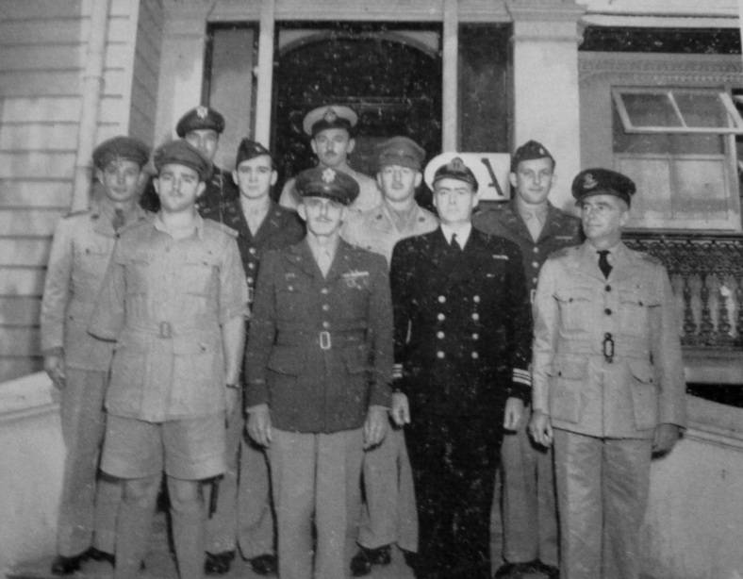
Hispanics in WWII Pearl Harbor
New Mexico National Guard sent to Philippines as translators directly before Japanese attack.
Many were part of the Bataan Death March and became prisoners of war
Staff of the Allied Translator and Interpreter Section in 1943.
Notes:
Arizona 158th Regiment one of few organizations in the Pacific to participate in every major landing from Australia to Japan. General MacArthur called them “the greatest fighting combat team ever deployed in battle.

Slide 23
Hispanics in WWII After the War
Utilized GI Bill for education, housing, starting small businesses
Specific opportunities given to each group. Challenges each group faced in receiving or utilizing GI bill benefits.
1. General benefits conferred, general challenges
2. Economically poor whites
3. Women
4. African Americans
5. Latinos
6. Native Americans
7. Japanese Americans
Notes:
1-3 minutes
For what reasons was the GI Bill so important?
What things did it do for veterans?

Slide 24
U.S. Women and WWII
Role was much larger than it was in WWI
Larger percentage fighting abroad, better equipped
Industry
6 m entered work force – 57% increase
No longer contentious, but now patriotic duty
2m in clerical, 2.5m in manufacturing
Crane operators, riveters, shell loaders, welders, tool makers
Lumberjacks = lumberjills, cowboys=cowgirls
A. American women moved out of domestic service to work in industry
Notes:
In 1944, 37 percent of all adult women were employed
African American women working as domestic servants was a vestige of slavery that remained prevalent up to ww2, gained much economic independence due to war time labor demands.

Slide 25
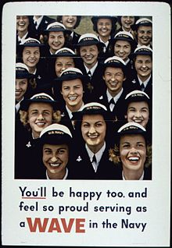
U.S. Women and WWII
Auxiliary Corps. (uniformed military units not in direct combat)
Women’s Army Corps (WACS)
US Naval Women’s Reserve (WAVES)
Women’s Coast Guard Reserve
Served as air traffic control, clerical support, teletype operators, communication experts, flight instructors, test pilots
Often flew “auxiliary missions” flying newly developed craft to shore stations, took over many shoreside duties (doctors, research, coastal rescue)
Notes:
200,000 total served, + 75,000 as nurses

Slide 26
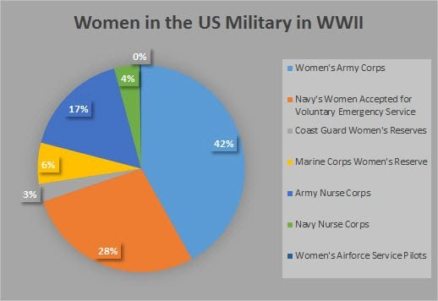
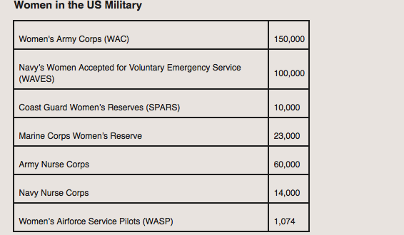
Notes:
WAC
50 percent of AAF WACs held traditional assignments such as file clerk, typist, and stenographer(note taker)
Other occupations
-weather observers and forecasters, cryptographers, radio operators, maintenance, sheet metal workers, parachute riggers, instructors, bombsight maintenance specialists, aerial photograph analysts, control tower operators, research technicians. Over 1,000 WAACs ran the statistical control tabulating machines (the precursors of modern-day computers) used to keep track of personnel records.

Slide 27
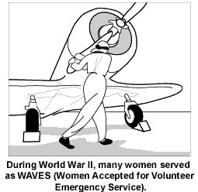
U.S. Women and WWII Rights
Paid lower wages
Little assistance in terms of childcare
Lanham Act (1941) – Federal aid to provide childcare facilities for communities with high war-related populations
1944 – 130,000 children in Lanham care
Grossly insufficient – most stayed with extended family
Notes:
In 1944, skilled female workers made an average weekly wage of $31.21 while skilled male workers earned $54.65 weekly.

Slide 28
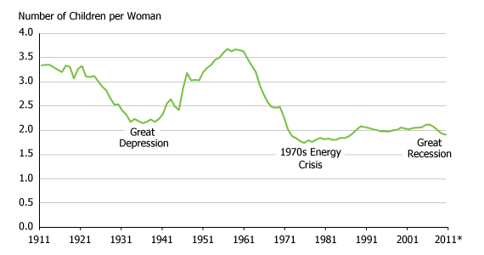
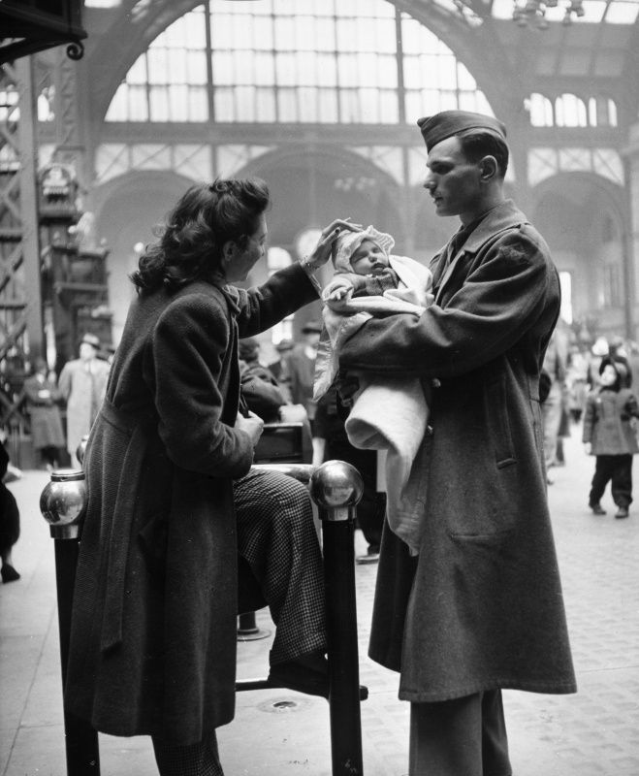
WWII Demographics
1940 – 900,000 14-19 year olds employed
3m in 1943
High school enrollment dropped – “back to school” program introduced in 1944 after war
Marriage and Birthrates
Marriage Rate 1939 – 73/1000, Marriage Rate 1943 – 93/1000
Birthrate 1939 – 2.1million births, Birthrate 1943 – 3.1m
Marriage after very short courtship was usual, before men left for war
“good-bye” babies
Were these stable relationships?
Divorce rate – 1939 -25,000, divorce rate 1943 – 359,000
Loss of family values? 8 hour orphans?

Slide 29
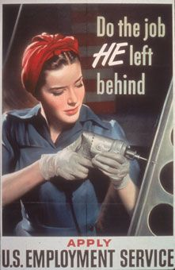
WWII – Social impact AFTER the war
Women had become more independent – in charge of home economies, worked independent of men
Returning men felt irrelevant, pushed out of roles they had left behind
Most women were unhappy in giving up there roles
Poll – 75% of women in Detroit, 85% in NYC wanted to keep jobs

Slide 30
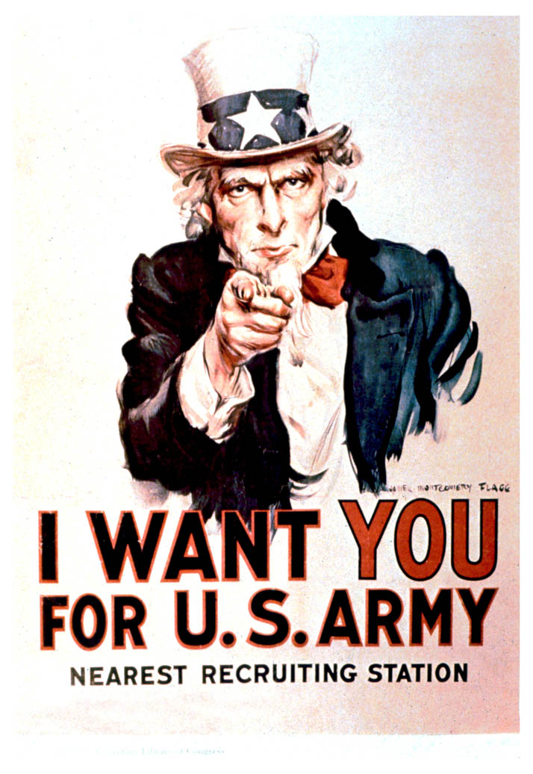
U.S. Conscription
Began in 1940 – before the war began – first peacetime conscription
Done after fall of France, Norway, low countries
All men 21-40 required to register for the draft
50m did so
Lottery held, those selected required to serve for one year
Cap set at 900,000 training at any one time
Notes:
allowances made for…
physical disabilities (IV-F),
education, work in important war industries (II-A),
men who were the primary support for children not their own and certain other dependents (III-A)
or conscientious objectors (who were usually redirected to noncombatant roles, such as medics).
Most selectees dutifully entered service, but many swore that they would not go beyond their first year

Slide 31
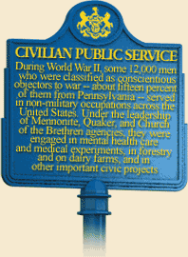
Expanding U.S. Conscription
Dec. 1942 – all men 18-65 required to register
Men 18-37 could be immediately called up
Odds of being called up went from 9:1 to 5:1
Build arm forces up to 9 million men, 200,000 inducted per month
Resistance
37,000 men received (CO) status and served as medics, fire-jumpers, worked in Civilian Public Service (CPS)
Had to serve longer (until 1947), pay room and board, worked on federal land (flood control, park management, etc.)
Not much meaningful work to do, was a way to keep CO’s out of public eye.
Nation of Islam – Black nationalist group, opposed conscription, many including leader Elijah Muhammad, arrested for draft dodging.
Notes:
ended voluntary enlistment. Paul V. McNutt, head of the War Manpower Commission, estimated that the changes would increase the ratio of men drafted from one out of nine to one out of five

