Slide 1
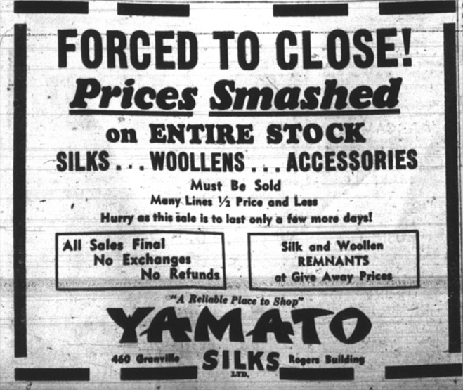
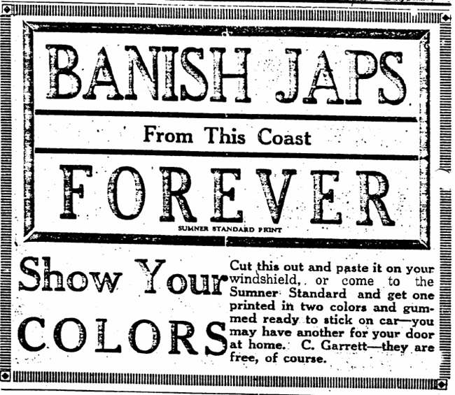
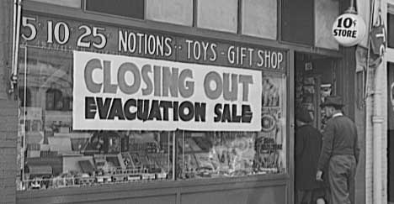
Unit 2: The Second World War and the Americas (1933–1945)
Bullet 4 - Treatment of Japanese Americans, Japanese Latin Americans and Japanese Canadians

Slide 2
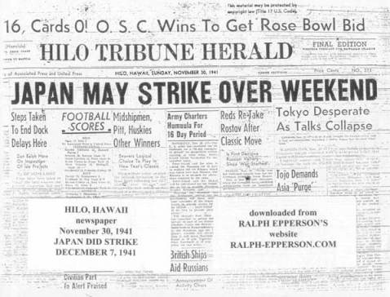
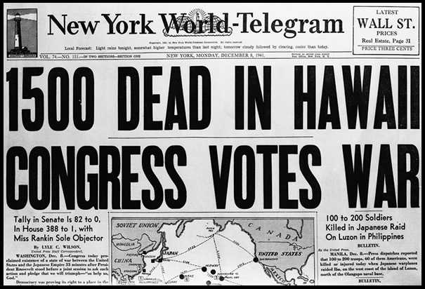
Treatment of Japanese Americans
Anti-Japanese feeling from most, but not all Americans took place after that Japanese attack on Pearl Harbor in December 1941
About 110,000 lined along the Pacific Coast & 150,000 lived in Hawaii
Notes:
About 15,000 Japanese Americans living elsewhere on the mainland
US had put Japanese Americans under surveillance after 1935
1940 intelligence agencies identified potential activists
Within weeks of the outbreak of war in 1940, 3,000 Japanese Americans had been arrested

Slide 3
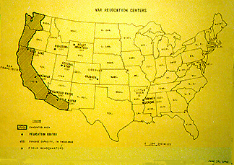
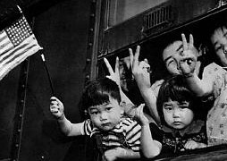
Treatment of Japanese Americans
Danger of Pacific coast attack, led to growing pressure to remove people of Japanese descent
Feared espionage, sabotage or general acts of disruptions
Notes:
1942 Californian press claimed around 20,000 Japanese in San Francisco were ready to action against USA
Sympathetic Japanese feared threat from others
Presidential action was required

Slide 4
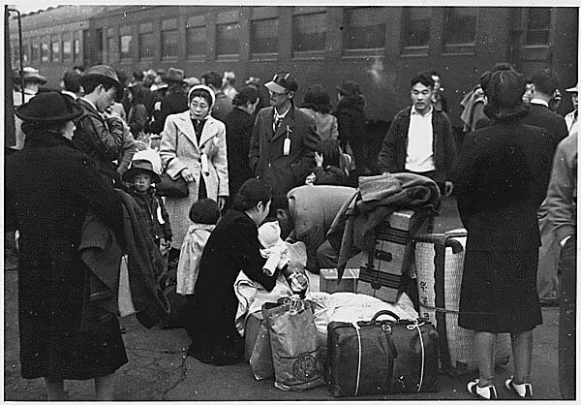
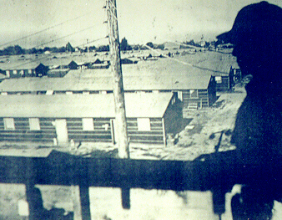
The Internment of Japanese Americans
19 February 1942, President Roosevelt signed Executive Order 9066
Relocation Issei & Nisei
Issei – first generation of Japanese immigrants to the USA
Nisei – the children of first generation Japanese immigrants
Notes:
Japanese Americans were allowed to take only a few possessions with them when relocated
General de Witt (head of Western Defense Command, USA) stated that the Japanese race was an enemy race
Japanese American farmers grew %40 of the state’s produce
Economic incentive for relocation
Farms were sold at a loss ($500 million in 1942 values)

Slide 5
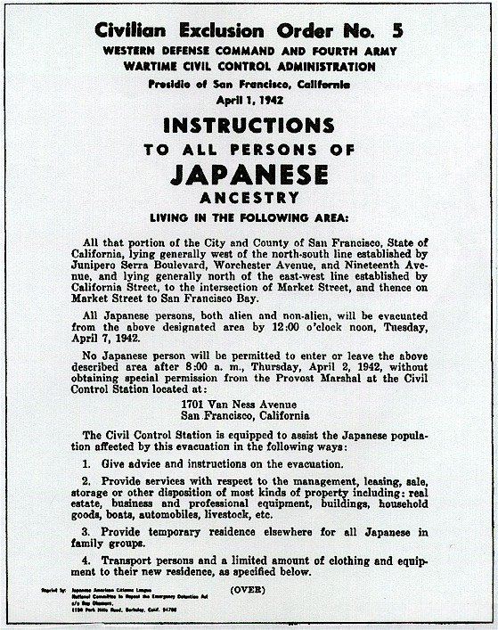

Slide 6
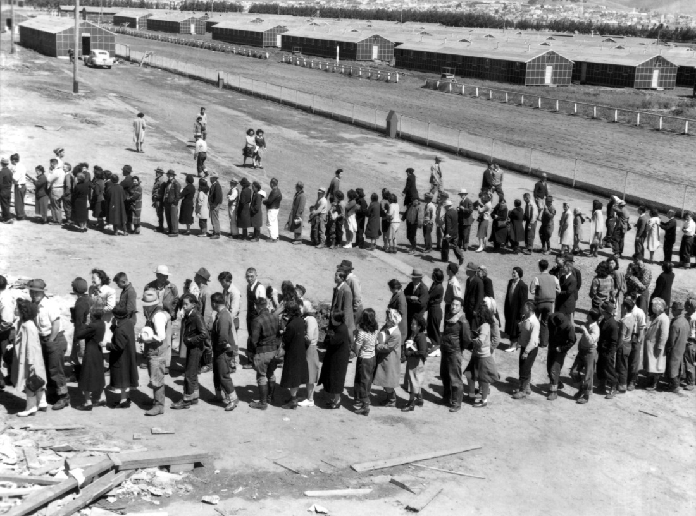
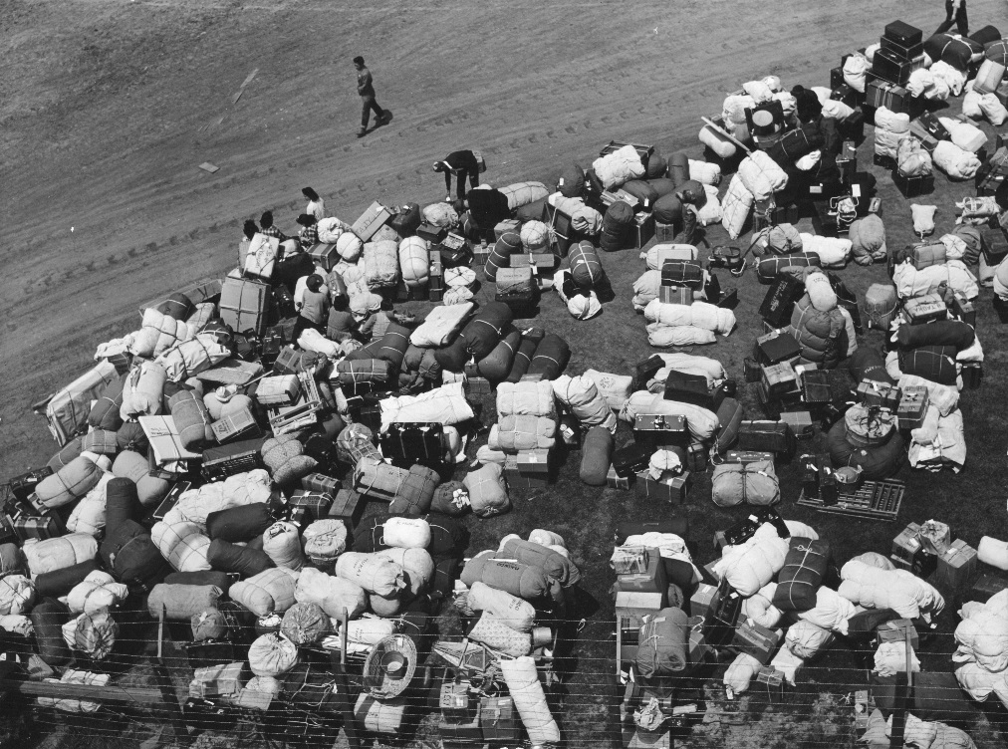
The Internment Camps
More than 100,000 Japanese Americans were moved from their homes to ten main camps in bleak parts of the USA in the spring of 1942
Notes:
Japanese Americans acted with great dignity and patriotism at the camps. They raised the stars and stripes flag each morning

Slide 7
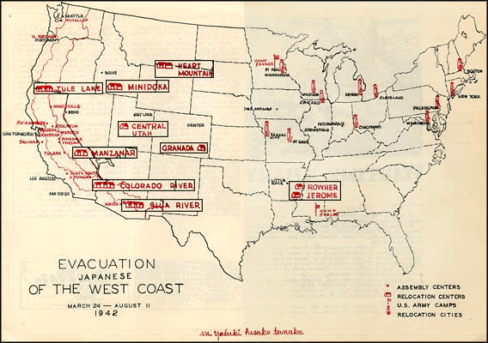

Slide 8
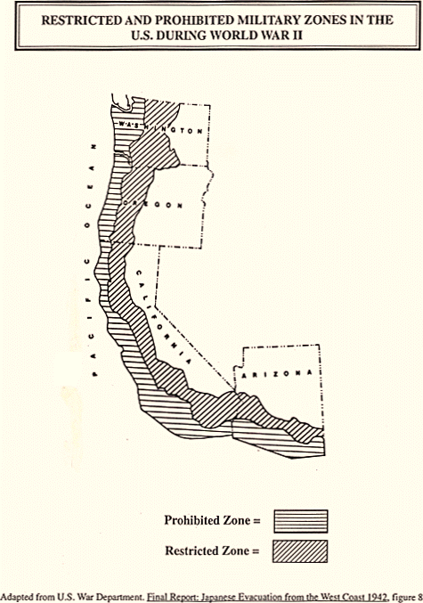

Slide 9
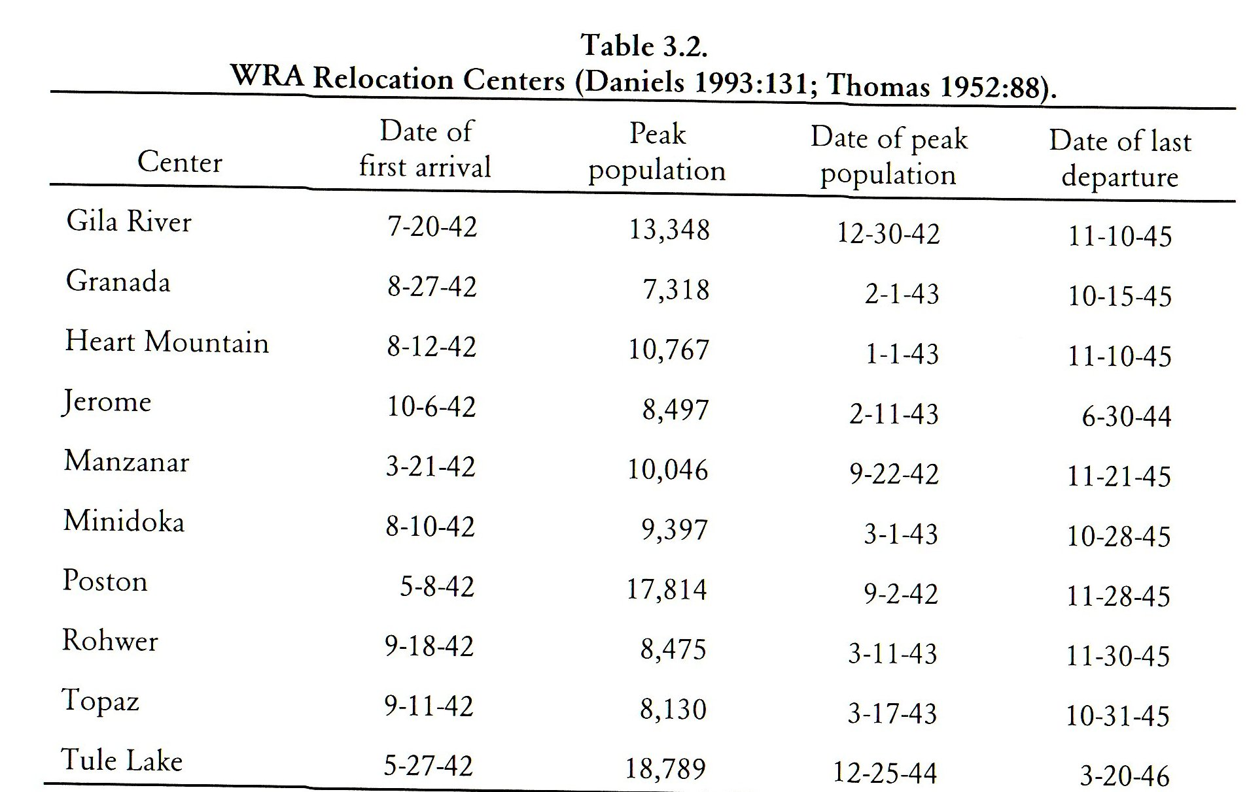

Slide 10
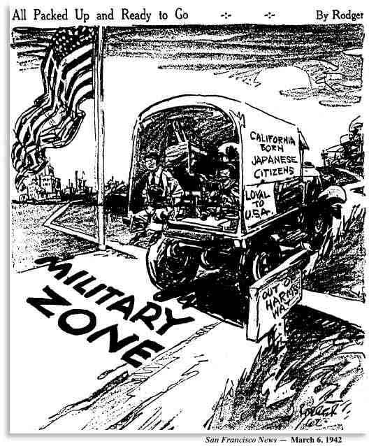

Slide 11
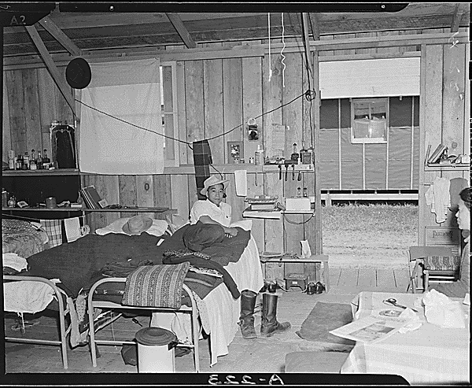

Slide 12
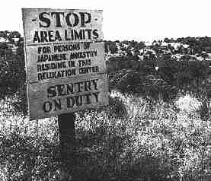
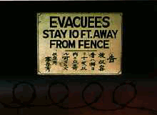

Slide 13
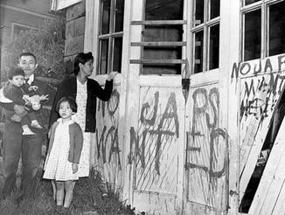
Reactions to Internment
Few criticized initially
Some called it ‘government racism’
Japanese Americans in Hawaii were not interned due to martial law imposed
Notes:
Many were released in May 1945
Many difficulties in starting their life over with all of their losses
1948 American Japanese Claims Act
$37 million compensation for surviving internees
1988 – Congress apologized and gave $20,000 to all surviving members

Slide 14
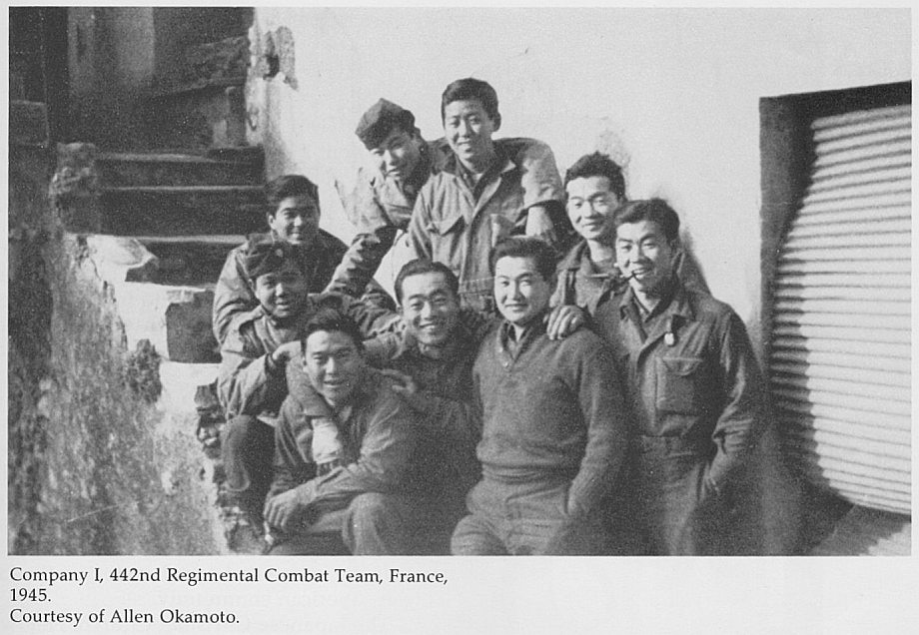
Reactions to Internment
30,000 Japanese Americans served in the US armed forces
442nd Regiment Combat Team (almost all Japanese Americans)
Served in Italy and France
Notes:
Were at the liberation of the Dachau concentration camp
9,500 Purple heart (highest casualty rate in US army history
10 people were convicted for spying for Japan, all were Caucasian

Slide 15
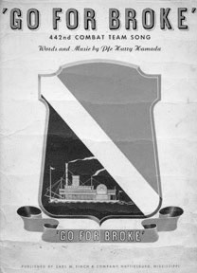
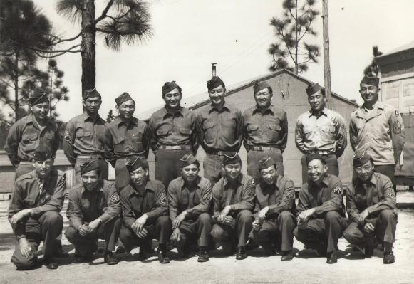
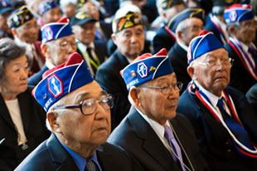

Slide 16
Treatment of Japanese Canadians

Slide 17
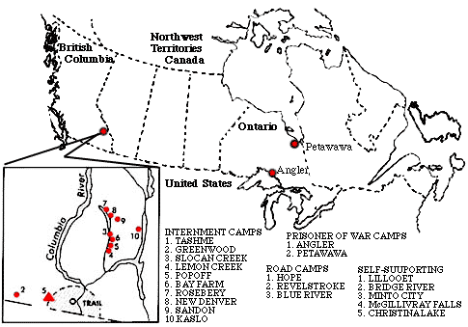

Slide 18
Treatment of Japanese Canadians
At the start of the war in 1939, about 23,000 Canadians of Japanese ancestry in British Columbia
13,000 born in Canada

Slide 19
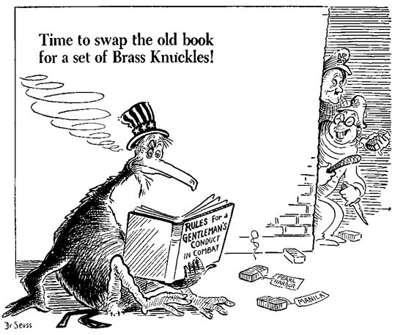
Pearl Harbor Attack
Had experienced discrimination and occasional violence before the attack
More incidents of
vandalism (Buddhist
temples)
Notes:
Canadian – Pacific Railway Company fired all Japanese Canadian workers
Feared espionage and sabotage

Slide 20
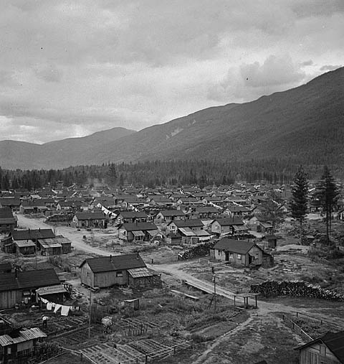
Internment Camps - 24, February 1942
(100 mile strip inland from Pacific coast was created)
All Japanese men between 18 – 45 removed and sent to camps within interior of Canada
Later all removed within the containment strip
Notes:
10 containment camps
Could leave, but could not seek work or go to school
Only option was to stay
Some young men worked on road construction or on farms if not at a camp

Slide 21
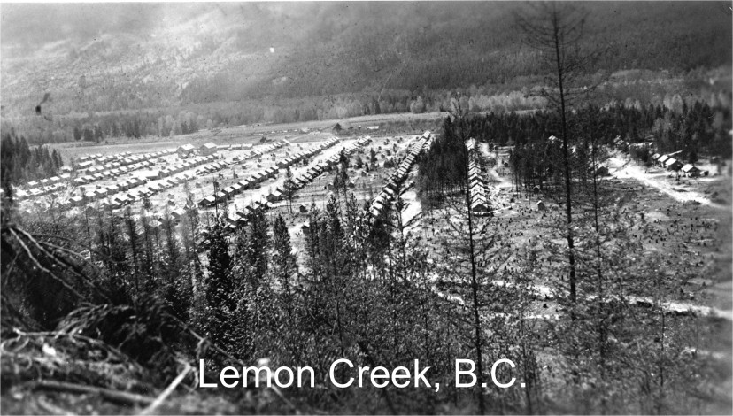
Internment Camps
Conditions were so poor, that upon Canadian learning of the camps, they sent food to camps
Notes:
Canada spent roughly 1/3 on their internees than the United States

Slide 22
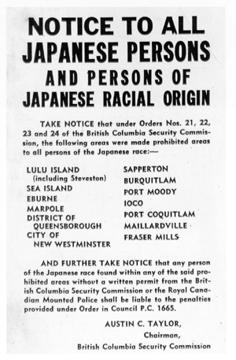
1943 Custodian of Aliens
Japanese property that was under protective custody, was sold off
This money was used to run the camps
Japanese Canadians were not consulted
Notes:
In all 7,068 pieces of property, personal and landholdings alike, were sold for a total of $2,591,456

Slide 23
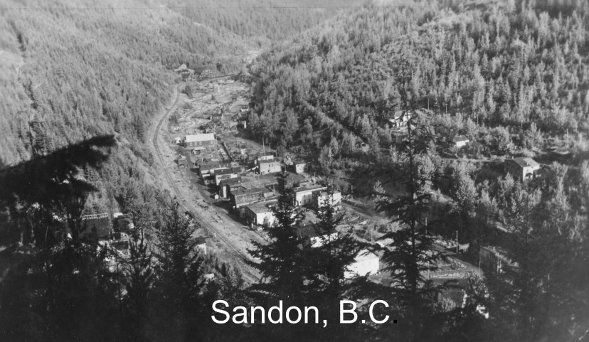
The End of the War
4,000 were stripped of their Canadian citizenship and deported to Japan
Notes:
Post WWII - 6,000 were racially repatriated to Japan by this policy

Slide 24
The End of the War
1 April 1949 – The Canadian government announced that Japanese Americans could live anywhere in Canada
Most did not return to British Columbia
Notes:
$1.3 million was awarded to 1,434 Japanese Canadians for damages to property
1988 each surviving internee received $21,000

Slide 25
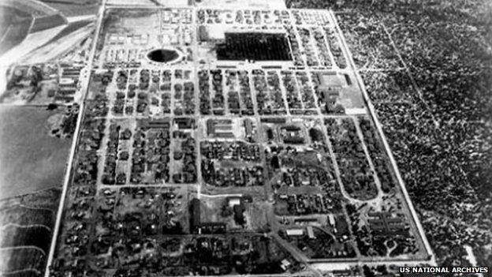
Treatment of Japanese Latin Americans
2,200 Japanese Americans from Latin American were help in internment camps by Immigration and Naturalization Service
Crystal City Internment Camp, South of San Antonio
Notes:
1942, Latin Americans of Japanese descent were rounded up and transported to American internment campus
1,800 (most) came from Brazil
250 from Panama, Bolivia, Columbia, Costa Rica, Ecuador, El Salvador, Mexico, Nicaragua and Venezuela

Slide 26
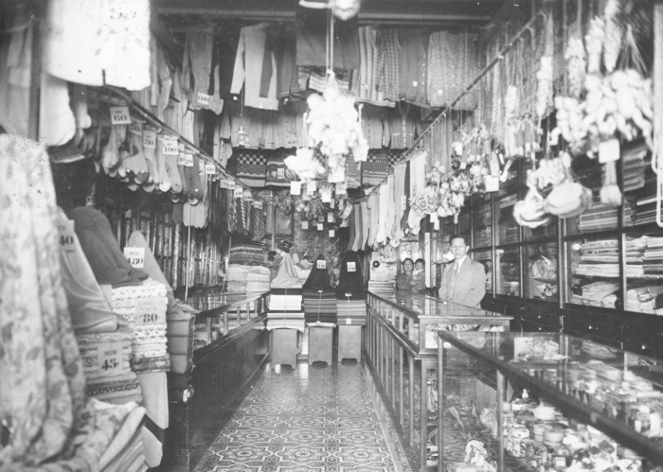
Treatment of Japanese Latin Americans
Originally intended to these internees as part of a hostage exchange program
Notes:
One trade occurred
Peru refused to accept post-war return of Japanese

