Slide 1
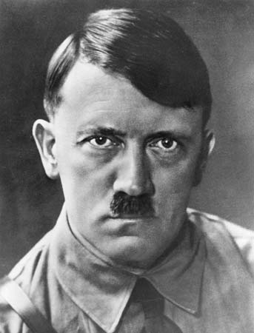
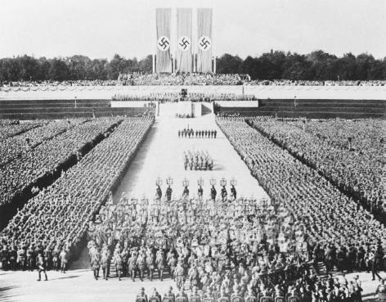
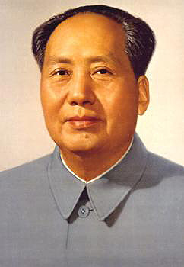
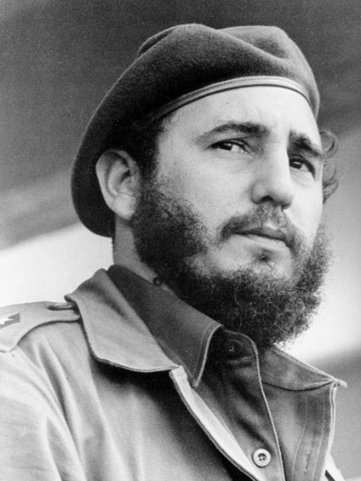
Why do Authoritarian States emerge?
L/O – To define an authoritarian state and to analyse the common factors in their emergence

Slide 2

What is an Authoritarian State?
Authoritarian State = a system of government that puts order and obedience to the regime above the personal freedoms of its citizens.
Defining Attributes:
One legal political party or limits the existence of other parties by not allowing them any significant role in political life
A government that is not constitutionally responsible to the people and exercises political power arbitrarily
A leader often chosen by or from the military following a coup.

Slide 3
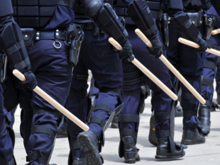
Characteristics of Authoritarian States
What characteristics do authoritarian states have? What makes them different to democracies today?
Little or no freedom of speech
No freedom of assembly
No freedom of movement
No freedom of travel abroad
No independent judicial system
All sources of information are censored
Any opposition is harshly punished
A leader whose popularity is reinforced by a personality cult

Slide 4
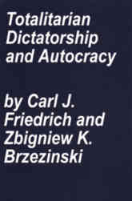
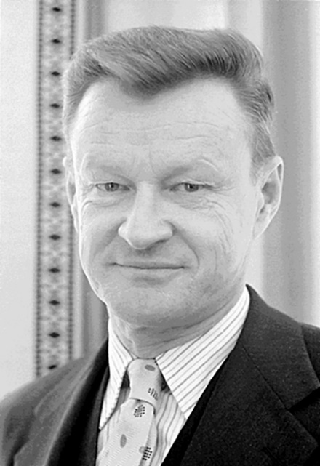
The Nature of Authoritarian States
Carl Friedrich and Zbigniew Brzezinski define an authoritarian state as a ‘crisis state’ – they have arisen during periods of conflict, division or confusion in a society.
They are usually the outcome of wars, economic collapse, religious or ethnic strife, or deep social divisions and class conflicts.
These stresses can lead to a sense of hopelessness or despair in the population, a fear for the future or concerns about society descending into chaos.

Slide 5
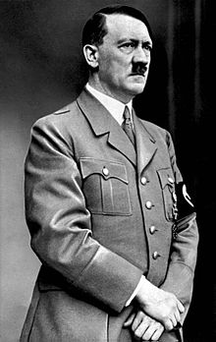
The Nature of Authoritarian States
It is in this context that people may be attracted to extreme solutions or ideologies which promise to restore hope and order.
These extreme measures may involve surrendering political power to one party which seeks to implement its ideology across all aspects of society.
Other political parties are suppressed through legal means or physical force. Institutions are eliminated or controlled in order for rulers to have complete dominance.

Slide 6
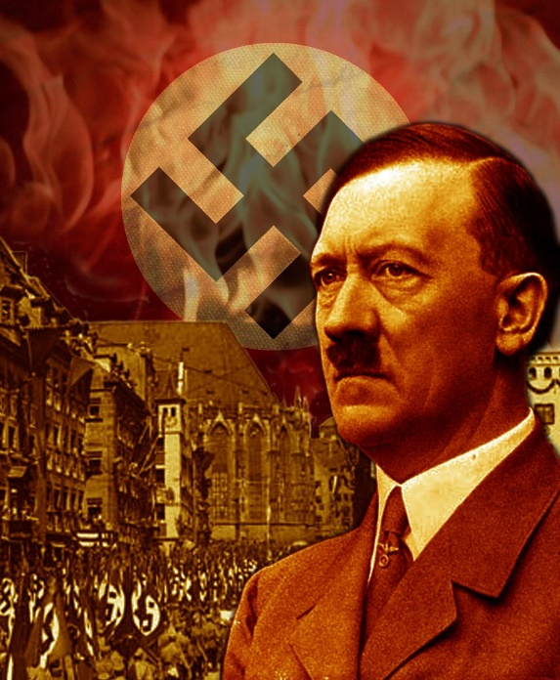
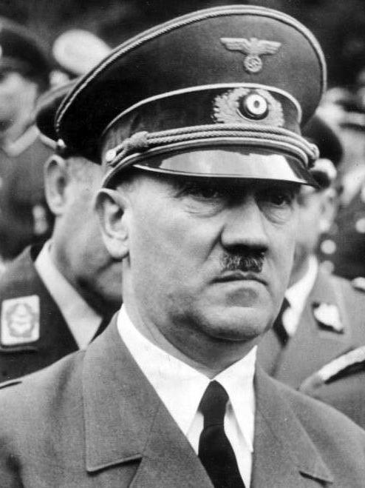
The Nature of Authoritarian States
In authoritarian states, all aspects of life – social, economic, cultural – are brought under the control of the party and must conform to their value system.
These measures are enforced through harsh repressive techniques, propaganda to eliminate other viewpoints, and other domestic policies which attract support for the regime and allow it to consolidate power.
Foreign policies like the successful waging of war can also enable authoritarian states to attract support and consolidate their power.

Slide 7
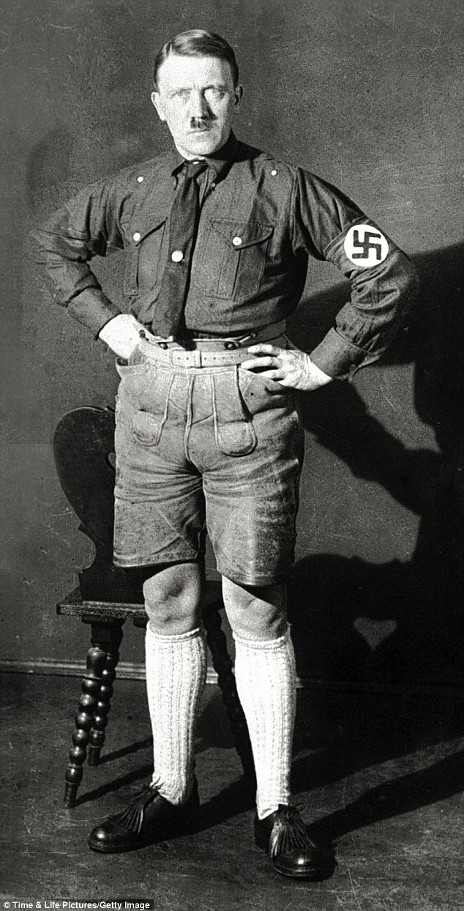
Authoritarian vs. Totalitarian States
‘Authoritarian’ states can sometimes be classed as ‘totalitarian’. The two terms refer to the scope of the power of government and both differ by degree.
Authoritarian governments are states in which power is concentrated in the hands of the few, who rule without consent. In authoritarian states, institutions may still exist that are not under government control.
Totalitarian states differ in that the state tries to control ALL aspects of public and private behaviour with their own ‘ideology’. Therefore some states may be authoritarian, but might not be totalitarian in behaviour. Yet totalitarian states are always authoritarian. Confused?!

Slide 8
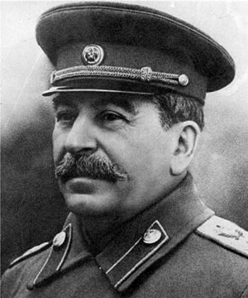
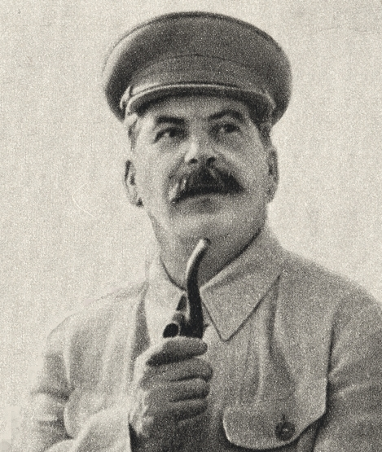
Totalitarian ‘Dictatorships’
The term dictatorship simple describes the source of power, usually meaning a form of government in which power is held by one individual, the dictator.
Not all totalitarian or authoritarian states are dictatorships. But usually most are.
Friedrich and Brzezinski describe ‘totalitarian dictatorship’ as: ‘a system of rule for realising totalist intentions under modern technical and political conditions.’

Slide 9
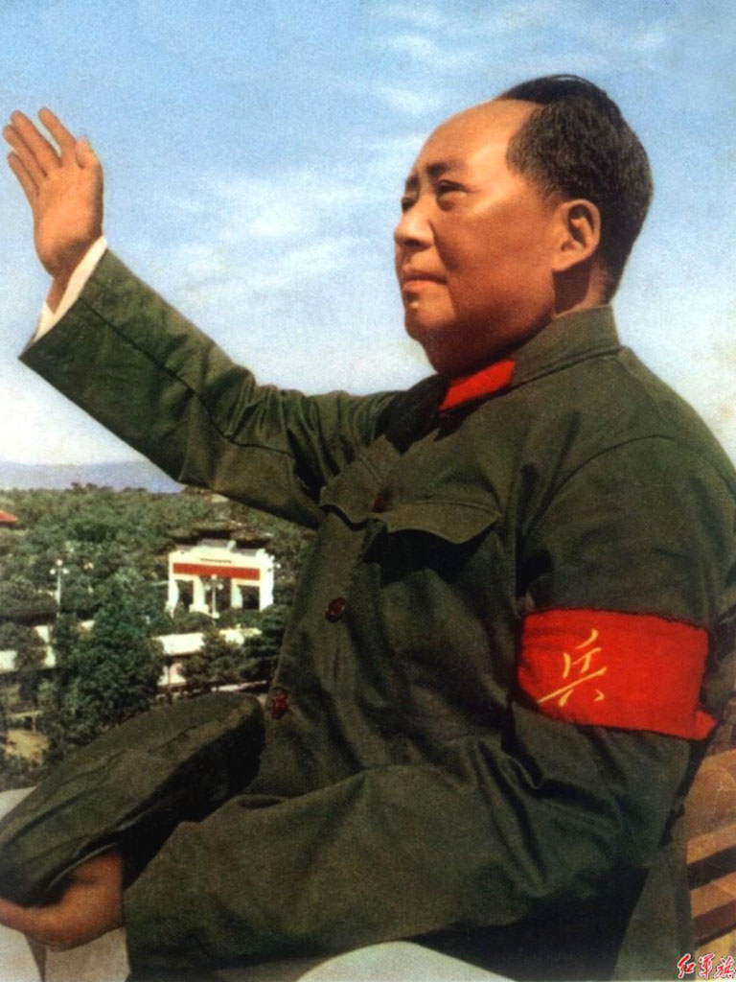
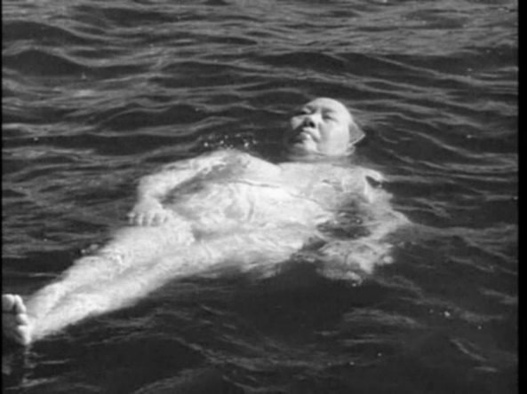
What are Authoritarian States?
So to conclude, authoritarian states are states in which power is concentrated in the hands of a single leader (dictatorship), class or faction (autocracy). It is the opposite of a democratic state.
There have been many throughout history including monarchies and theocracies. Most authoritarian states become ‘totalitarian’ in that the government seeks to regulate all aspects of life, both public and private. This is the opposite to ‘pluralism’.
Friedrich and Brzezinski go on to argue that fascist and communist totalitarian dictatorships are basically alike. Is this true?

Slide 10

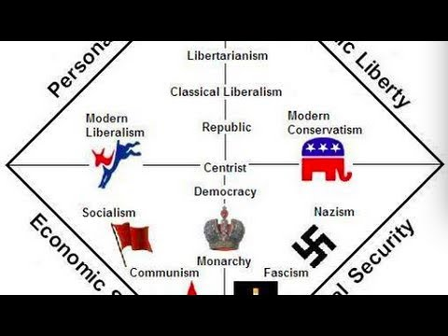
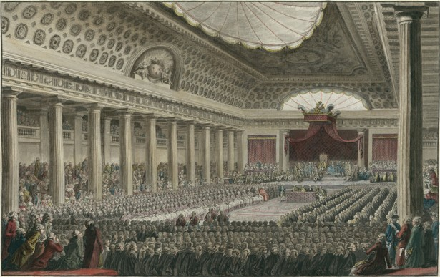
Ideologies of Authoritarian States
Authoritarian and totalitarian dictatorships usually seek to control all aspects of life and maintain their power through some kind of unifying ideology.
Political ideologies can be left-wing or right-wing. Right-wing views are conservative and reactionary (resistant to change). Left-wing views desire radical or revolutionary change.
These terms originated during the French revolutionary period, when revolutionaries sat on the left side of the chamber in the Estates-General, and conservatives on the right.

Slide 11


Slide 12
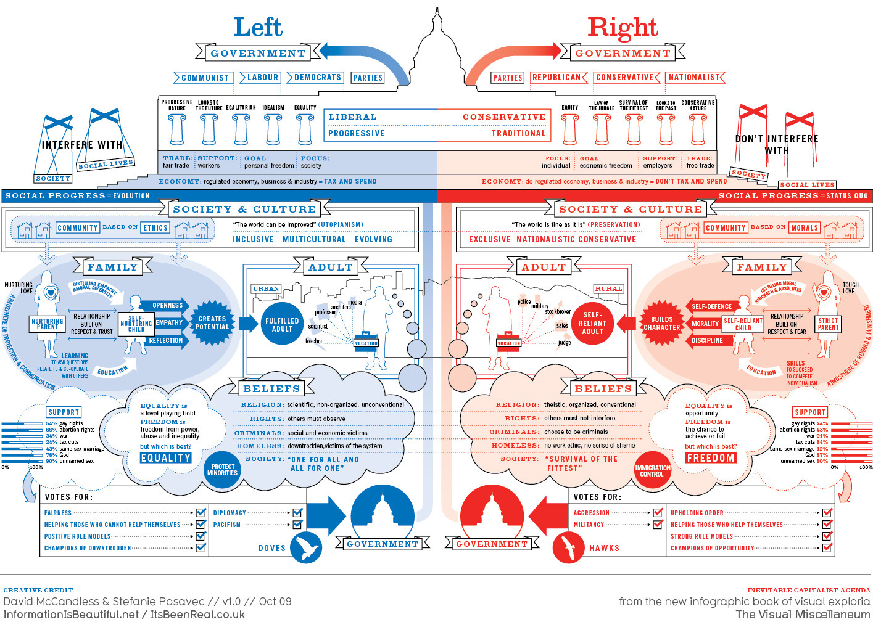

Slide 14
Ideologies of Authoritarian States
Socialism = influenced by Marxism, grew as a reaction to the injustices of capitalism. Modern socialism seeks common ownership of production so that an equal society can be created.
Communism = a form of revolutionary socialism by Karl Marx that proposed a scientific view of change, in which conflict between classes leads to new forms of government.
Nationalism = an intense belief that the nation-state is the highest form of political organisation and it is as members of a nation that individual derive their true identity and worth.
Fascism = a radical form of ultra-nationalism that is anti-liberal, anti-communist, anti-conservative and is influenced by Racism and Social Darwinism.

Slide 15
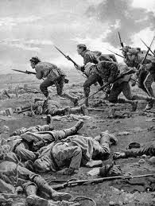

Emergence of Authoritarian States
As ‘crisis states’, 20th century authoritarian states arose out of specific historical conditions, in which leaders used legal and illegal methods to take advantage of chaos and upheaval to eliminate opposition and take power.
For your exam, you will need to think of the historical conditions and crises environments in each state, that enable authoritarian leaders to take power.
What historical conditions can create a crisis state?

Slide 16

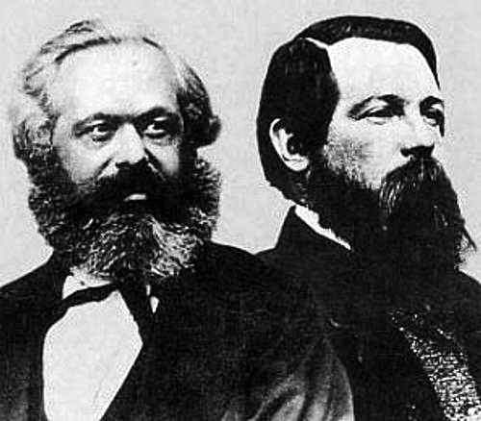
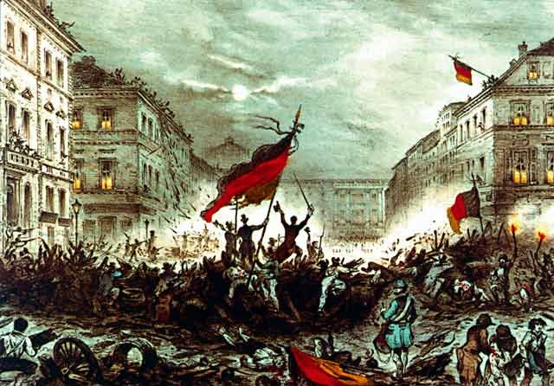
Historical Conditions
Authoritarian states DO NOT emerge in times of peace and prosperity. Crises states are induced by:
War, including the aftermath of war
Economic Crisis
Political Instability
Lack of leadership
Unpopular or tyrannical governments
Fear of revolution
New ideas introduced in politics
Nationalism, independence movements

Slide 17
Leaders and their Methods
The single-party states we will study are all really ‘single-leader states’. In nearly all authoritarian states, a single leader becomes so dominant that he personifies the party and becomes a dictator.
In studying the rise to power of authoritarian states, you need to consider the role of leaders and how they contributed to the rise to power of a party.
What qualities do authoritarian leaders need to successful take power?

Slide 18
Leaders and their Methods
Physical characteristics – size, physical appearance, personal magnetism, show of strength and power
Intelligence – spiritual depth, ability to articulate a programme of reform and advancement
Personal skills and qualities – public speaking (oratory), ability as a writer, personal charm, magnetism (charisma), ability to project an aura of confidence, determination, sincerity
Personal history – evidence of heroism, courage, record of personal sacrifice and struggle against injustices, real or imagined
Ability to Recruit – to gain support of powerful and talented individuals, maintain a large following
Motivation – has the necessary motivation to succeed

Slide 19
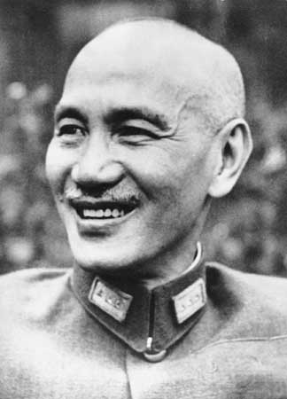
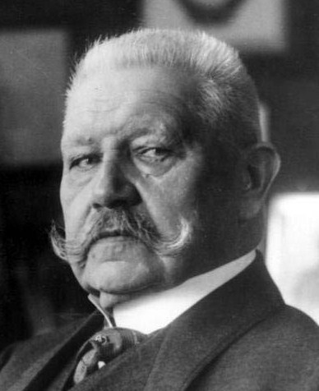
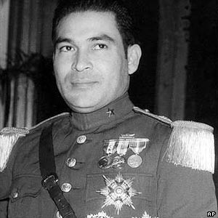
Elimination of Opposition
The mistakes or shortcomings of opponents are crucial to the success of the new leader and the party in their attempt to seize and hold onto power.
In almost every case, prior to regime change, the defeated power had failed to respond to the problems in society, effectively opening the door to its opponents.
This failure maybe due to a rigidity of approach, weak leadership, or underestimation of its opposition.

Slide 20
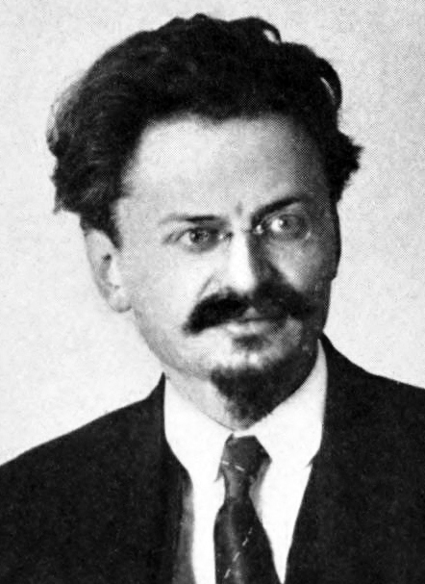
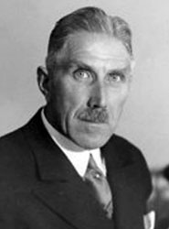
Elimination of Opposition
The main ways in which governments in power maybe unable to withstand challenges are:
  Weak or unpopular policies
  Rigid or insensitive attitudes
  Lack of experience and a failure to recognise problems
  Failure to embrace reform or a determination to retain traditional structures and policies
  Divided leadership – no clear direction
  Underestimating strength of opposition

Slide 21
Plenary
Authoritarian governments are states in which power is concentrated in the hands of the few, who rule without consent.
Totalitarian states differ in that the state tries to control ALL aspects of public and private behaviour with their own ‘ideology’.
Carl Friedrich and Zbigniew Brzezinski define an Authoritarian state as a ‘crisis state’ – they have arisen during periods of conflict, division or confusion in a society.
The emergence of authoritarian states can be analysed and compared by examining the historical conditions (1) that weakened the opposition (2) and enabled leaders to rise (3) that took advantage of socio-political uncertainty.

