Slide 1
Section 1 – Identification and Evaluation of Sources
.

Slide 2
Identification and Evaluation of the Sources 500 words
IA is a Historical INQUIRY – That means…
You should develop and apply historical skills such as
Analyzing a range of source material and considering different perspectives
Selecting and evaluating evidence and arguments to reach a relevant conclusion
Requirements
Analyze in detail TWO sources you will use in your investigation
Make sure one is primary, one is secondary.

Slide 3
Consider…
You will be expected to discuss as much detail about origins and purpose of source. You will not be able to measure value/limitations without this
Does this source have significance to your RQ?
Consider looking at a Primary Source – Secondary often strive to be balanced
Make sure the sources have differing view points
One secondary source max

Slide 4
Identification and Evaluation of the Sources Due Session 12
Requirements
This investigation will seek to answer the question…Clearly state your IA Question.
Define anything that may help make meaning clear
Investigation will analyze…
Brief explanation of the nature of the sources you have selected
How are each relevant to your investigation
Detailed, yet concise OPVL including content (tone and language)
Stay away from first person – “This investigation will”

Slide 6
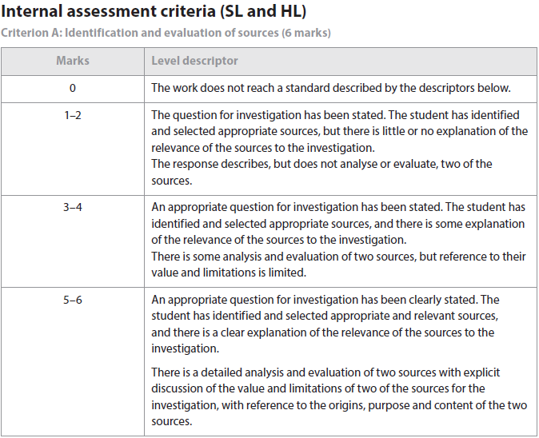

Slide 7
Reminders
clearly state the question they have chosen to investigate (this must be stated as a question)
include a brief explanation of the nature of the two sources they have selected for detailed analysis,
including an explanation of their relevance to the investigation. (use sources that you rely on in the Investigation)
analyze two sources in detail. With reference to the origins, purpose and content, the student should
analyze the value and limitations of the two sources in relation to the investigation.

Slide 8
Formatting
Paragraph 1 – around 100 words
State Question, relevance, why these sources were chosen.
Paragraph 2 and 3 – around 200 words each
In bold provide relevant Source Material – Author, Title of document, date.
Endnote in Chicago Manual Style, superscript 1, attached endnotes page (you will add to this later)
Concise, clear OPCVL

Slide 9
Section 2 - Investigation

Slide 10
Investigation 1300 words
The “meat” of your IA
Must be clearly and effectively organized
Must contain critical analysis – integrated throughout
Clearly focused on your RQ
Conclusion – firm, must be drawn from your analysis (synthesize from all of your major arguments)
Must have a Works Cited page following the MLA Style Method
Use parenthetical in text citations
Have works cited in the end
I suggest using a mixture of secondary and primary sources

Slide 11
Tips
Use your organized research as a roadmap!
Evidence must be integrated with very clear critical commentary that leads the reader to an eventual evidence base conclusion that addresses the question.
Organize! - Logical, clear
Consider different perspectives
Quote sparingly – summarize, paraphrase, explain
Ideas that are not your own should be included in endnotes
Avoid long narrative
Conclusion is essential – not a summary of points but instead a well-reasoned, convincing, evidence based closer to the investigation

Slide 13
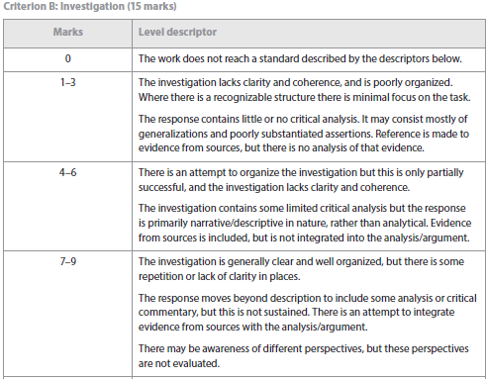

Slide 14
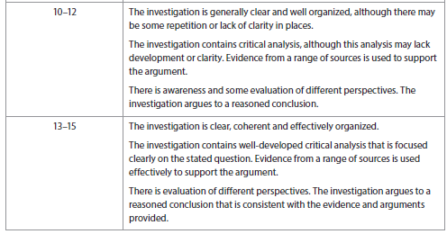

Slide 16
IA Reflection
400 words – 4 marks
Goal – To show that you understand how to think like a historian and you applied this thinking to your investigation.

Slide 17
Nature of the reflection
First person IS acceptable ONLY in this section
Goals
Demonstrate METHODS used by historians
Quantitative/Qualitative, what is truth?/why schools of thought?/types of research/purpose in writing?/propaganda/zeitgeist(lens of truth)?
Difficulties/challenges with these methods SPECIFIC to your Investigation?
Where do I find this?
Try prologue, introduction, epilogue of your most relevant sources
Book reviews
Useful links at http://ibhistoryia.weebly.com/section-3.html - you must read some of these to get ideas about how to write.

Slide 18
1–2
The reflection contains some discussion of what the investigation highlighted to the student about the methods used by the historian.
The reflection demonstrates little awareness of the challenges facing the historian and/or the limitations of the methods used by the historian.
The connection between the reflection and the rest of the investigation is implied, but is not explicit.
3–4
The reflection is clearly focused on what the investigation highlighted to the student about the methods used by the historian
The reflection demonstrates clear awareness of challenges facing the historian and/or limitations of the methods used by the historian.
There is a clear and explicit connection between the reflection and the rest of the investigation.

Slide 19
Do not
Discuss personal challenges
"I procrastinated" or "I learned about time management".
Answer TOK questions about history in general and haphazardly

Slide 20
Do
Present an understanding of the SPECIFIC historical debate or challenges being faced by historians(such as you) studying your topic
Persisting myths (national mythmaking, prejudices, vested interest, money)
Historiography – HOW historians write about this topic – FLAWED?
Zeitgeist (spirit of the time) – History written by the victors?
Flaws of US Historians during Cold War? Jim Crow? Late 60’s.
Source selection – Freedom to select from all viewpoints? Underrepresented views? Access to archives?
Connect to YOUR INVESTIGATION
Challenges concerning your sources (read the preface, prologue, epilogue – much of this is dealt with in these sections of the book)
How did the author get the information he or she did? What might be missing? Think OPCVL – who is the author? What in their background may shape the way they write? What goals do they have in mind when they write?

Slide 21
Assess one of the following Reflections
http://www.wistorian.com/history-ia-reflection.html

Slide 22
Questions to ponder
These can be integrated into your reflection, especially if relevant to your research.
What methods used by historians did you use in your investigation?
What did your investigation highlight to you about the limitations of those methods?
What are the challenges facing the historian? How do they differ from the challenges facing a scientist or a mathematician?
What challenges in particular does archive-based history present?
How can the reliability of sources be evaluated?
What is the difference between bias and selection?
What constitutes a historical event?
Who decides which events are historically significant?
Is it possible to describe historical events in an unbiased way?
What is the role of the historian?
Should terms such as “atrocity” be used when writing about history, or should value judgments be avoided?
If it is difficult to establish proof in history, does that mean that all versions are equally acceptable?

Slide 23
Steps
Go to http://ibhistoryia.weebly.com/section-3.html Go through PP, watch video
Understand how historians process, think, argue.
Challenges in history
Read the prologue, intro, epilogue of your sources, read historians reviews of other historians work.
Answer Questions to ponder – focus specifically on your research and topic
Print Markbands – evaluate yourself as you write.

